Slide 1
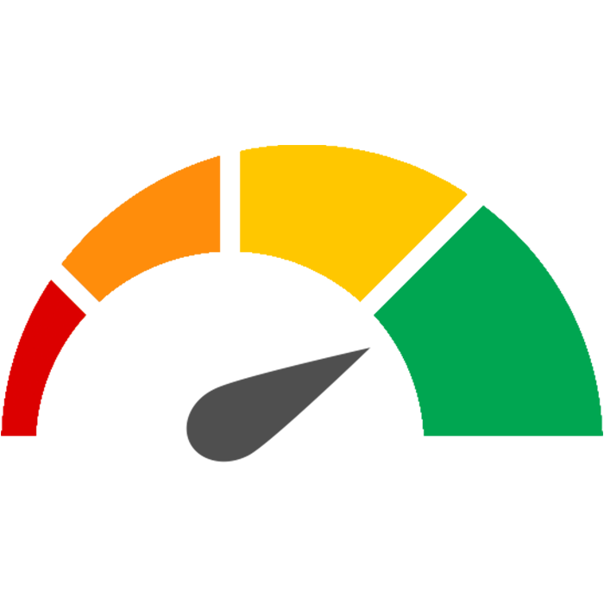
RITIS Performance Report
Top 10 Bottlenecks
Quarterly Congestion Analysis Report
2022 Q1
For the Baltimore, MD region

Slide 2
Top 10 Bottlenecks in the Region
Q1 2022
Rank | Location | Previous Quarter Ranking | Avg. Max. Length (mi) | Avg. Daily Duration | Agency-reported Events | Base Impact
1 | MD-295 S @ MD 198 | 2 | 2.86 | 2h 19m | 224 | 33,466
2 | I-695 CW @ MD-122/SECURITY BLVD/EXIT 17 | -- | 2.33 | 1h 40m | 249 | 14,706
3 | I-95 S @ MD-43/WHITE MARSH BLVD/EXIT 67 | 7 | 7.56 | 26m | 213 | 16,300
4 | I-695 CW @ MD-372/WILKENS AVE/EXIT 12 | -- | 1.93 | 1h 2m | 409 | 9,928
5 | US-50 E @ WILLIAM PRESTON LANE BRG | -- | 4.42 | 52m | 817 | 19,281
6 | I-695 CCW @ I-83/MD-25/EXIT 23 | 9 | 3.38 | 39m | 318 | 9,997
7 | I-695 CCW @ US-40/EXIT 15 | 10 | 4.06 | 25m | 663 | 8,369
8 | I-95 N @ MD-152/EXIT 74 | 3 | 7.62 | 18m | 325 | 11,676
9 | I-695 CCW @ MD-26/EXIT 18 | -- | 2.09 | 46m | 303 | 7,934
10 | MD-295 S @ P.G./ANNE ARUNDEL CO LINE | -- | 4.21 | 30m | 244 | 10,291
CW = Clockwise CCW = Counterclockwise
Red #s = highest value for that metric
Bottlenecks are ranked by Base Impact – the sum of queue lengths over the duration of the bottleneck and weighted by speed differential, congestion or total delay (by default, the table is sorted by the base impact weighted by the total delay).

Slide 3
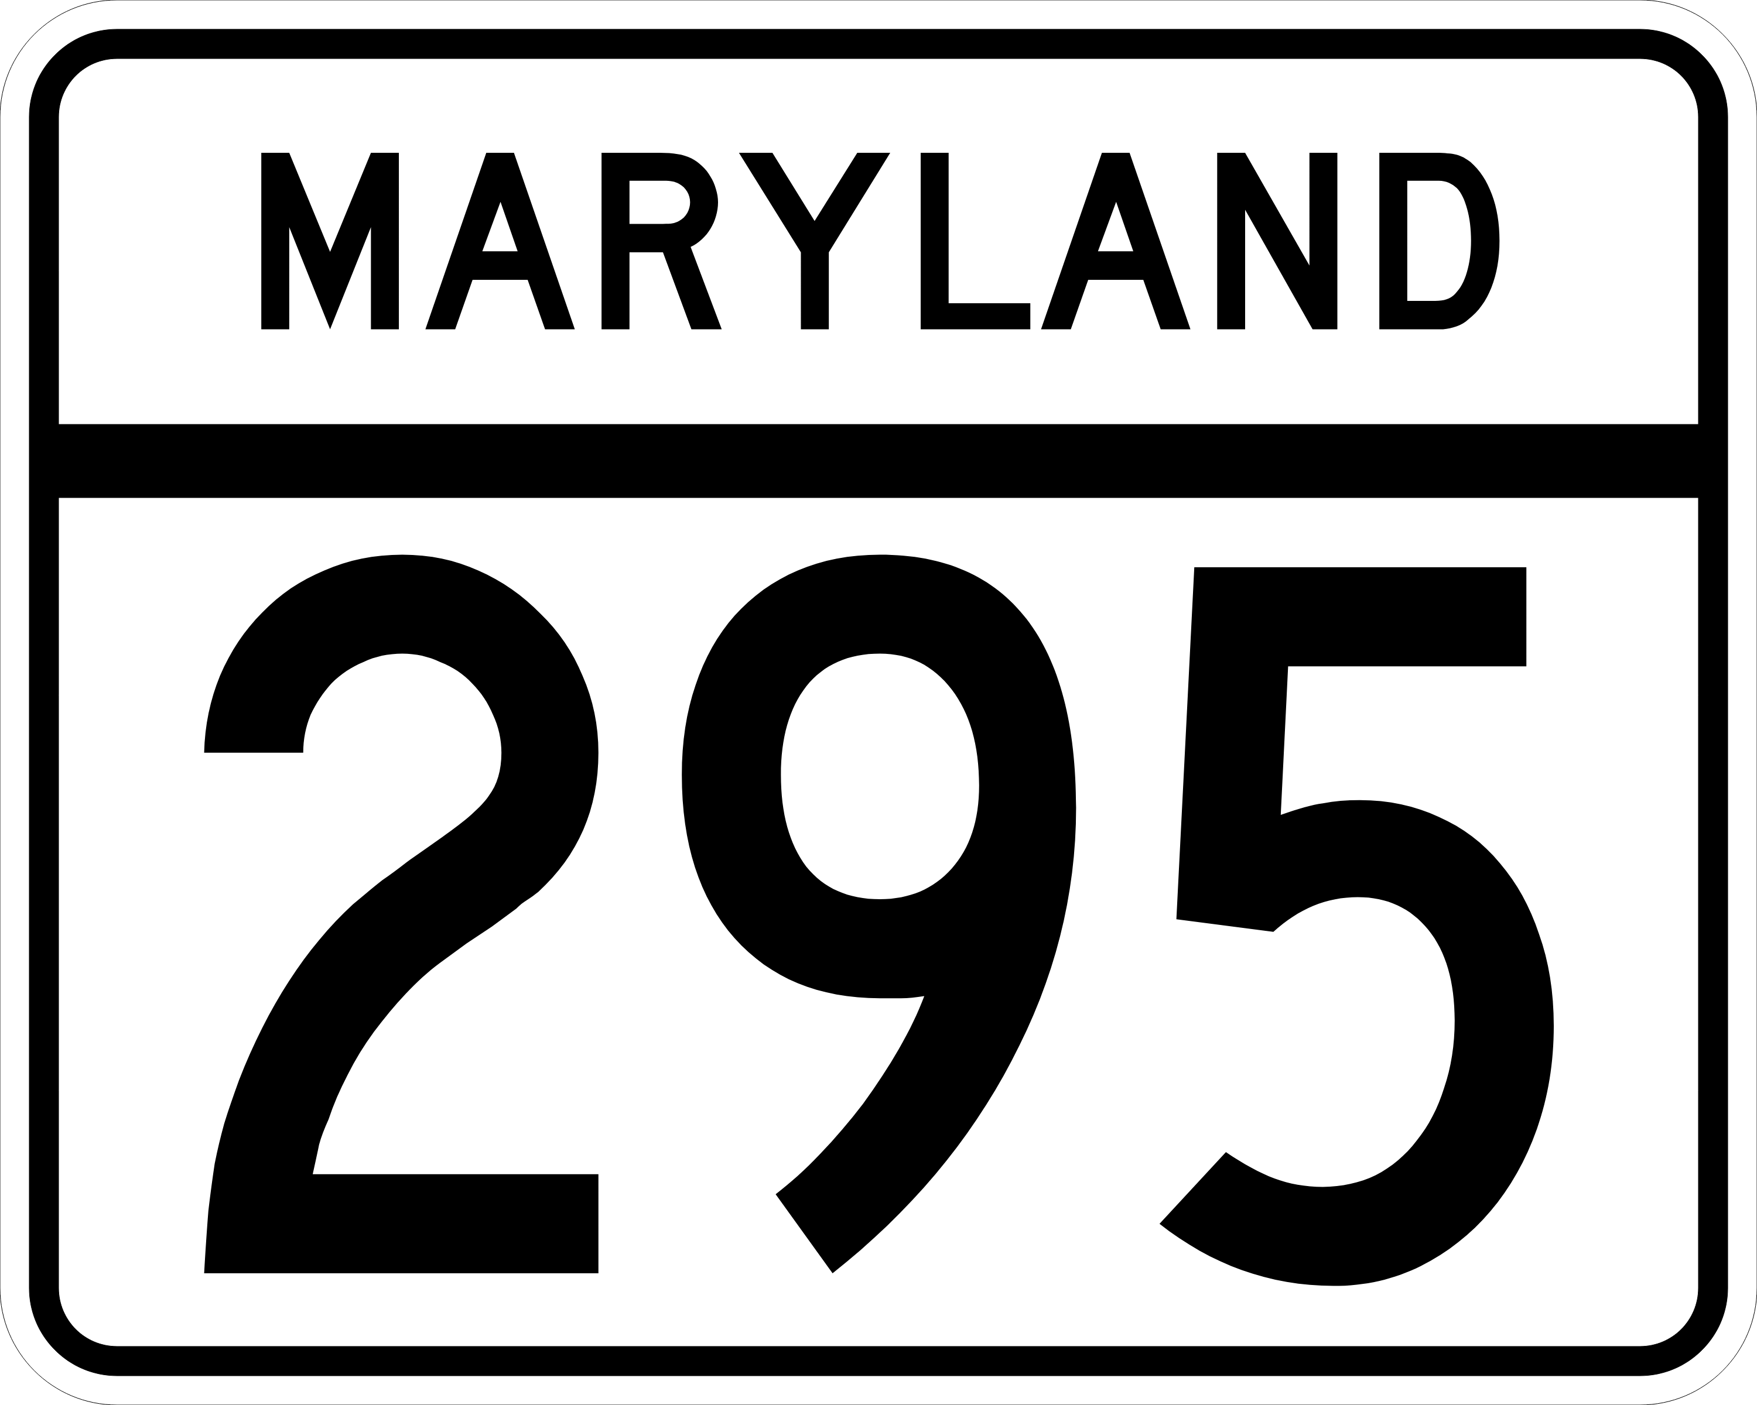
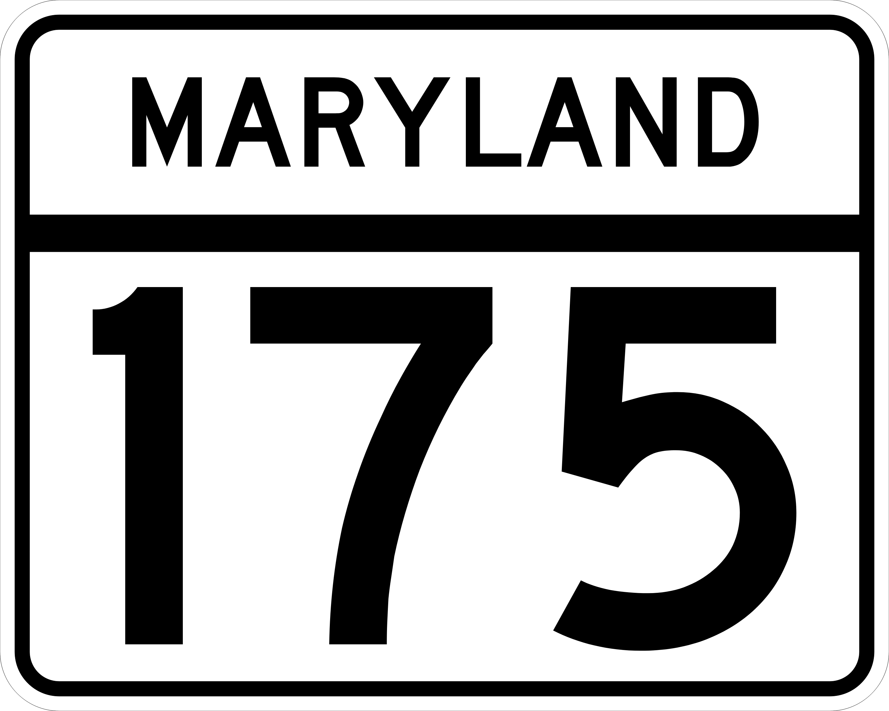
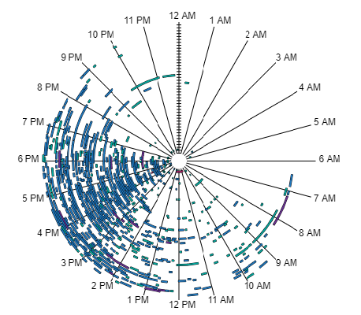
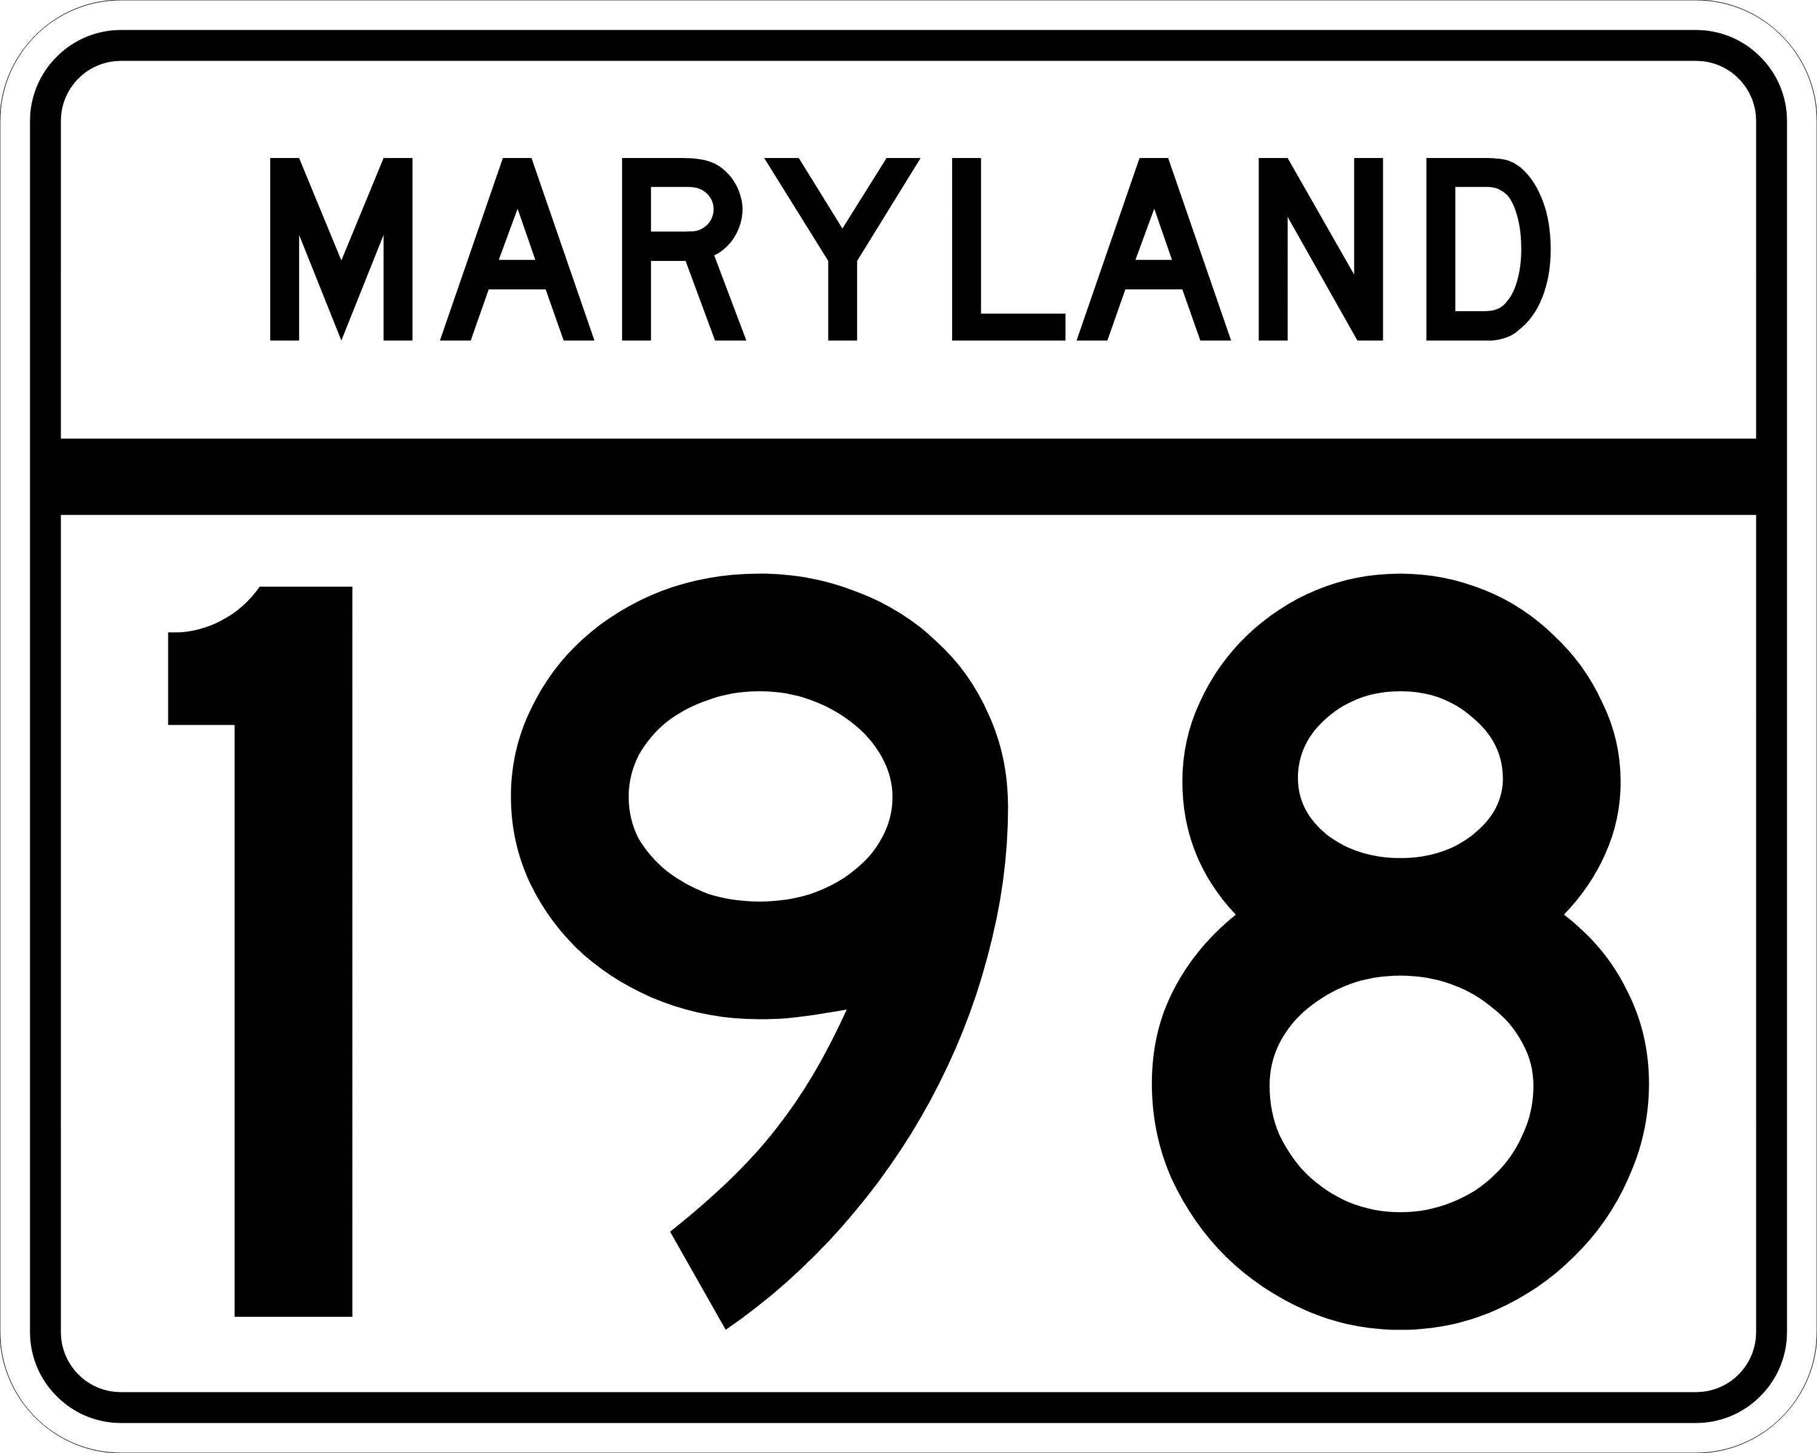
1
MD-295 SB @ MD-198
Quarterly Bottleneck Evaluation Summary
Q1 2022
PK. AVG. SPEED
PK. TRAVEL TIME
Q1 DELAY COST
AM Peak | 7:50 AM
52.6 mph
(24% slower than free flow)
AM Peak | 7:50 AM
17.1 min
Delay Cost
$2.273M
PM Peak | 5:35 PM
43.1 mph
(34% slower than free flow)
PM Peak | 5:35 PM
20.8 min
Veh-hrs. of Delay
75,293 h
A
Congested Locations
Bottleneck Occurrences
Corridor Speeds Over Time
Arundel Mills Blvd.
6AM – 8AM Arundel Mills Blvd. to MD-175
2PM – 6PM MD-175 to MD-198
The center represents the beginning of 01.01.22 and the outer edge the end of 03.31.22
For animated playback of corridor speeds
over time, click anywhere on the map below.
A
32
B
B
Fort
Meade
General areas of events/incidents
Congested Locations
A
B
(there were 224 Agency-reported events during Q1 2022)
Southbound PM congestion from MD 198 extending into the southern portion of the Baltimore region near Fort Meade occurring during both the morning and afternoon peak periods.
Volume-related delays are most likely caused by factors such as Baltimore commuters to DC and Fort Meade and the MD 295 merge with the heavily congested Capital Beltway.
A
B
Most bottlenecks occurred between
2-7 PM
Speed (mph)
0
10
20
30
40
50
Speed (mph)
Max Queue Length (miles)
0
10
20
30
40
50
<2
2-4.9
5-7.9
> 8

Slide 4
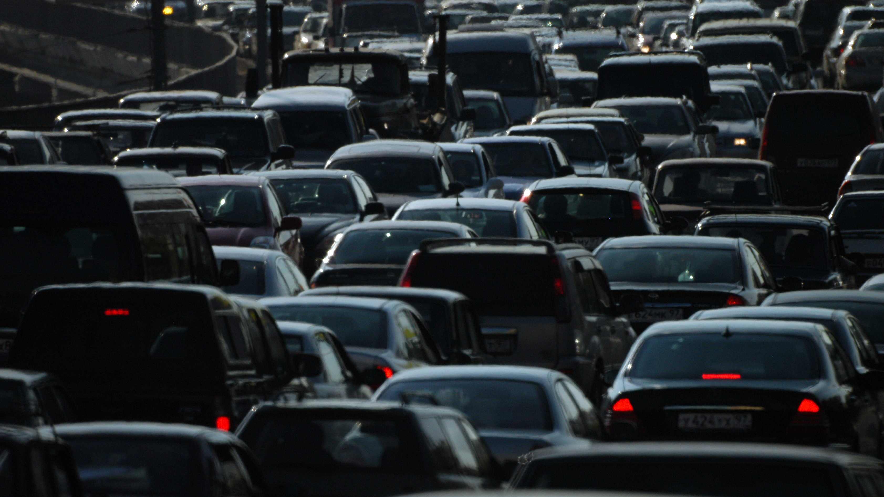
For more information, contact:

Ed Stylc, Planner Analyst
Baltimore Metropolitan Council
Offices at McHenry Row
1500 Whetstone Way, Suite 300
Baltimore, MD 21230
410.732.0500 ext. 1031office | 443.562.9751 cell | estylc@baltometro.org
RITIS Performance Report

