Slide 1
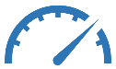
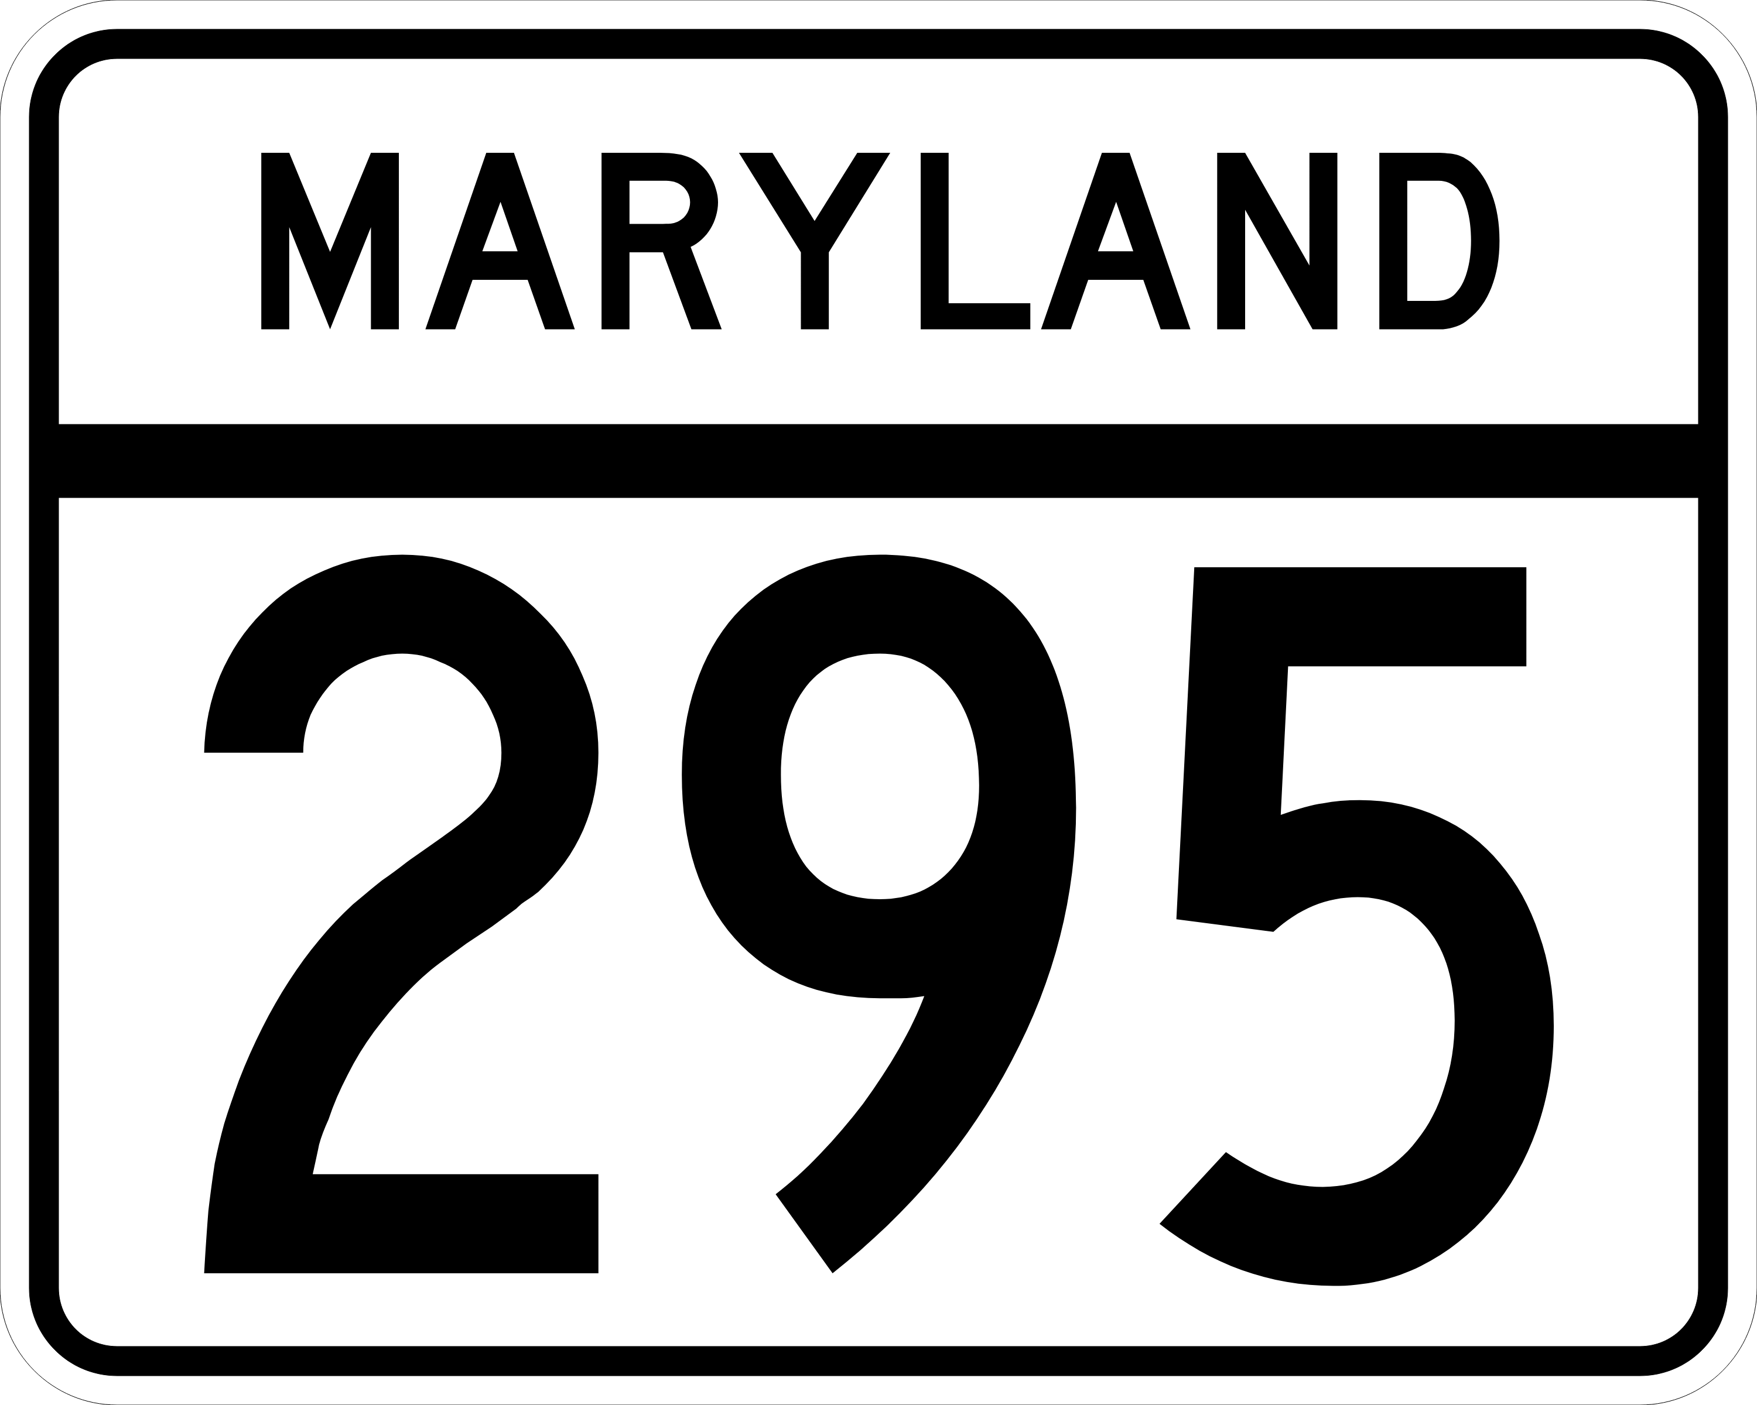
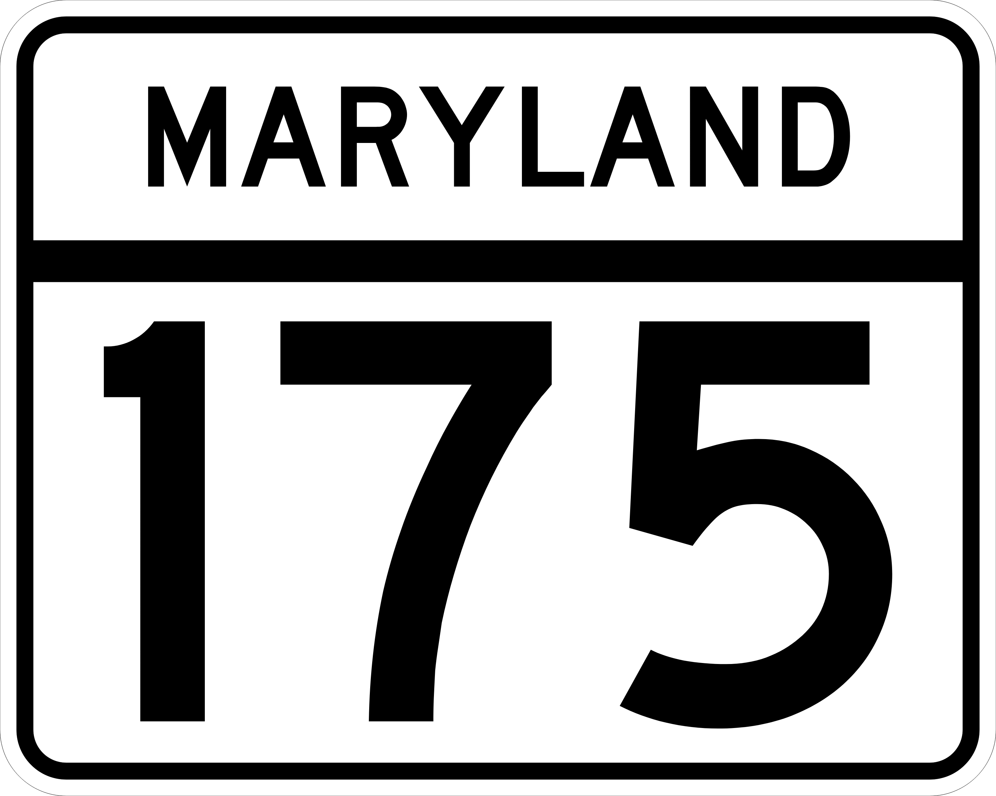
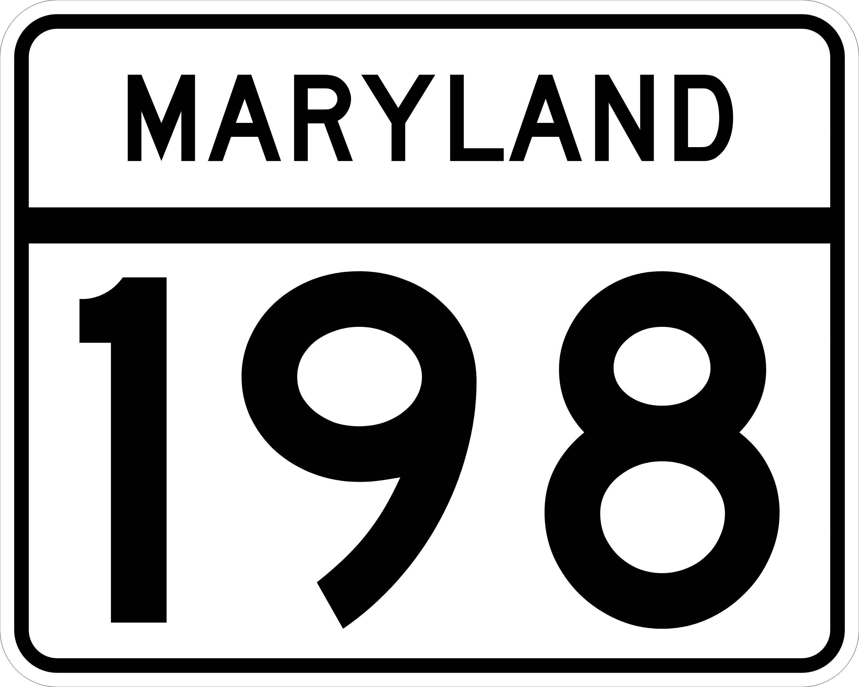
1
MD-295 S @ MD-198
Quarterly Bottleneck Evaluation Report
Q1 2022
Southbound PM congestion from MD 198 extends into the southern portion of the Baltimore region near Fort Meade occurring during both the morning and afternoon peak periods.
Volume-related delays are most likely caused by factors such as:
Baltimore commuters to DC and Fort Meade, and;
The MD 295 merge with the heavily congested Capital Beltway.
$2.273M
Click on an icon for more detail
The Total Delay Cost
for Q1 of 2022
52.6mph
The average minimum speed,
morning rush @ 7:50 AM
25% lower than free flow speed
75,293hr
User Cost
The Vehicle-hrs. of Delay
for Q1 of 2022
Click play button
for animated map
43.1mph
There were
224 Agency-reported events
during
Q1 2022
The average minimum speed,
evening rush @ 4:55 PM
31% lower than free flow speed
Average
Speed
Vehicle-hrs.
of Delay
17.1min
A
6AM – 8AM
Arundel Mills Blvd. to MD-175
The average maximum travel time
morning rush @ 7:50 AM
Congested
Locations
Average
Travel Time
A
B
20.8min
Arundel Mills Blvd.
2PM – 6PM
Md-198 to MD-175
32
Bottlenecks
The average maximum travel time
evening rush @ 4:55 PM
B
Incident Areas
Congested Locations
Fort
Meade
A
B
2pm-7pm
Most of the Bottlenecks along this roadway occurred between these times

Slide 2
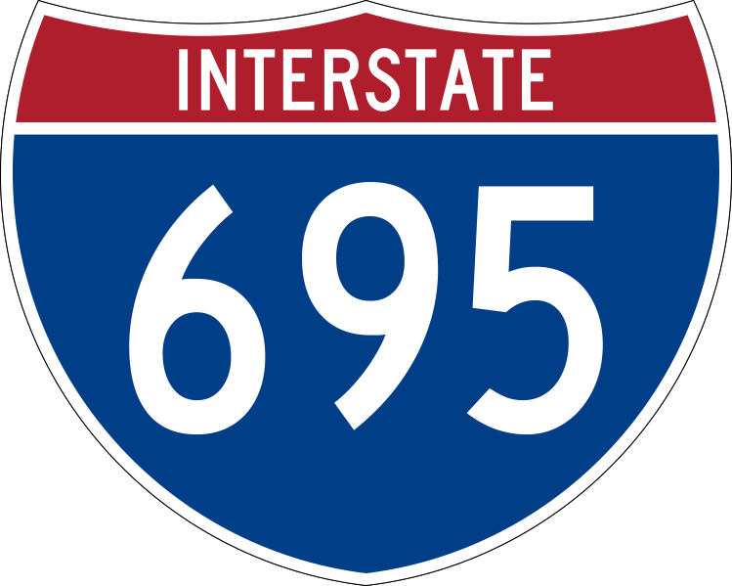
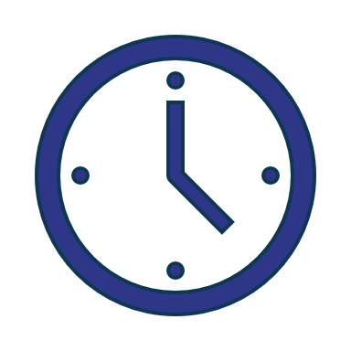
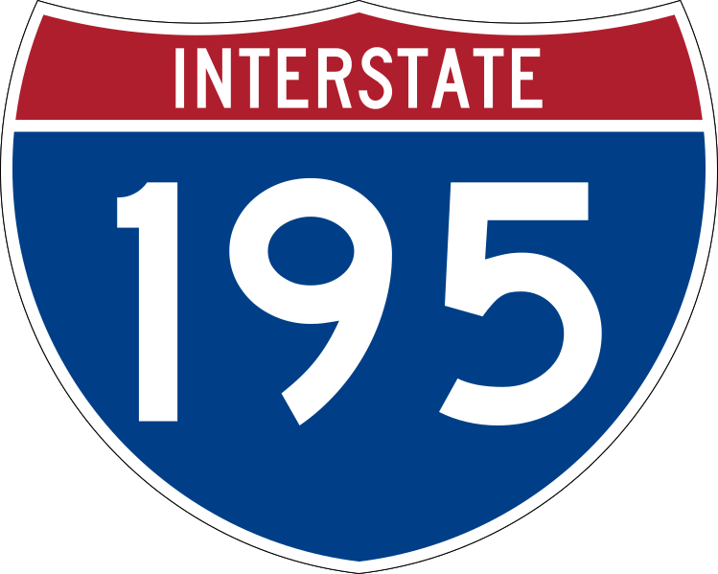
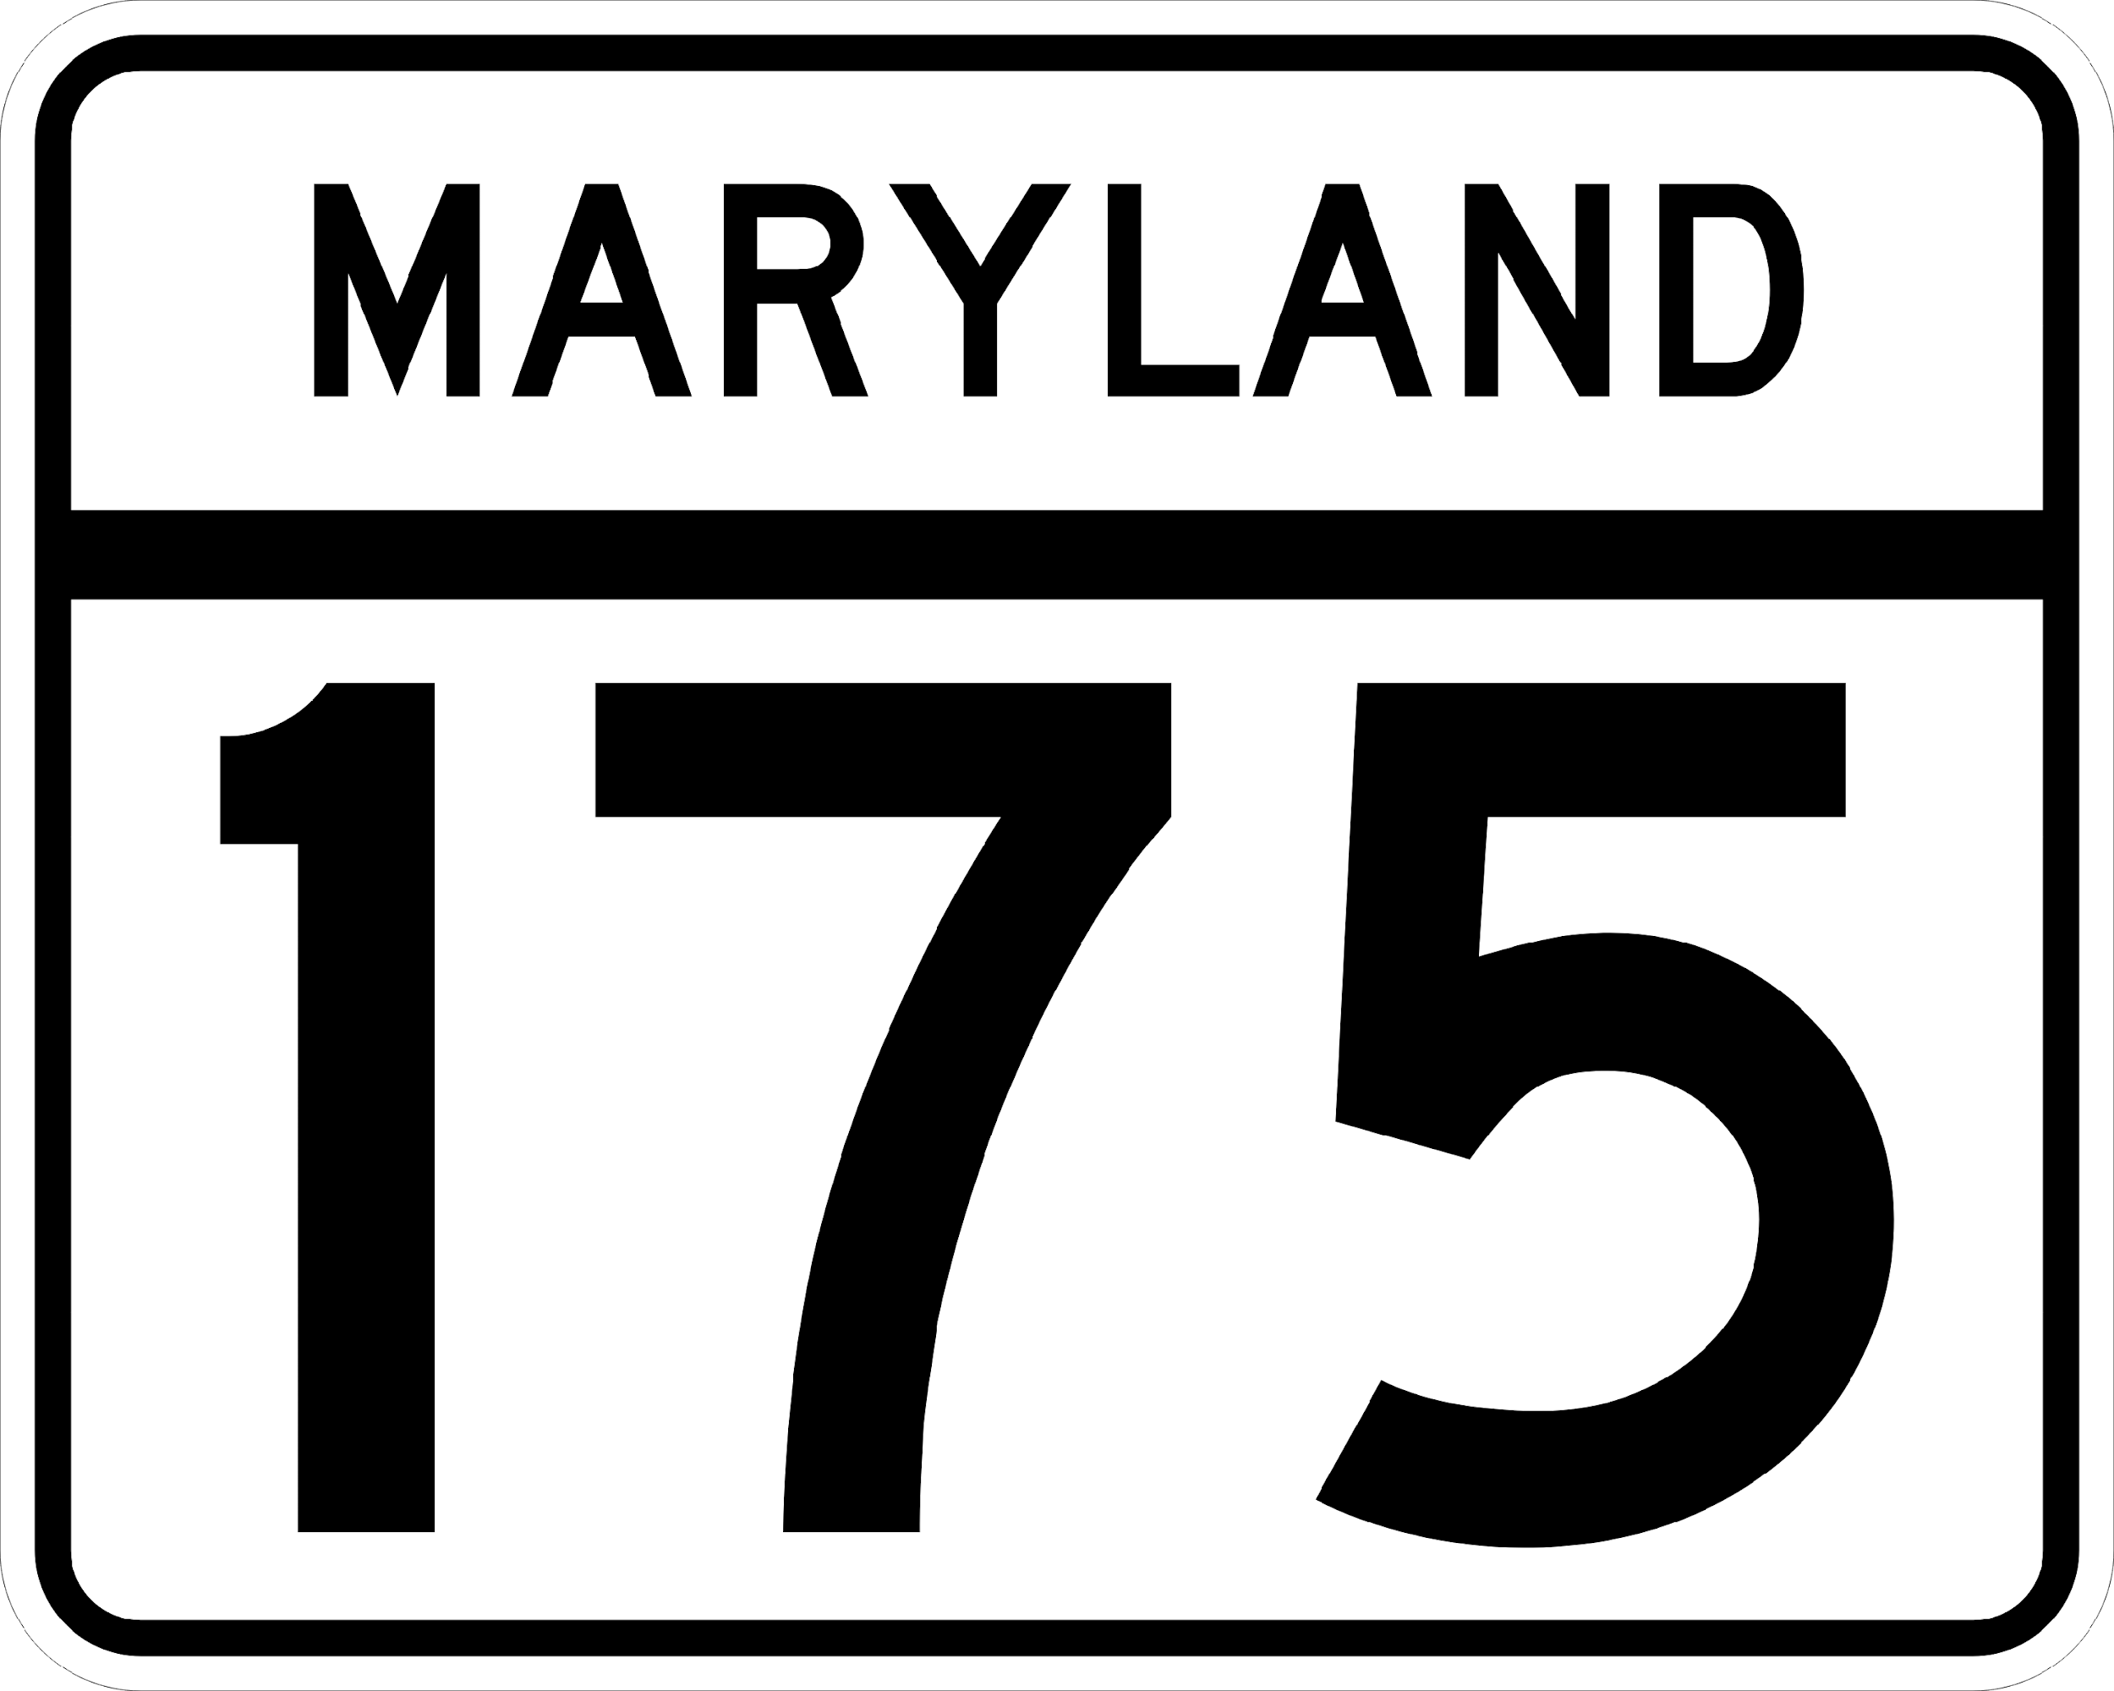
1
MD-295 S @ MD-198
Q1 2022
Quarterly Bottleneck Evaluation Summary
Southbound PM congestion from MD 198 extends into the southern portion of the Baltimore region near Fort Meade occurring during both the morning and afternoon peak periods.
Volume-related delays are most likely caused by factors such as Baltimore commuters to DC and Fort Meade, and the MD 295 merge with the heavily congested Capital Beltway.
User Delay Cost
Max Average Travel Time
$2.273M
The total Q1 Delay Cost for this bottleneck
17.1min
7:50 AM (Morning Rush)
20.8min
5:35 PM (Evening Rush)
Vehicle-hrs. of Delay
Bottleneck Occurrences
The total Q1 Veh.-hrs. of Delay for this bottleneck
2pm - 7pm
Most of the bottlenecks occurred between these times
75,293h
Min Average Speed
A
Congestion Locations
Arundel Mills Blvd.
52.6mph
32
7:50 AM (Morning Rush)
B
A
6AM – 8AM Arundel Mills Blvd. to MD-175
Incident Areas
Congested Locations
43.1mph
Fort
Meade
5:35 PM (Evening Rush)
A
B
B
2PM – 7PM Md-198 to MD-175
(there were 224 agency-reported events during Q1 2022 )
Notes:
Ran the Bottleneck Ranking tool with what I think you used as query inputs – it’s close anyway. That gives me access to results so I can play with content.

Slide 3
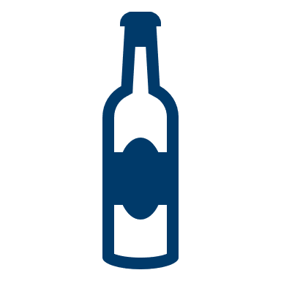
1
MD-295 S @ MD-198
Q1 2022
Quarterly Bottleneck Evaluation Summary
Southbound PM congestion from MD 198 extends into the southern portion of the Baltimore region near Fort Meade occurring during both the morning and afternoon peak periods.
Volume-related delays are most likely caused by factors such as Baltimore commuters to DC and Fort Meade, and the MD 295 merge with the heavily congested Capital Beltway.
Min Average Speed
Bottleneck Occurrences
Morning rush 52.6 mph @ 7:55 AM
2pm - 7pm
Most of the bottlenecks occurred between
Evening rush 43.1 mph @ 4:55 PM
Max Average Travel Time
User Delay Cost
Morning rush 17.1 min @ 7:55 AM
$2.273M
The total Q1 Delay Cost for this bottleneck
Evening rush 20.8 min @ 4:55 PM
A
Arundel Mills Blvd.
Congested Locations
32
Vehicle-hrs. of Delay
B
Incident Areas
Congested Locations
A
6AM – 8AM Arundel Mills Blvd.
to MD-175
Fort
Meade
The total Q1 Veh.-hrs. of Delay for this bottleneck
75,293h
A
B
(there were 224 agency-reported events during Q1 2022 )
B
2PM – 7PM MD-175 to MD-198
Notes:
Ran the Bottleneck Ranking tool with what I think you used as query inputs – it’s close anyway. That gives me access to results so I can play with content.

Slide 4
1
MD-295 S @ MD-198
Q1 2022
Quarterly Bottleneck Evaluation Summary
(Change from Q1 2021 )
Southbound PM congestion from MD 198 extends into the southern portion of the Baltimore region near Fort Meade occurring during both the morning and afternoon peak periods.
Volume-related delays are most likely caused by factors such as Baltimore commuters to DC and Fort Meade, and the MD 295 merge with the heavily congested Capital Beltway.
🞥
⬤
Min Average Speed
Morning rush 52.6 mph @ 7:55 AM
Bottleneck Occurrences
0 mph
2pm - 7pm
Evening rush 43.1 mph @ 4:55 PM
Most of the bottlenecks occurred between
-3.3 mph
+ 1 hour
Max Average Travel Time
User Delay Cost
Morning rush 17.1 min @ 7:55 AM
$2.273M
+ 4.2 min
The total Q1 Delay Cost for this bottleneck
Evening rush 20.8 min @ 4:55 PM
+ $1.016M
+ 6.1 min
A
Arundel Mills Blvd.
Congested Locations
32
Vehicle-hrs. of Delay
B
Incident Areas
Congested Locations
A
6AM – 8AM Arundel Mills Blvd.
to MD-175
N/A
Fort
Meade
The total Q1 Veh-hrs. of Delay for this bottleneck
75,293h
A
B
+ 33.641h
B
2PM – 7PM MD-175 to MD-198
N/A
(there were 224 agency-reported events during Q1 2022 )
Notes:
Ran the Bottleneck Ranking tool with what I think you used as query inputs – it’s close anyway. That gives me access to results so I can play with content.

