Slide 1
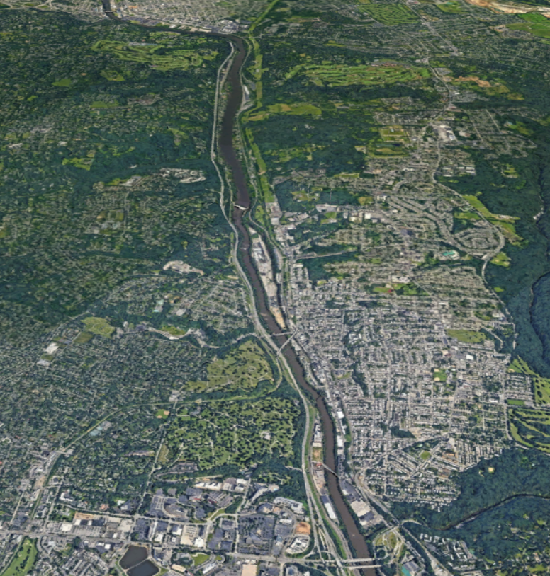
CATT Lab Performance Summary
Corridor Performance Report
I-76 from US 1 (City Ave) to I-476
Performance Year
2020
Notes:
For each slide, Changed the size to 8 ½ x 11 for printing purposes, then rearranged each page’s content to accommodate.

Slide 2
Region of Study:
I-76 between US 1 (City Ave) and I-476
Overview Map
This portion of I-76, also known as the “Schuylkill Expressway”, is one of Philadelphia’s major northwest-southeast corridors connecting commuters from the northwestern Philadelphia suburbs to Center City. It is paralleled by PA Route 23 to the south and Ridge Pike and Ridge Avenue to the north.
This seven-mile section of the Schuylkill Expressway extends from US 1 to I-476 and is a limited access four-lane divided highway that contains a northbound off-ramp at Hollow Road (Exit 337) half-way between and a southbound and northbound on- and off-ramp, respectively, at Matsonford Road on the northwestern end.
The roadway carries about 130,000 vehicles a day, four times more than what it is built to handle. As a result, the roadway has become known for frustrating delays.
Ridge Pike
Hollow Rd
Ridge Ave
Purpose of Study:
This annual study examines the yearly performance of this critical corridor in terms of travel time and congestion variations and compares it to prior years back to 2017.
N
Notes:
Reversed the text/graphic; added a note that the purpose of the performance report needs to be made clear.

Slide 3
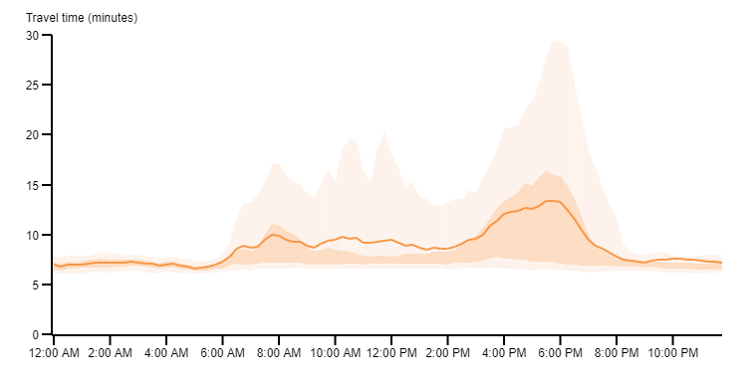
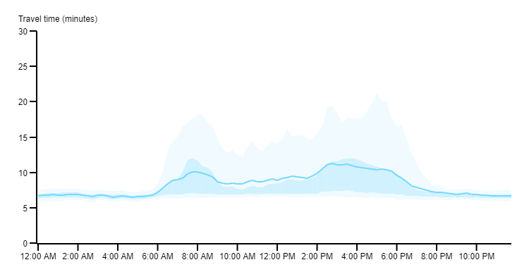
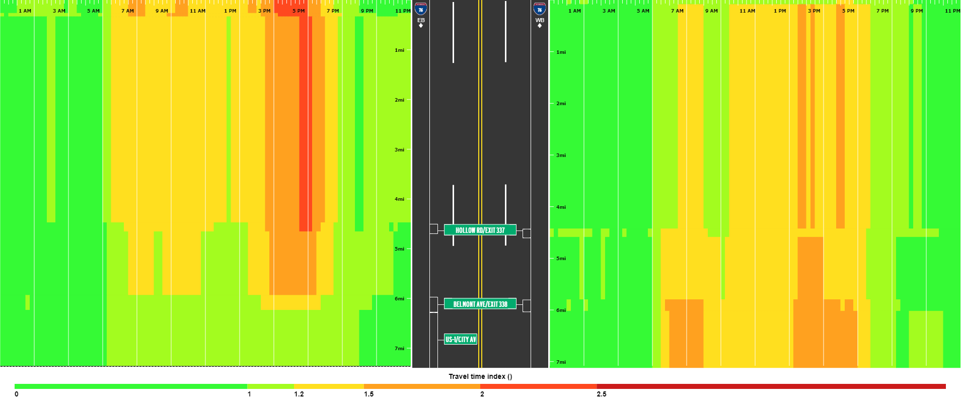
2020 Corridor Travel Times and Congestion
Weekday travel times for this portion of the I-76 corridor were aggregated over the entire year. During the PM peak period, the eastbound direction indicates a higher peak average travel time compared to the westbound direction, or about 2.5 minutes longer. In the eastbound direction, the PM peak travel times and planning times are consistently higher than the AM times. The average PM peak travel time is about 3.5 minutes longer than the AM period travel time, and the planning time is approximately 9 minutes longer. This is due in part to expanded job opportunities in the King of Prussia and Conshohocken areas farther west and City residents commuting back home from work. The heat map at the bottom of the page shows the geographic location of typical congestion through the day.
Eastbound
Westbound
AM Peak
Avg Travel Time = 8.92 mins
Planning Time = 14.65 mins
AM Peak
Avg Travel Time = 9.09 mins
Planning Time = 16.07 mins
PM Peak
Avg Travel Time = 12.44 mins
Planning Time = 23.91 mins
PM Peak
Avg Travel Time = 9.95 mins
Planning Time = 17.68 mins
6 AM – 9 AM
4 PM – 7 PM
6 AM – 9 AM
4 PM – 7 PM
Travel Time Index
F
A
E
B
C
D
Locations of Typical Slow Downs (EB)
Locations of Typical Slow Downs (WB)
A: 3PM – 6PM : Matsonford Rd to Hollow Rd
B: 4PM – 5PM : Hollow Rd to Belmont Ave
C: 6AM – 8AM : US 1 to Belmont Ave
D: 1PM – 5PM : US 1 to Belmont Ave
E: 1PM – 3PM : Belmont Ave to Hollow Rd
F: 2PM – 5PM : Hollow Rd to Matsonford Rd
Notes:
Deleted the page layout (Title & Content from pptx) as it was interfering with the graphics. Changed the layout to better accommodate the info, streamlined things (e.g.; eliminated the double lines – too busy), aligned things and changed appearances here and there.

Slide 4
2020 Changes in Travel Times
How did travel times change over the course of 2020? This depends on time of day and direction of travel. The bar charts show monthly travel times by peak period and direction. The line charts show the percentage change in travel times and planning times as compared to a January 2020 baseline. The percent change in travel times has not exceeded the January baseline since February as a result of the pandemic.
Eastbound
Westbound
AM Peak
6AM – 9AM
PM Peak
4PM – 7PM
Free flow Travel Time
Free flow Travel Time
Average Travel Time
Average Travel Time
Planning Travel Time
Planning Travel Time
A
Variable
B
Variable
AM Peak
6AM – 9AM
%
C
More Variable
D
Back to Baseline
PM Peak
4PM – 7PM
Observations
A: In the eastbound AM peak period, travel times decreased from Feb to Apr and then gradually increased through the analysis period. B: In the westbound AM peak, there was a sharp decline in travel time from Feb to Apr and then gradually increased through Oct, but then declined through Dec. C: Travel times in the eastbound direction during the PM peak declined sharply from Jan to Apr (60%), and then gradually increased through Dec. D: Travel times in the westbound direction during the PM peak declined from Feb to Apr, and then remained relatively flat through the end of the year, while approaching baseline conditions.
A
B
C
D
Notes:
Header change to match previous page, sizing, alignment, moved Observation text to under the charts that were referenced, etc.

Slide 5
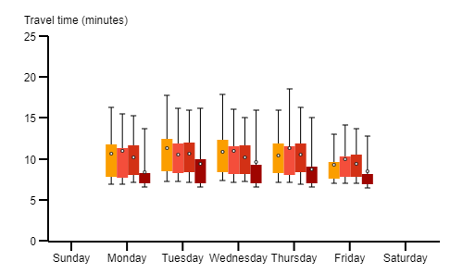
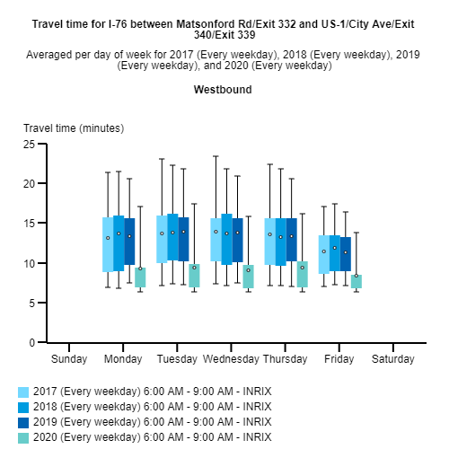
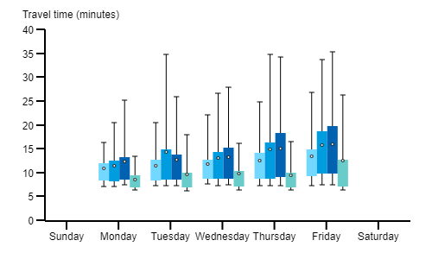
Comparison with previous years
How much did travel times change compared to previous years? In the AM and PM peak periods, average travel times and travel time reliability were fairly constant from 2017 to 2019. However, there were significant improvements in travel times and reliability in 2020 as a result of the pandemic.
Eastbound
Westbound
A
Stable - Improving
B
Stable - Improving
AM Peak
6AM – 9AM
C
Declining-Improving
D
Declining-Improving
PM Peak
4PM – 7PM
A: During the AM peak period in the eastbound direction, travel times and reliability remained relatively constant from 2017 to 2019 but improved significantly in 2020. B The same is true for the westbound direction, but the travel times were higher and less reliable. C During the PM peak period in the eastbound direction travel times progressively increased and reliability decreased from 2017 to 2019, but improved significantly in 2020. D The same holds true for the westbound direction with the exception of lower travel times and in some instances more variability in travel.
A
B
C
D
95th
Converging whiskers denote improving reliability
The box plot presents a simplified distribution of the range of travel times throughout the period of interest, based on percentiles.
75th
AVG
Reduced average travel time denotes improving typical conditions
25th
5th

Slide 6
For more information, contact:

Thomas K. Edinger, AICP
Delaware Valley Regional Planning Commission
190 N Independence Mall West
8th Floor
Philadelphia, PA 19106
215.238.2865 office | tedinger@dvrpc.org email

