Slide 1
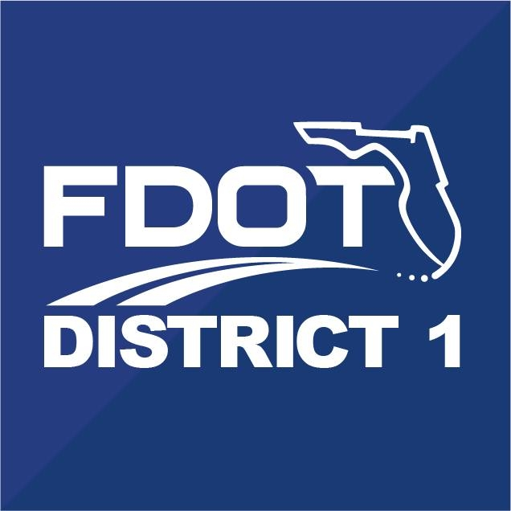
Weekly Work Zone Performance Assessment
Diverging Diamond Interchange Project
(I-75/SR 93 & SR 884/Colonial Blvd. Interchange • Fort Myers • Lee County)
Sunday, April 9th through Saturday, April 15, 2023
1

Slide 2
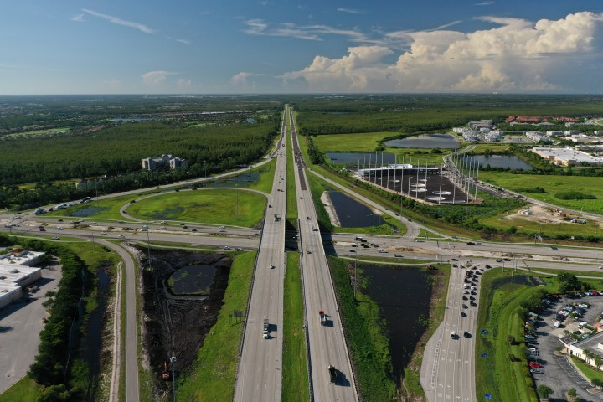
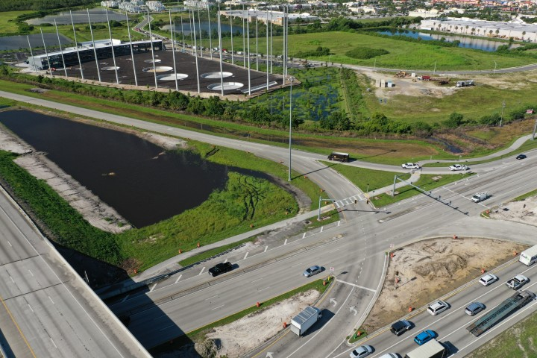
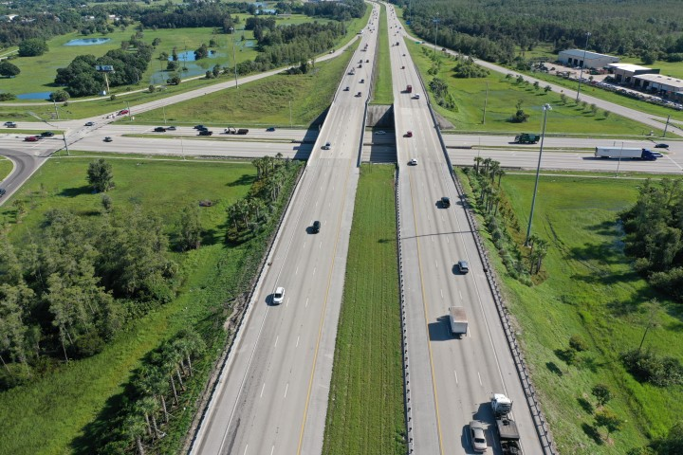
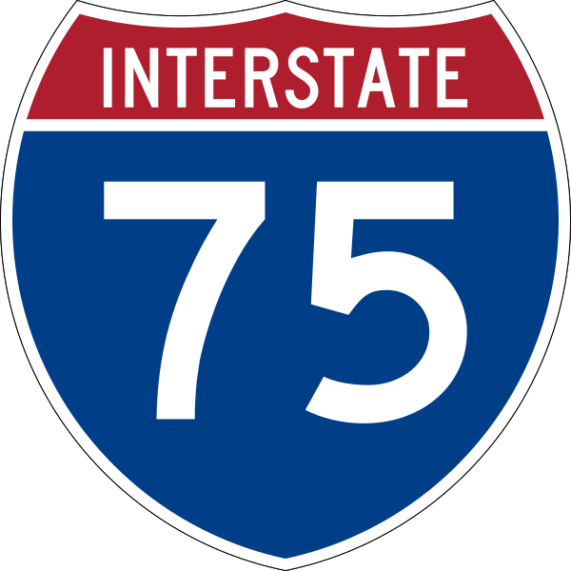
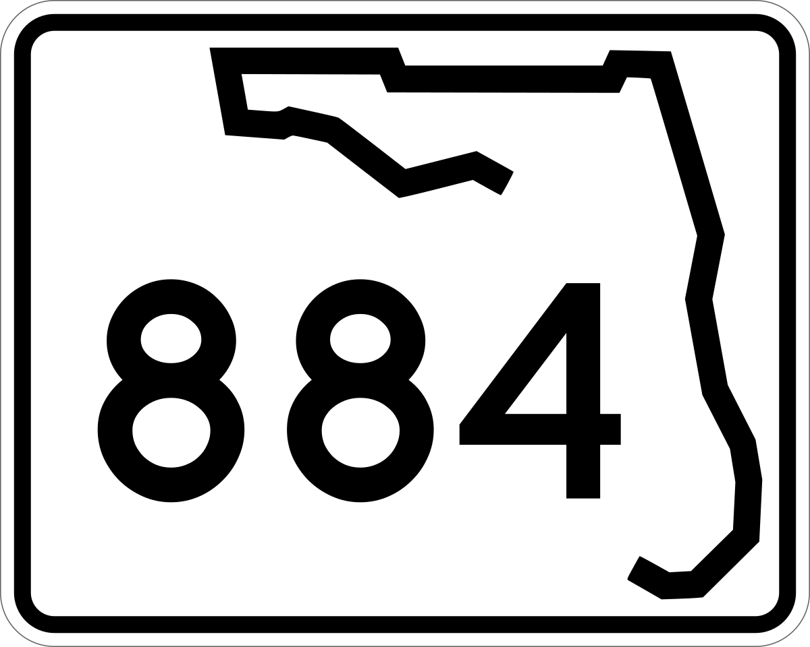
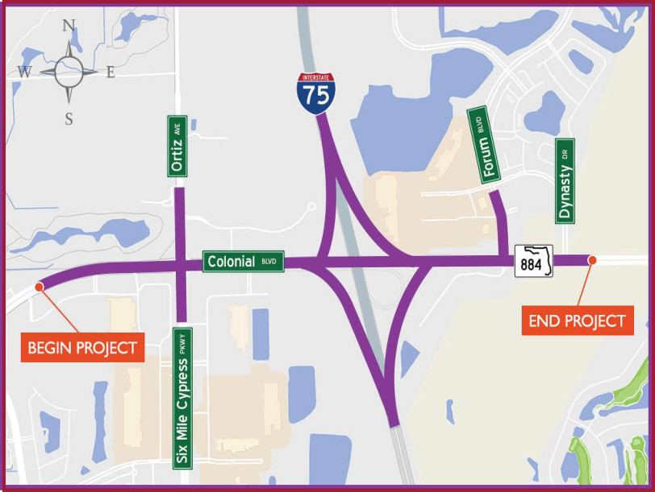
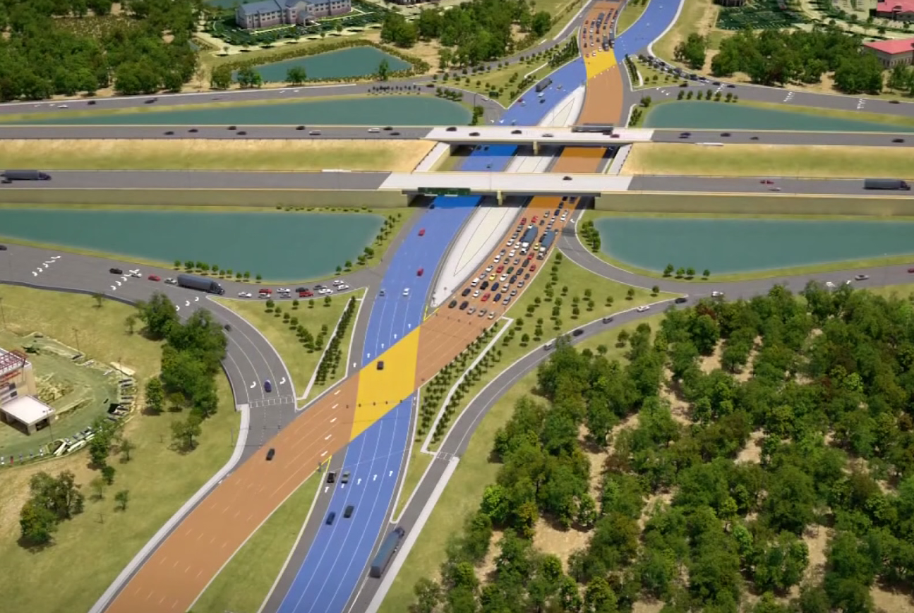
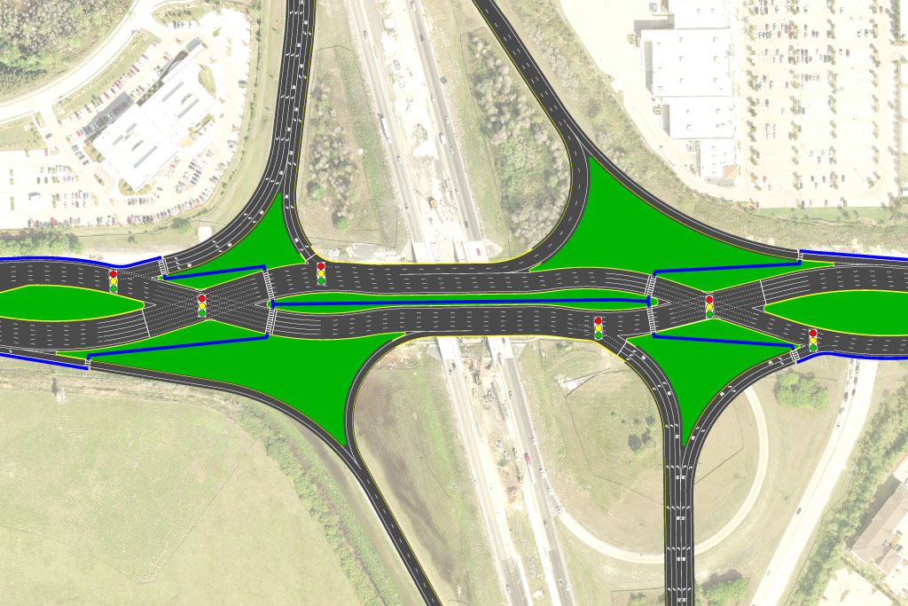
Diverging Diamond Interchange (I-75/SR 93 & SR 884/Colonial Blvd. Interchange)
Project Description
I-75 at Colonial Boulevard (SR 884) improvements involve the reconfiguration of the I-75 at Colonial Boulevard Interchange to a Diverging Diamond Interchange (DDI).
The improvements will enhance access to I-75, as well as improve overall safety, increase capacity, and facilitate emergency evacuation within the County. In addition, the improvements will help serve travel demands created by anticipated countywide population and employment growth.
Other improvements along Colonial Boulevard include a Continuous Flow Intersection (CFI) at the intersection of Six Mile Cypress Parkway/Ortiz Avenue and a Superstreet Intersection at the Colonial Boulevard/Forum Boulevard intersection.
Project Location Map & Details
Project No.: 413065-1
Work Type: Diverging Diamond
Interchange Construction
Phase: Construction
Limits: I-75/SR 93: approximately
1.5 miles from Colonial Boulevard to SR 82/Dr. Martin Luther King Jr. Boulevard
SR 884/Colonial Boulevard: approximately 1.6 miles from just west of Colonial Gardens Circle to just east of Dynasty Drive I-75/SR 884 interchange
Length: 3.1 miles
City: Fort Myers
County: Lee
Road(s): I-75, SR 884, SR 93
Construction Cost: $52.7 million
Est. Completion: Early 2024
Proposed Improvement

Slide 3
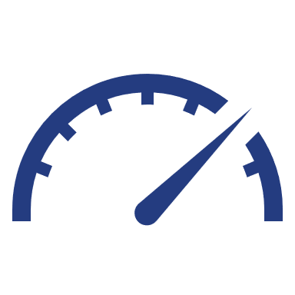
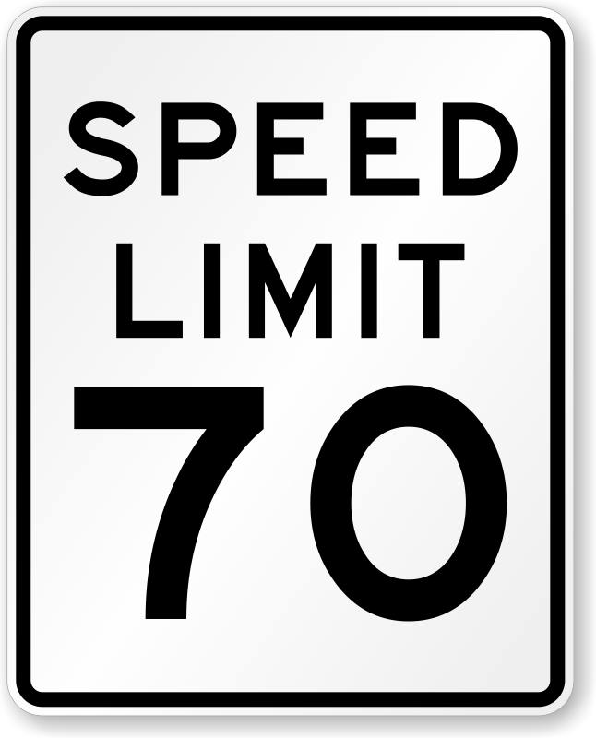
Construction PM
David Jones
(863) 519-2345
Communications
Brian Bollas
(813) 262-8549
Weekly Work Zone Performance Report
Week of April 9th to April 15th, 2023 • 8 AM to 5 PM
I-75/SR 93 & SR 884/Colonial Blvd. Interchange
Project No. 413065-1
SB
Work Zone Performance Metrics
↑
↑
NB
Avg. Daily
Vehicle Speed
Significant
Queue
Avg. Daily
Veh.-hr. of Delay
SR 82/
Exit 138
NB 72.2mph
(1.94min Travel Time)
SB 71.4mph
(1.85min Travel Time)
1hr 19min
CONGESTED LENGTH 4.60MI
(occurred NB @ Exit 136 on Apr 12, 2023, from 11:34am to 12:53pm)
20hr
AVG. DAILY DELAY COST $600
Day-by-Day Performance Metrics
METRIC  | DIR | Sun (4/9) | Mon (4/10) | Tue (4/11) | Wed (4/12) | Thu (4/13) | Fri (4/14) | Sat (4/15)
Avg. Speed (mph) | NB | 76.7 | 72.5 | 71.6 | 63.1 | 74.0 | 72.0 | 77.3
 | SB | 76.7 | 73.3 | 72.0 | 60.9 | 72.0 | 71.8 | 75.7
Avg. TT (min) | NB | 1.83 | 1.94 | 1.96 | 2.22 | 1.90 | 1.94 | 1.82
 | SB | 1.72 | 1.80 | 1.84 | 2.17 | 1.84 | 1.84 | 1.75
Total Cost (dollars) | NB | $0 | $0 | $340 | $1.0K | $0 | $270 | $0
 | SB | $0 | $0 | $0 | $1.6K | $0 | $1.0K | $0
Veh.-hr. of Delay (hours) | NB | 0 | 0 | 12hr | 35hr | 0 | 9hr | 0
 | SB | 0 | 0 | 0 | 55hr | 0 | 31hr | 0
WORK
ZONE
Work Zone Length ~1.5 mi
Hours of Operation: 8 AM to 5 PM
Notable Events
SR 884/
Exit 136
NB/SB off-ramp backups to Exit 136 - SR 884
(Wkday AM PK HRs, just prior to
the start of the active WZ)
Heavy rain caused hazardous driving conditions on 4/12
(11:00am to 1:00pm)
!
NB wrong way-facing vehicle on shoulder on 4/12
(12:37pm to 1:01pm)
Daniels Pkwy
Exit 131
BOLD = WORST PERFORMANCE
For the Week - Total Cost | $4.2K • Total Veh.-hr. of Delay | 142hr
N.T.S.

Slide 4
Construction PM
David Jones
(863) 519-2345
Communications
Brian Bollas
(813) 262-8549
Weekly Work Zone Performance Report
Week of April 9th to April 15th, 2023 • 8 AM to 5 PM
I-75/SR 93 & SR 884/Colonial Blvd. Interchange
Project No. 413065-1
Work Zone Details
Work Zone Performance Metrics
Avg. Daily
Vehicle Speed
Significant
Queue
Avg. Daily
Veh.-hr. of Delay
NB 72.2mph
(1.94min Travel Time)
SB 71.4mph
(1.85min Travel Time)
1hr 19min
CONGESTED LENGTH 4.60mi
(occurred NB @ Exit 136 on Apr 12, 2023, from 11:34am to 12:53pm)
20hr
AVG. DAILY DELAY COST $600
Limits | Approx. 1.5 mi, from SR 884/ Colonial Blvd to SR 82/Dr. Martin Luther King Jr. Blvd.
Lane Status | Construction is not closing any lanes on I-75 except at nighttime.
Counter Measures | Barrels, arrow boards.
Operation | All lanes are open (3 thru lanes & 1 aux lane) in both directions.
Hours of Operation | Typical are 8am to 5pm, night work between 9pm and 6am.
Police Enforcement | During lane closures are present before lane is closed and shortly after it is open.
Posted Work Zone Speed | 65mph during lane closure operations.
Day-by-Day Performance Metrics
METRIC  | DIR | Sun (4/9) | Mon (4/10) | Tue (4/11) | Wed (4/12) | Thu (4/13) | Fri (4/14) | Sat (4/15)
Avg. Speed (mph) | NB | 76.7 | 72.5 | 71.6 | 63.1 | 74.0 | 72.0 | 77.3
 | SB | 76.7 | 73.3 | 72.0 | 60.9 | 72.0 | 71.8 | 75.7
Avg. TT (min) | NB | 1.83 | 1.94 | 1.96 | 2.22 | 1.90 | 1.94 | 1.82
 | SB | 1.72 | 1.80 | 1.84 | 2.17 | 1.84 | 1.84 | 1.75
Total Cost (dollars) | NB | $0 | $0 | $340 | $1.0K | $0 | $270 | $0
 | SB | $0 | $0 | $0 | $1.6K | $0 | $1.0K | $0
Veh.-hr. of Delay (hours) | NB | 0 | 0 | 12hr | 35hr | 0 | 9hr | 0
 | SB | 0 | 0 | 0 | 55hr | 0 | 31hr | 0
Notable Events
NB/SB off-ramp backups to Exit 136 - SR 884
(Wkday AM PK HRs, just prior to
the start of the active WZ)
Heavy rain caused hazardous driving conditions on 4/12
(11:00am to 1:00pm)
!
NB wrong way-facing vehicle on shoulder on 4/12
(12:37pm to 1:01pm)
BOLD = WORST PERFORMANCE
For the Week - Total Cost | $4.2K • Total Veh.-hr. of Delay | 142hr

Slide 5
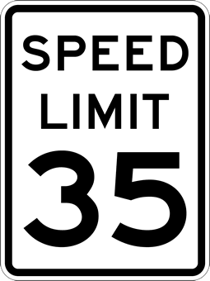
Construction PM
David Jones
(863) 519-2345
Communications
Brian Bollas
(813) 262-8549
Weekly Work Zone Performance Report
Week of April 9th to April 15th, 2023 • 8 AM to 5 PM
I-75/SR 93 & SR 884/Colonial Blvd. Interchange
Project No. 413065-1
Work Zone Performance Metrics
Notable Events
EB
↑
↑
WB
Avg. Daily
Vehicle Speed
Significant
Queue
Avg. Daily
Veh.-hr. of Delay
Traffic
Congestion
EB 30.5mph
(6.89min Travel Time)
WB 27.3mph
(7.70min Travel Time)
2hr 47min
CONGESTED LENGTH 5.33 mi
(occurred EB @ Ortiz Ave on Apr 11, 2023, from 3:22pm to 6:09pm)
WEEKDAYS
EB 3:00pm to 5:00pm
WB 5:30am to 9:00am
(from I-75 to Winkler Ave.)
Winkler Avenue
445h
AVG. DAILY DELAY COST $13,500
Colonial Gardens Circle
Day-by-Day Performance Metrics
METRIC  | DIR | Sun (4/9) | Mon (4/10) | Tue (4/11) | Wed (4/12) | Thu (4/13) | Fri (4/14) | Sat (4/15)
Avg. Speed (mph) | EB | 36.1 | 30.5 | 30.2 | 26.9 | 30.4 | 28.0 | 33.1
 | WB | 35.1 | 29.0 | 23.5 | 25.7 | 27.4 | 24.0 | 29.7
Avg. TT (min) | EB | 5.79 | 6.89 | 6.97 | 7.81 | 6.93 | 7.5 | 6.36
 | WB | 5.99 | 7.25 | 8.95 | 8.17 | 7.68 | 8.75 | 8.16
Total Cost (dollars) | EB | $0 | $19.3K | $5.9K | $11.6K | $6.1K | $12.5K | $0
 | WB | $0 | $0 | $16.1K | $6.0K | $4.0K | $12.1K | $0
Veh.-hr. of Delay (hr.) | EB | 0 | 637 | 194 | 384 | 233 | 414 | 0
 | WB | 0 | 0 | 534 | 198 | 132 | 400 | 0
WORK
ZONE
Traffic
Incident
Work Zone Length ~1.6 mi
Hours of Operation: 8 AM to 5 PM
WED, April 12, 2023
EB 3:47pm to 4:45pm
Collision blocked 2 lanes
(just beyond I-75)
Analysis Segment Length - 3.5mi)
Dynasty Drive
Weather
WED, April 12, 2023
Heavy rain and gusty winds caused hazardous driving conditions
(11:00am to1:00pm)
82
BOLD = WORST PERFORMANCE
N.T.S.
For the Week - Total Cost | $93.6K • Total Veh.-hr. of Delay | 3,126h

Slide 6
Construction PM
David Jones
(863) 519-2345
Communications
Brian Bollas
(813) 262-8549
Weekly Work Zone Performance Report
Week of April 9th to April 15th, 2023 • 8 AM to 5 PM
I-75/SR 93 & SR 884/Colonial Blvd. Interchange
Project No. 413065-1
Work Zone Details
Work Zone Performance Metrics
Notable Events
Avg. Daily
Vehicle Speed
Significant
Queue
Avg. Daily
Veh.-hr. of Delay
Traffic
Congestion
EB 30.5mph
(6.89min Travel Time)
WB 27.3mph
(7.70min Travel Time)
2hr 47min
CONGESTED LENGTH 5.33 mi
(occurred EB @ Ortiz Ave on Apr 11, 2023, from 3:22pm to 6:09pm)
WEEKDAYS
EB 3:00pm to 5:00pm
WB 5:30am to 9:00am
(from I-75 to Winkler Ave.)
445h
AVG. DAILY DELAY COST $13,500
Limits | Approx. 1.6 mi from just west of Colonial Gardens Cir to just east of Dynasty Dr I-75/SR 884 interchange.
Lane Status | No lane closures during daytime operations.
Counter Measures | Barrels, arrow boards.
Operation | All lanes are open, 3 thru lanes in each direction.
Hours of Operation | Typical are 8am to 5pm, night work between 9pm and 6am.
Police Enforcement | During lane closures - are present before lane is closed and shortly after it is open.
Posted Work Zone Speed | 35mph
Day-by-Day Performance Metrics
METRIC  | DIR | Sun (4/9) | Mon (4/10) | Tue (4/11) | Wed (4/12) | Thu (4/13) | Fri (4/14) | Sat (4/15)
Avg. Speed (mph) | EB | 36.1 | 30.5 | 30.2 | 26.9 | 30.4 | 28.0 | 33.1
 | WB | 35.1 | 29.0 | 23.5 | 25.7 | 27.4 | 24.0 | 29.7
Avg. TT (min) | EB | 5.79 | 6.89 | 6.97 | 7.81 | 6.93 | 7.5 | 6.36
 | WB | 5.99 | 7.25 | 8.95 | 8.17 | 7.68 | 8.75 | 8.16
Total Cost (dollars) | EB | $0 | $19.3K | $5.9K | $11.6K | $6.1K | $12.5K | $0
 | WB | $0 | $0 | $16.1K | $6.0K | $4.0K | $12.1K | $0
Veh.-hr. of Delay (hours) | EB | 0 | 637 | 194 | 384 | 233 | 414 | 0
 | WB | 0 | 0 | 534 | 198 | 132 | 400 | 0
Traffic
Incident
WED, April 12, 2023
EB 3:47pm to 4:45pm
Collision blocked 2 lanes
(just beyond I-75)
Weather
WED, April 12, 2023
Heavy rain and gusty winds caused hazardous driving conditions
(11:00am to1:00pm)
BOLD = WORST PERFORMANCE
For the Week - Total Cost | $93.6K • Total Veh.-hr. of Delay | 3,126h

Slide 7
CONTACT INFORMATION
Communications
Brian Bollas
(813) 262-8549
Construction PM
David Jones
(863) 519-2345
For more project information, click here
7

