Slide 1
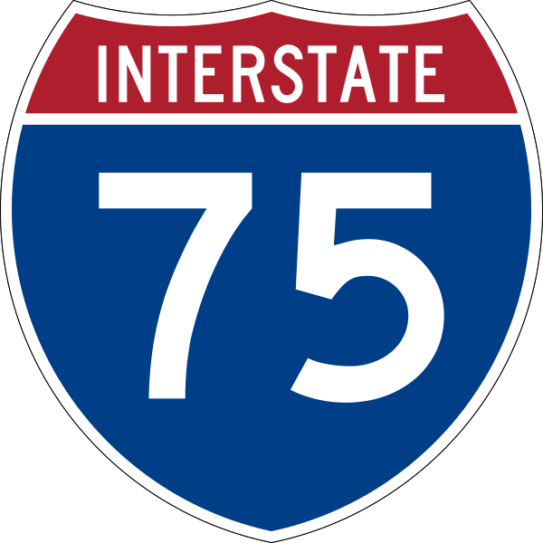
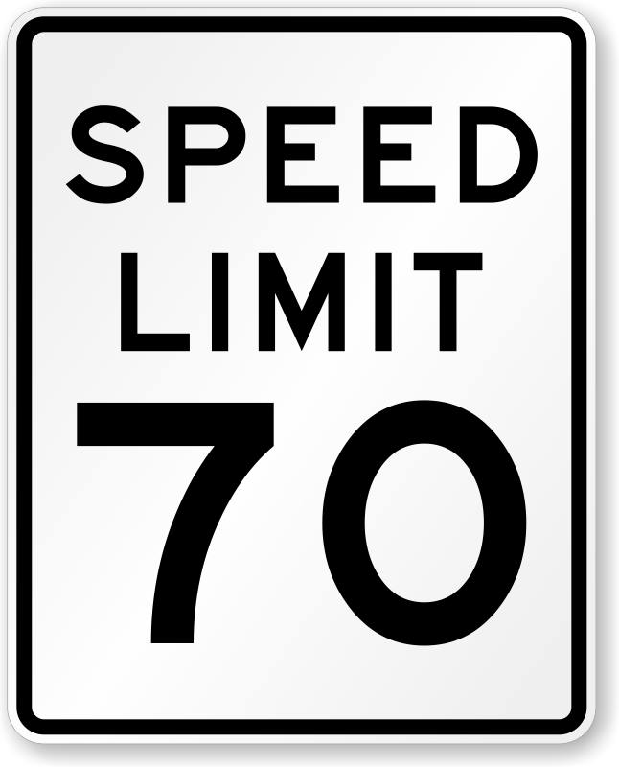
Construction PM
David Jones
(863) 519-2345
Communications
Brian Bollas
(813) 262-8549
Daily Work Zone Performance Report
Wednesday, April 12, 2023 • 8 AM to 5 PM
I-75/SR 93 & SR 884/Colonial Blvd. Interchange
Project No. 413065-1
SB
↑
↑
NB
 | Speed |  | Travel Time |  | Queues |  | Delay (N/S)
 | AVERAGE | SLOWEST | AVERAGE | LONGEST | MAX LENGTH | TOTAL DURATION | VEH-HR OF DELAY | USER DELAY COST
NB | 72.2mph | 40.1mph | 2.2min | 3.5min | 4.6mi | 1h 19m | 56hr | $1.6K
 | (8am to 5pm) | (12:10pm) | (8am to 5pm) | (12:20pm) | (11:24am to 12:53pm) | (11:24am to 12:53pm) | (8am to 5pm) | (8am to 5pm)
SB | 71.4mph | 31.8mph | 2.1min | 4.2min | 1.5mi | 24min | 86hr | $2.6K
 | (8am to 5pm) | (11:30am) | (8am to 5pm) | (11:30am) | (7:31am to 7:55am) | (7:31am to 7:55am) | (8am to 5pm) | (8am to 5pm)
SR 82/
Exit 138
WORK
ZONE
Work Zone (~1.5 mi)
Events |  | Delay
TRAFFIC CONGESTION | TRAFFIC INCIDENTS | WEATHER
SR 884/
Exit 136
SB off-ramp back-up to SR 884
(7:19am to 8:32am)
NB off-ramp back-up to SR 884
(7:52am to 8:10am)
NB wrong way-facing vehicle on shoulder
(12:37pm to 1:01pm)
NB crash
(4:47pm to 7:02pm)
NB Disabled vehicle
(5:03pm to 5:06pm)
Heavy rain and gusty winds caused hazardous driving conditions
(11:00am to1:00pm)
NOTES: Analysis indicates that the mid-day NB queue was most likely a result of heavy rain coupled with the wrong way-facing driver on the shoulder, potentially causing additional slowdown. The morning SB queue was most likely due to the impact of SR-884 off-ramp traffic slowing down to exit I-75, and possibly backing down the ramp, impacting mainline flow. The rainy weather seemed to have some affect on traffic flow later in the day: speeds dropped to 31mph @ 11:30am.
Daniels Pkwy
Exit 131

Slide 2
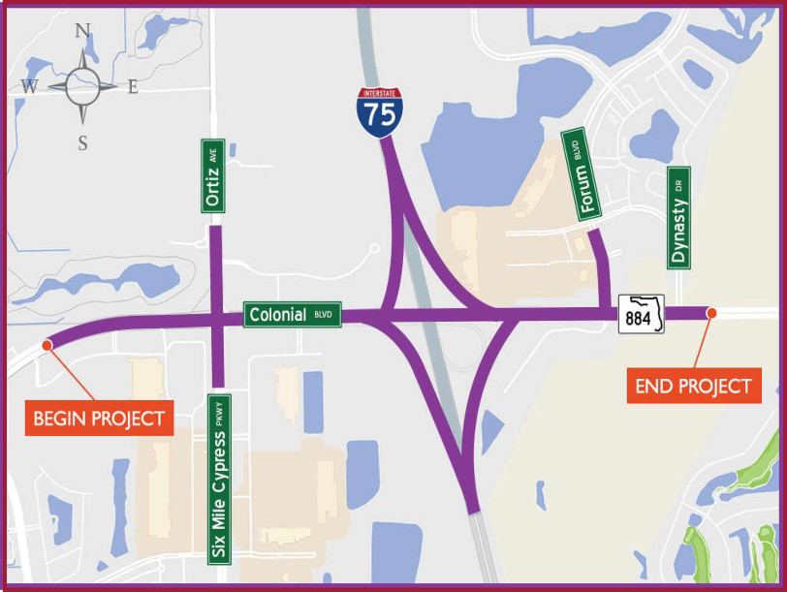
Construction PM
David Jones
(863) 519-2345
Communications
Brian Bollas
(813) 262-8549
Daily Work Zone Performance Report
Wednesday, April 12, 2023 • 8 AM to 5 PM
I-75/SR 93 & SR 884/Colonial Blvd. Interchange
Project No. 413065-1
Work Zone Details
SB
↑
↑
NB
Speed
Travel Time
SR 82/
Exit 138
Average speed
through Work Zone
during operations
72.2mph NB↑
[8am to 5pm]
71.4mph SB↓
[8am to 5pm]
Slowest speed through Work Zone
during operations
40.1mph NB↑
[12:10pm]
31.8mph SB↓
[11:30am]
Average travel time
through Work Zone
during operations
2.2min NB↑
(8am to 5pm)
2.1min SB↓
(8am to 5pm)
Longest travel time through Work Zone
during operations
3.5min NB↑
(12:20pm)
4.2min SB↓
(11:45am)
WORK
ZONE
Work Zone (1.5 mi)
Limits | Approx. 1.5 mi, from SR 884/ Colonial Blvd to SR 82/Dr. Martin Luther King Jr. Blvd.
Lane Status | Construction is not closing any lanes on I-75 except at nighttime.
Counter Measures | Barrels, arrow boards.
Operation | All lanes are open (3 thru lanes & 1 aux lane) in both directions.
Hours of Operation | Typical are 8am to 5pm, night work between 9pm and 6am.
Police Enforcement | During lane closures are present before lane is closed and shortly after it is open.
Posted Work Zone Speed | 65mph during Lane closure operations.
SR 884/
Exit 136
Queues
Total Delay
Max
Queue
4.6mi NB↑
[11:24am to 12:53pm]
1.5mi SB↓
[7:31am to 7:55am]
Total
Duration
1h 19m NB↑
[11:24am to 12:53pm]
24 m SB↓
[7:31am to 7:55am]
Vehicle-hours
of Delay
142hr
Total
Cost
$4.2K
Contributing Factors
5 Events
2 congestion
3 Incidents
1 Weather Event
Rain, wind
Daniels Pkwy
Exit 131
Notes:
REVISIONS FROM UX MEETING + MY OWN - ADDED LIMITS: TO WORK ZONE PROFILE, STETCHED THE SIDEBAR TO ACCOMMODATE AND SHIFTED TO THE FAR LEFT; ADDED LIMITS TO THE SPEED PROFILE FOR THE WORK ZONE HEADING; ADDED WORK ZONE ACTIVE TIME IN THE CALLOUT BENEATH THE SPREED PROFILE; REGROUPED KEY METRICS AND OPERATIONAL IMPACT RESULTS; ADDED A DIVIDER BETWEEN THOSE TWO GROUPINGS.

Slide 3
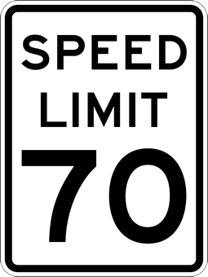
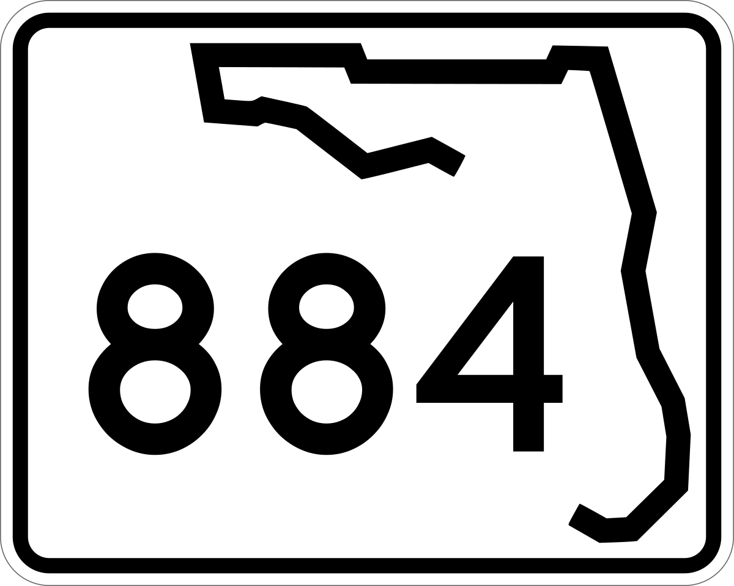
Construction PM
David Jones
(863) 519-2345
Communications
Brian Bollas
(813) 262-8549
Daily Work Zone Performance Report
Wednesday, April 12, 2023 • 8 AM to 5 PM
I-75/SR 93 & SR 884/Colonial Blvd. Interchange
Project No. 413065-1
Work Zone Details
Notable Speed Drops (6 AM to 6 PM)
SB
↑
↑
NB
Limits: Approx. 1.5 mi from Colonial Blvd to SR 82/Dr. Martin Luther King Jr. Blvd.
Lane Status: Construction is not closing any lanes on I-75 except at nighttime.
Counter Measures: Barrels, arrow boards.
SR 82/
Exit 138
40.1 mph @12:10 pm
31.8 mph @11:30 am
40.0 mph @7:30 am
Northbound
Active Work Zone (8 AM to 5 PM)
Southbound
WORK
ZONE
Work Zone Length ~1.5 mi
Hours of Operation: 8 AM to 5 PM
Wrong way driver
NB/SB
off-ramp backups
!
Crash
Rain w/
gusty winds
Disabled Vehicle
D
Operation: All lanes are open (3 thru lanes & 1 aux lane) in both directions.
Hours of Operation: Typical are 8am to 5pm, night work between 9pm and 6am.
Police Enforcement: During lane closures are present before lane is closed and shortly after it is open.
Posted WZ speed: 65mph during Lane closure operations.
Work Zone Key Metrics
SR 884/
Exit 136
Longest Queues Assessment
Vehicle-hrs. of Delay
Wed, April 12, 2023
(07:31 AM to 07:55 AM) Duration 24m
Max queue length 1.51 mi
142 (11am to 1pm)
$4.2K in Total Cost
This SB queue was most likely a result of the traffic backing up from Colonial Blvd down the off-ramp during the morning rush.
Possible Contributing Impacts (for event detail, hover over icons
shown below the speed drop chart)
SB
Colonial Blvd.
Colonial Blvd.
5 Events
2 congestion; 3 Incidents
This NB queue was most likely due to the impact of the work zone area lane closure, coupled with a rain event that occurred from 10 AM to 1 PM, and possible slowdown from rubber-
necking due to a vehicle stopped on the shoulder facing the wrong way.
Slowest Travel Time
Wed, April 12, 2023
(11:34 AM to 12:53 PM) Duration 1h 19m
Max queue length 4.60 mi
1 Weather Event
Rain, wind
NB
Southbound
4.2m
@ 11:30 AM
Northbound
3.5m
@ 12:20 PM
Holiday/Special Event
None
Daniels Pkwy
Exit 131
N.T.S.
Notes:
REVISIONS FROM UX MEETING + MY OWN - ADDED LIMITS: TO WORK ZONE PROFILE, STETCHED THE SIDEBAR TO ACCOMMODATE AND SHIFTED TO THE FAR LEFT; ADDED LIMITS TO THE SPEED PROFILE FOR THE WORK ZONE HEADING; ADDED WORK ZONE ACTIVE TIME IN THE CALLOUT BENEATH THE SPREED PROFILE; REGROUPED KEY METRICS AND OPERATIONAL IMPACT RESULTS; ADDED A DIVIDER BETWEEN THOSE TWO GROUPINGS.

Slide 4
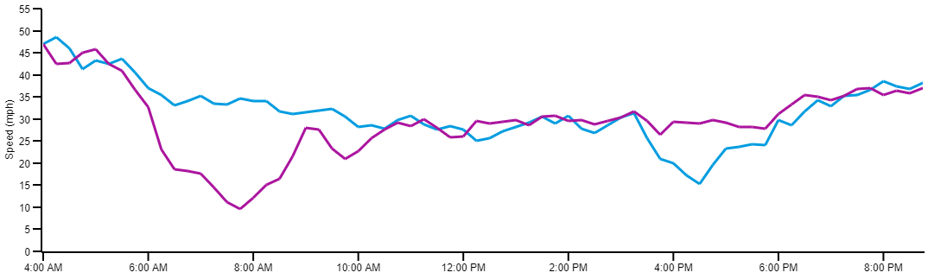
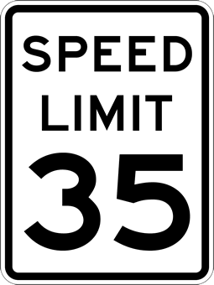
Construction PM
David Jones
(863) 519-2345
Communications
Brian Bollas
(813) 262-8549
Daily Work Zone Performance Report
Wednesday, April 12, 2023 • 8 AM to 5 PM
I-75/SR 93 & SR 884/Colonial Blvd. Interchange
Project No. 413065-1
Work Zone Details
Notable Speed Drops (6 AM to 6 PM)
Limits: Approx. 1.6 mi from just west of Colonial Gardens Cir to just east of Dynasty Dr I-75/SR 884 interchange
Lane Status: No lane closures during daytime operations
Counter Measures: Barrels, arrow boards
EB
WB
Active Work Zone (from 8 AM to 5 PM)
Colonial Gardens Circle
9.6 mph @7:45 am
25.1 mph @12:15 pm
15.2 mph @4:30 pm
Eastbound
Westbound
WORK
ZONE
WB Congestion
EB Congestion
Work Zone (1.6 mi)
Rain w/
gusty winds
Operation: All Lanes Open. 3 Thru lanes each direction
Hours of Operation: Typical are 8am to 5pm, night work between 9pm and 6am
Police Enforcement: During lane closures are present before lane is closed and shortly after it is open
Posted WZ speed: 35 mph
Crash
Work Zone Key Metrics
Vehicle-hrs. of Delay
Longest Queues Assessment
Wed, April 12, 2023
(04:55 PM to 6:07 PM)
Duration 1h 12m
Max queue length 2.83 mi
Dynasty Drive
173 (4pm to 5pm)
$5.2K in Total Cost
Possible Contributing Impacts (for event detail, hover over icons shown below the speed drop chart)
EB
This EB queue was most likely a result of the traffic back ups due to the construction area, coupled with the tail end of back-ups from the crash and congestion from evening rush hour traffic.
Colonial Blvd.
3 Events
2 congestion; 1 Incident
Slowest Travel Time
Colonial Blvd.
1 Weather Event
Rain, wind
This WB queue was most likely due to the impact of the work zone area lane closure, coupled with the tail end of normal morning rush hour traffic.
Westbound
22.0 min
@ 7:45 AM
Eastbound
13.8min
@ 4:30 PM
WB
Wed, April 12, 2023
(09:45 AM to 10:38 AM) Duration 52m
Max queue length 2.85 mi
Holiday/Special Event
None
Notes:
REVISIONS FROM UX MEETING + MY OWN - ADDED LIMITS: TO WORK ZONE PROFILE, STETCHED THE SIDEBAR TO ACCOMMODATE AND SHIFTED TO THE FAR LEFT; ADDED LIMITS TO THE SPEED PROFILE FOR THE WORK ZONE HEADING; ADDED WORK ZONE ACTIVE TIME IN THE CALLOUT BENEATH THE SPREED PROFILE; REGROUPED KEY METRICS AND OPERATIONAL IMPACT RESULTS; ADDED A DIVIDER BETWEEN THOSE TWO GROUPINGS.

Slide 5
Construction PM
David Jones
(863) 519-2345
Communications
Brian Bollas
(813) 262-8549
Weekly Work Zone Performance Report
Week of April 9th to April 15th, 2023 • 8 AM to 5 PM
I-75/SR 93 & SR 884/Colonial Blvd. Interchange
Project No. 413065-1
Day-by-Day Performance Metrics |  | Day-by-Day Performance Metrics
METRIC  | DIR | Sun (4/9) | Mon (4/10) | Tue (4/11) | Wed (4/12) | Thu (4/13) | Fri (4/14) | Sat (4/15)
Avg. Speed  (mph) | NB | 76.7 | 72.5 | 71.6 | 63.1 | 74.0 | 72.0 | 77.3
 | SB | 76.7 | 73.3 | 72.0 | 60.9 | 72.0 | 71.8 | 75.7
Total Cost  (dollars) | NB | $0 | $0 | $340 | $1.0K | $0 | $270 | $0
 | SB | $0 | $0 | $0 | $1.6K | $0 | $1.0K | $0
Veh.-hr. of Delay  (hr. min) | NB | 0 | 0 | 12hr | 35hr | 0 | 9hr | 0
 | SB | 0 | 0 | 0 | 55hr | 0 | 31hr | 0
SB
↑
BOLD = WORST PERFORMANCE
↑
NB
SR 82/
Exit 138
WORK
ZONE
Work Zone Length ~1.5 mi
Hours of Operation: 8 AM to 5 PM
SR 884/
Exit 136
Worst Performance for the Week
Events for the Week (24 Total)
Notable Impacts for the Week
Slowest Speeds
(on 4/12)
SB – 31.8mph (11:30am)
NB – 40.1 mph (12:10pm)
Most Delay
(on 4/12)
90 min
(11am to 1:00pm)
NB/SB off-ramp backups to Exit 136 - SR 884
(AM PK HRs, just prior to the
start of the active WZ)
Heavy rain caused hazardous driving conditions on 4/12
(11:00am to1:00pm)
Significant Queue
(NB at Exit 136, on 4/12)
1hr 19 min | 4.6 mi (11:34 am to 12:53pm)
Greatest Delay Cost (4/12)
$2.6k
(11am to 1:00pm)
!
NB wrong way-facing vehicle on shoulder on 4/12
(12:37pm to 1:01pm)
Daniels Pkwy
Exit 131
N.T.S.

Slide 6
Construction PM
David Jones
(863) 519-2345
Communications
Brian Bollas
(813) 262-8549
Weekly Work Zone Performance Report
Week of April 9th to April 15th, 2023 • 8 AM to 5 PM
I-75/SR 93 & SR 884/Colonial Blvd. Interchange
Project No. 413065-1
Work Zone Details
Day-by-Day Performance Metrics |  | Day-by-Day Performance Metrics
METRIC  | DIR | Sun (4/9) | Mon (4/10) | Tue (4/11) | Wed (4/12) | Thu (4/13) | Fri (4/14) | Sat (4/15)
Avg. Speed  (mph) | NB | 76.7 | 72.5 | 71.6 | 63.1 | 74.0 | 72.0 | 77.3
 | SB | 76.7 | 73.3 | 72.0 | 60.9 | 72.0 | 71.8 | 75.7
Total Cost  (dollars) | NB | $0 | $0 | $340 | $1.0K | $0 | $270 | $0
 | SB | $0 | $0 | $0 | $1.6K | $0 | $1.0K | $0
Veh.-hr. of Delay  (hr. min) | NB | 0 | 0 | 12hr | 35hr | 0 | 9hr | 0
 | SB | 0 | 0 | 0 | 55hr | 0 | 31hr | 0
BOLD = WORST PERFORMANCE
Limits | Approx. 1.5 mi, from SR 884/ Colonial Blvd to SR 82/Dr. Martin Luther King Jr. Blvd.
Lane Status | Construction is not closing any lanes on I-75 except at nighttime.
Counter Measures | Barrels, arrow boards.
Operation | All lanes are open (3 thru lanes & 1 aux lane) in both directions.
Hours of Operation | Typical are 8am to 5pm, night work between 9pm and 6am.
Police Enforcement | During lane closures are present before lane is closed and shortly after it is open.
Posted Work Zone Speed | 65mph during lane closure operations.
Worst Performance for the Week
Events for the Week (24 Total)
Notable Impacts for the Week
Slowest Speeds
(on 4/12)
SB|31.8mph (11:30am)
NB|40.1 mph (12:10pm)
Most Delay
(on 4/12)
90 min
(11am to 1:00pm)
NB/SB off-ramp backups to Exit 136 - SR 884
(AM PK HRs, just prior to the
start of the active WZ)
Heavy rain caused hazardous driving conditions on 4/12
(11:00am to1:00pm)
Significant Queue
(NB at Exit 136, on 4/12)
1hr 19 min|4.6 mi (11:34 am to 12:53pm)
Greatest Delay Cost (4/12)
$2.6k
(11am to 1:00pm)
!
NB wrong way-facing vehicle on shoulder on 4/12
(12:37pm to 1:01pm)

Slide 7
Construction PM
David Jones
(863) 519-2345
Communications
Brian Bollas
(813) 262-8549
Weekly Work Zone Performance Report
Week of April 9th to April 15th, 2023 • 8 AM to 5 PM
I-75/SR 93 & SR 884/Colonial Blvd. Interchange
Project No. 413065-1
Work Zone Performance Metrics
Contributing Factors
SB
↑
↑
NB
Avg. Daily
Vehicle Speed
Significant
Queue
Avg. Daily
Veh.-hr. of Delay
Incidents
& Events
Notable
Weather
!
NB 72.2mph
(1.94min Travel Time)
SB 71.4mph
(1.85min Travel Time)
1hr 19min
CONGESTED LENGTH 4.60mi
(occurred NB @ Exit 136 on Apr 12, 2023, from 11:34am to 12:53pm)
Heavy rain caused hazardous driving conditions on 4/12
(11:00am to 1:00pm)
SR 82/
Exit 138
20min
AVG. DAILY DELAY COST $600
29
22 WITH DURATIONS < 2hr
7 WITH DURATIONS > 2hr
WORK
ZONE
Day-to-Day Performance Metrics Summary
Speed (mph)
Work Zone Length ~1.5 mi
Hours of Operation: 8 AM to 5 PM
38-29 mph
- Noteworthy speed reductions
0
20
30
40
50
60
70
38-39
mph
(7:50-8:10am)
SR 884/
Exit 136
24-28
mph
(11:25-11:45am)
27-29
mph
(12:00-12:35pm)
35-36
mph
(3:10-3:25pm)
Daniels Pkwy
Exit 131
N.T.S.

Slide 8
Construction PM
David Jones
(863) 519-2345
Communications
Brian Bollas
(813) 262-8549
Weekly Work Zone Performance Report
Week of April 9th to April 15th, 2023 • 8 AM to 5 PM
I-75/SR 93 & SR 884/Colonial Blvd. Interchange
Project No. 413065-1
Work Zone Details
Work Zone Performance Metrics
Contributing Factors
Avg. Daily
Vehicle Speed
Significant
Queue
Avg. Daily
Veh.-hr. of Delay
Incidents
& Events
Notable
Weather
!
NB 72.2mph
(1.94min Travel Time)
SB 71.4mph
(1.85min Travel Time)
1hr 19min
CONGESTED LENGTH 4.60mi
(occurred NB @ Exit 136 on Apr 12, 2023, from 11:34am to 12:53pm)
Heavy rain caused hazardous driving conditions on 4/12
(11:00am to 1:00pm)
20min
AVG. DAILY DELAY COST $600
29
22 WITH DURATIONS < 2hr
7 WITH DURATIONS > 2hr
Limits | Approx. 1.5 mi, from SR 884/ Colonial Blvd to SR 82/Dr. Martin Luther King Jr. Blvd.
Lane Status | Construction is not closing any lanes on I-75 except at nighttime.
Counter Measures | Barrels, arrow boards.
Operation | All lanes are open (3 thru lanes & 1 aux lane) in both directions.
Hours of Operation | Typical are 8am to 5pm, night work between 9pm and 6am.
Police Presence | During lane closures are present before lane is closed and shortly after it is open.
Posted Work Zone Speed | 65mph during lane closure operations.
Day-to-Day Performance Metrics Summary
Speed (mph)
38-39 mph
- Noteworthy speed reductions
0
20
30
40
50
60
70
38-39
mph
(7:50-8:10am)
24-28
mph
(11:25-11:45am)
27-29
mph
(12:00-12:35pm)
35-36
mph
(3:10-3:25pm)

Slide 9
Construction PM
David Jones
(863) 519-2345
Communications
Brian Bollas
(813) 262-8549
Weekly Work Zone Performance Report
Week of April 9th to April 15th, 2023 • 8 AM to 5 PM
I-75/SR 93 & SR 884/Colonial Blvd. Interchange
Project No. 413065-1
Work Zone Performance Metrics
Contributing Factors
SB
↑
↑
NB
Avg. Daily
Vehicle Speed
Significant
Queue
Avg. Daily
Veh.-hr. of Delay
Incidents
& Events
Notable
Weather
!
NB 72.2mph
(1.94min Travel Time)
SB 71.4mph
(1.85min Travel Time)
1hr 19min
CONGESTED LENGTH 4.60mi
(occurred NB @ Exit 136 on Apr 12, 2023, from 11:34am to 12:53pm)
Heavy rain caused hazardous driving conditions on 4/12
(11:00am to 1:00pm)
SR 82/
Exit 138
20hr
AVG. DAILY DELAY COST $600
24
20 WITH DURATIONS < 2hr
4 WITH DURATIONS > 2hr
WORK
ZONE
Day-to-Day Comparative Speed Summary
Work Zone Length ~1.5 mi
Hours of Operation: 8 AM to 5 PM
Comparative Speed — Measured speed as a percentage of the historical average speed for this time of day and day of week.
Click here to open Trend Map (Light) to explore results.
SR 884/
Exit 136
Comparative Speed (%)
0
40
50
60
70
80
95
Daniels Pkwy
Exit 131
N.T.S.

Slide 10
Construction PM
David Jones
(863) 519-2345
Communications
Brian Bollas
(813) 262-8549
Weekly Work Zone Performance Report
Week of April 9th to April 15th, 2023 • 8 AM to 5 PM
I-75/SR 93 & SR 884/Colonial Blvd. Interchange
Project No. 413065-1
Work Zone Details
Work Zone Performance Metrics
Contributing Factors
Avg. Daily
Vehicle Speed
Significant
Queue
Avg. Daily
Veh.-hr. of Delay
Incidents
& Events
Notable
Weather
!
NB 72.2mph
(1.94min Travel Time)
SB 71.4mph
(1.85min Travel Time)
1hr 19min
CONGESTED LENGTH 4.60mi
(occurred NB @ Exit 136 on Apr 12, 2023, from 11:34am to 12:53pm)
Heavy rain caused hazardous driving conditions on 4/12
(11:00am to 1:00pm)
20hr
AVG. DAILY DELAY COST $600
24
20 WITH DURATIONS < 2hr
4 WITH DURATIONS > 2hr
Limits | Approx. 1.5 mi, from SR 884/ Colonial Blvd to SR 82/Dr. Martin Luther King Jr. Blvd.
Lane Status | Construction is not closing any lanes on I-75 except at nighttime.
Counter Measures | Barrels, arrow boards.
Operation | All lanes are open (3 thru lanes & 1 aux lane) in both directions.
Hours of Operation | Typical are 8am to 5pm, night work between 9pm and 6am.
Police Presence | During lane closures are present before lane is closed and shortly after it is open.
Posted Work Zone Speed | 65mph during lane closure operations.
Day-to-Day Comparative Speed Summary
Comparative Speed — Measured speed as a percentage of the historical average speed for this time of day and day of week.
Click here to open Trend Map (Light) to explore results.
Comparative Speed (%)
0
40
50
60
70
80
95

