Slide 1
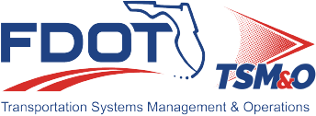
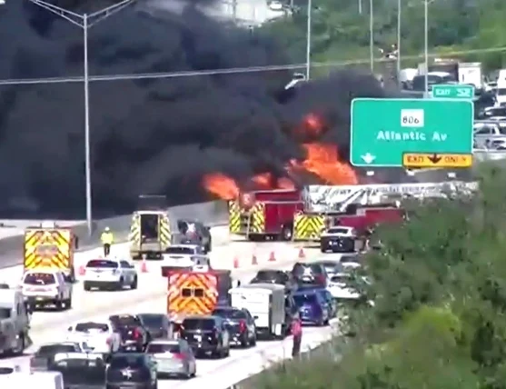
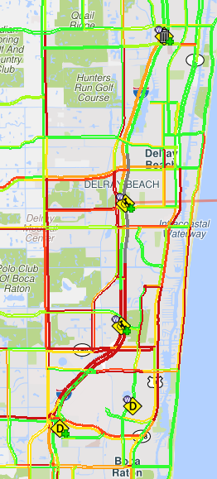
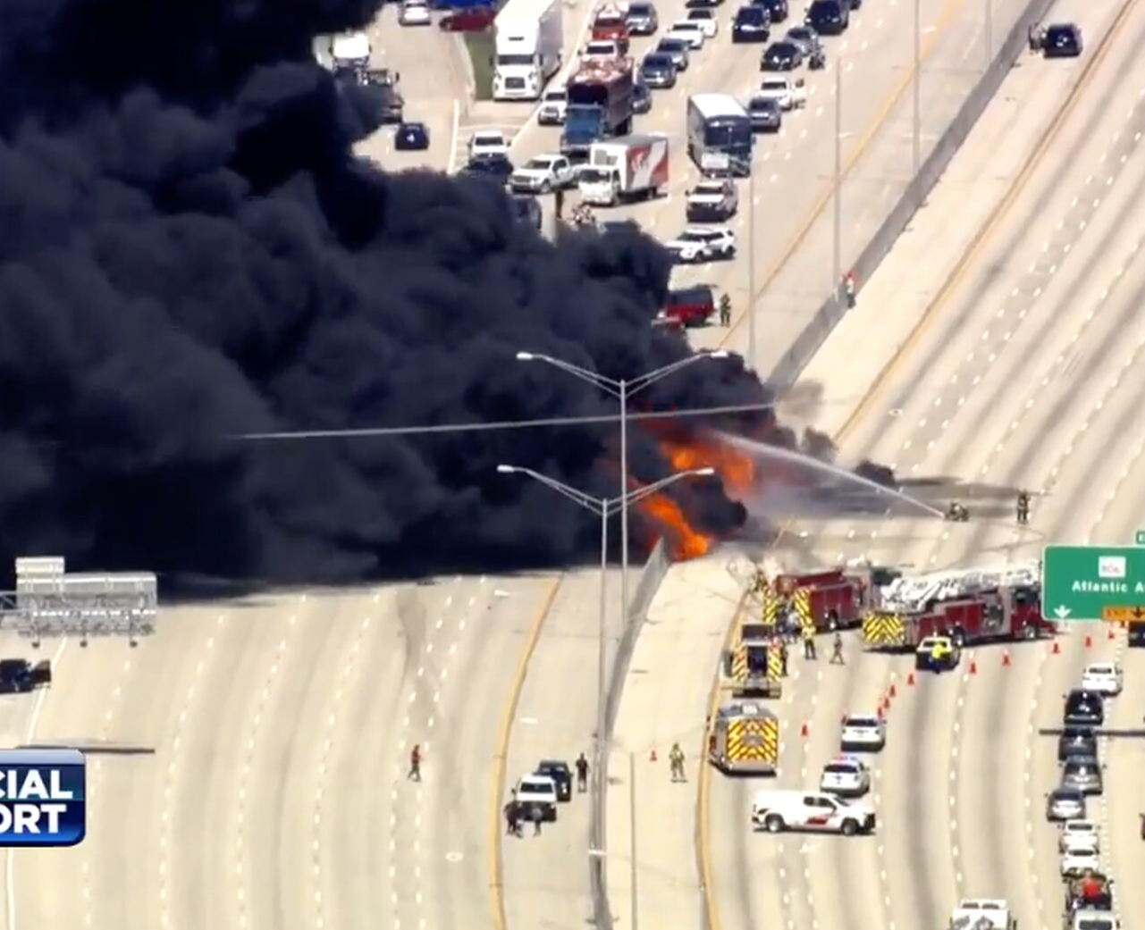
Major Incident Report
October 2022
Fuel Tanker Collision and Fire
FDOT District 4, Palm Beach County
Event ID
2317190
Event Numbers
N
1
4
Number of vehicles involved
5
0
Injuries
Fatalities
$205k
User Delay Cost
On October 25th, 2022, at around 1:15 PM an overturned fuel tanker truck caught fire on I-95 at Atlantic Avenue, Delray Beach. The incident started with the collision of the tanker truck with a vehicle, where both hit the middle concrete barrier. Three other vehicles were involved. There were five injuries and no fatalities.
The incident resulted in a complete closure of both directions of I-95 for several hours. Southbound lanes were reopened at approximately 4:15 PM and Northbound lanes were partially reopened at 5:26 PM.
Responded to the scene: Delray Beach fire crew, Palm Beach County fire crew, Boca Raton fire crew, Florida Highway Patrol, and the Palm Beach County Sheriff's Office.
Event Occurs
PBC TMC Notified
FIRE Arrives on Scene
SIRV Arrives on Scene
All Lanes Closed
NB Lanes Partially Reopened
Event Cleared
Normal Traffic Flow
T₀
T₁
T₂
T₃
T₄
T₅
T₆
T₇
1:15
PM
1:17
PM
1:19
PM
1:20
PM
1:41
PM
5:26
PM
8:27
PM
8:45
PM

Slide 2
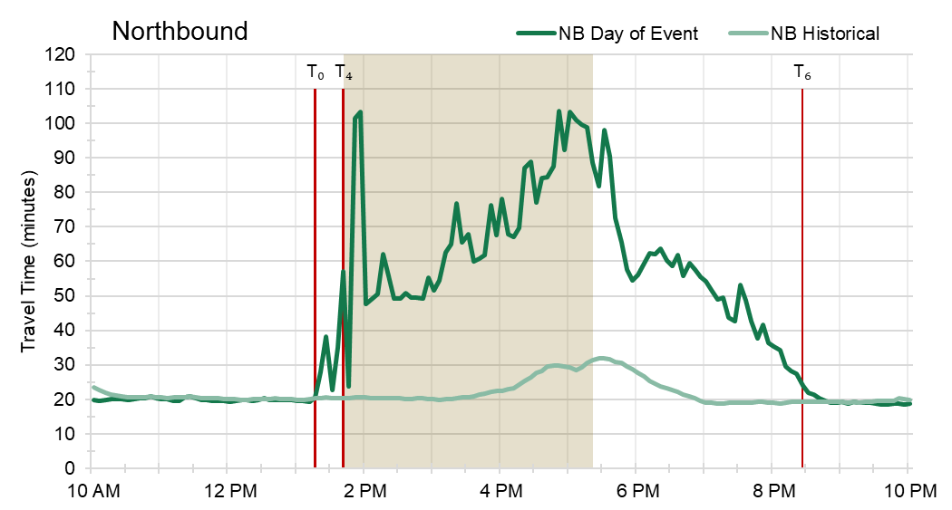
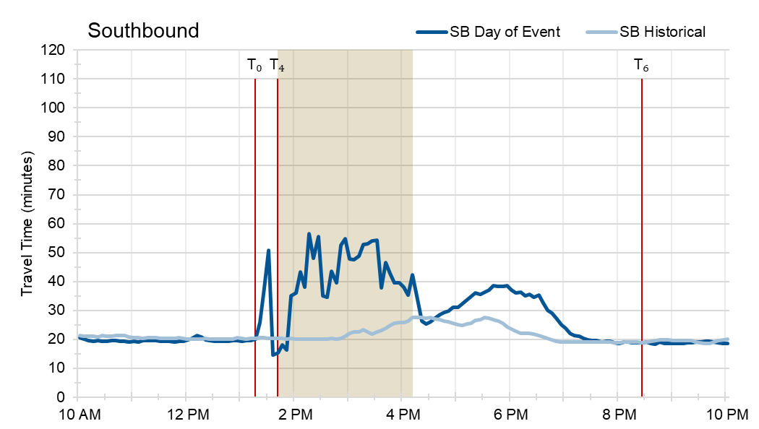
Fuel Tanker Collision and Fire
Performance Results
Event ID
2317190
Travel Time
Performance data is unreliable while the roadway is closed.
Timeline Markers:
T₀ - Event Occurs
T₄ - All Lanes Closed
T₆ - Event Cleared
Event Bottleneck
 | NB | SB
Traffic Diverted on | Linton Blvd | Woolbright Rd
Max Bottleneck Length | 8.4 miles | 7.8 miles
Bottleneck Duration | 7h 30min | 4h 30min
Delay Cost | Event hours set as 1PM to 9 PM
 | Historical Avg. | During Event | Percent Increase
User Delay Cost ($) | $30,245 | $205,405 | 579%
Hours of Delay (Person-Hours) | $1,226.93 | $8,332.45
Delay per VMT (minutes/mile) | $0.23 | $1.99 | 755%

