Slide 1
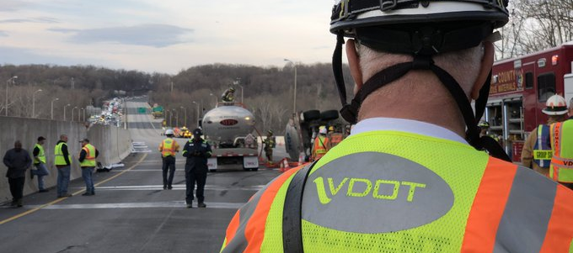
After-action Review
Overturned Tanker Truck on the American Legion Bridge
I-495 NB Inner Loop • Montgomery County, MD / Fairfax County, VA
Thursday, March 28, 2019
RITIS Performance Report

Slide 2
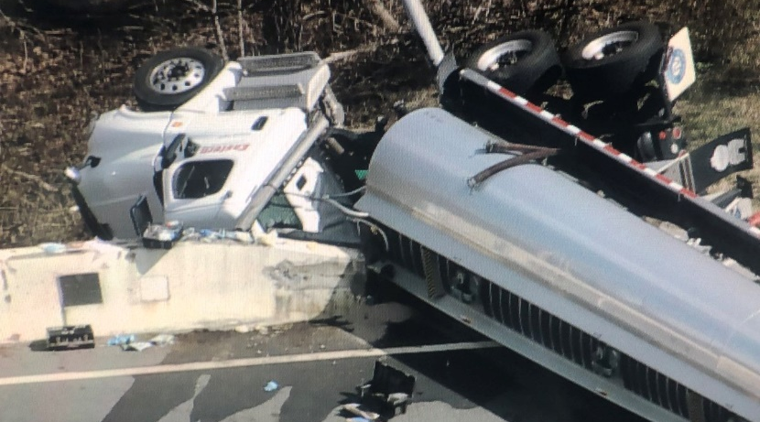
Incident Summary Overturned Gasoline Tanker
Approx. Crash Location
NB (Inner Loop) at the American Legion Bridge in Fairfax Co, VA • March 28, 2019
A tanker truck swerves to avoid slowed traffic, overturns and strikes two vehicles, then is struck by a 3rd vehicle.
The event started early Thursday afternoon, with traffic back to normal early Friday morning.
Most NB lanes were blocked for several hours to respond to and clean up the incident.
No major injuries. No fire. Two leaks (<500 gal.) were sealed.
Tanker blocking multiple lanes approaching AL bridge
NJ barrier breached and the tanker is leaking
Spare truck used to offload remaining fuel
Incident Timeline | Total Elapsed Time: 12 hours 48 minutes
Incident closed/traffic returning to normal
(2:40 AM)
Earliest record/ VSP Enroute
(1:52 PM)
SSP advised a vehicle is trapped under the tanker
(2:19 PM)
CCTV shows 2 sand trucks arrived
(3:31 PM)
Spare truck
enroute (ETA 10PM)
(4:56 PM)
Tanker loaded with 8,500 gallons of gas and is spilling
(2:11 PM)
Traffic backed up to I-270 split
(2:44 PM)
IL left lane temporarily reopened to bleed off traffic queue
(3:44 PM)
Tanker up-righted and hauled away
(1:57 AM)
Begin
Fairfax Co FD requested Outer Loop lane closure
(2:14 PM)
Fairfax hazmat on scene; requests a hot wash
(2:47 PM)
IL traffic being diverted to VA 123
(3:54 PM)
Cleanup still
in progress
(2:00 AM)
End
Overturned tanker is currently leaking
(2:08 PM)
Deployed sand truck from Gaithersburg & Fairland shops
(2:31 PM)
VDOT advises all OL lanes can be reopened
(3:40 PM)
Tank fuel transfer in progress
(8:55 PM)
IL – Inner Loop OL – Outer Loop - Break line (to account for long periods between key actions/events)

Slide 3
Incident Impacts
Overturned Gasoline Tanker
NB (Inner Loop) at the American Legion Bridge • Thursday, March 28, 2019
Area Impacts (Click here to view Trend Map regional network animations)
I-495 Mainline Impacts (Click here to open Congestion Scan)
2:00 PM Mar 27, 2019 (Wed)
2:00 PM Mar 28, 2019 (Thu)
2:00 PM Mar 29, 2019 (Fri)
FRI 3/29/19
THU 3/28/19
WED 3/27/19
NB (Inner Loop)
George Washington Parkway
George Washington Parkway
George Washington Parkway
(Center) Shortly after the incident, traffic speeds were already being significantly impacted on both NB and SB I-495, as well as the GW Pkwy., with several secondary incidents having occurred. Note that the America Legion Bridge experienced three separate incidents occurring during three consecutive days in virtually the same spot, warranting further investigation.
Comparisons of the I-495 mainline on the day of the incident vs the shoulder days shows the extent – both temporally &
spatially – the incident had on travel. Backups of 5 - 7 miles lasted over 5+ hours during the response & clean-up of the
incident and subsequent reopening of the roadway. Significant queuing also occurred in the SB direction due to rubbernecking.
I-495 Mainline User Delay Cost (Click here to open full UDC results)
Takeaways
This section of I-495 - from I-66 (VA) to Cabin John Pkwy (MD) - showed significant impact from the incident, in terms of user delay cost and vehicle hours of delay. UDC & Veh-hrs. of Delay for the day of the incident were 182% higher than the average for the other three Thursdays in March, however, allowing queuing traffic to safely pass and proficient, on-going public outreach helped minimize impacts.
$219.2k
in delay costs
Successful Incident Response - considering no FITM plans exist for this facility
Effective Messaging - majority of commuters avoided the area and used alternate routes to MD
Effective Management - Once the scene was secured, queued traffic was allowed to pass. Drop in “emergency” calls within the queue once it cleared
Efficient Detours and Diversions - Inner Loop queue only got to I-66. Limiting access to Inner Loop from Tysons/Dulles Toll Road area was helpful
Agency PIOs on site – facilitated information-sharing with the media and public to set expectations
7,258
veh-hr. of delay
Effective inter-agency information sharing and coordination due to Unified Command structure
“Knowing your local and regional partners before you get to the scene is critical”
Notes:
UDC/Veh-hr of Delay
$526k week 1 avg.; $487.3 week 2 avg.; $647k week3,; $724k week 4
$81,417 Daily Avg
$120k Thurs. Avg.

Slide 4
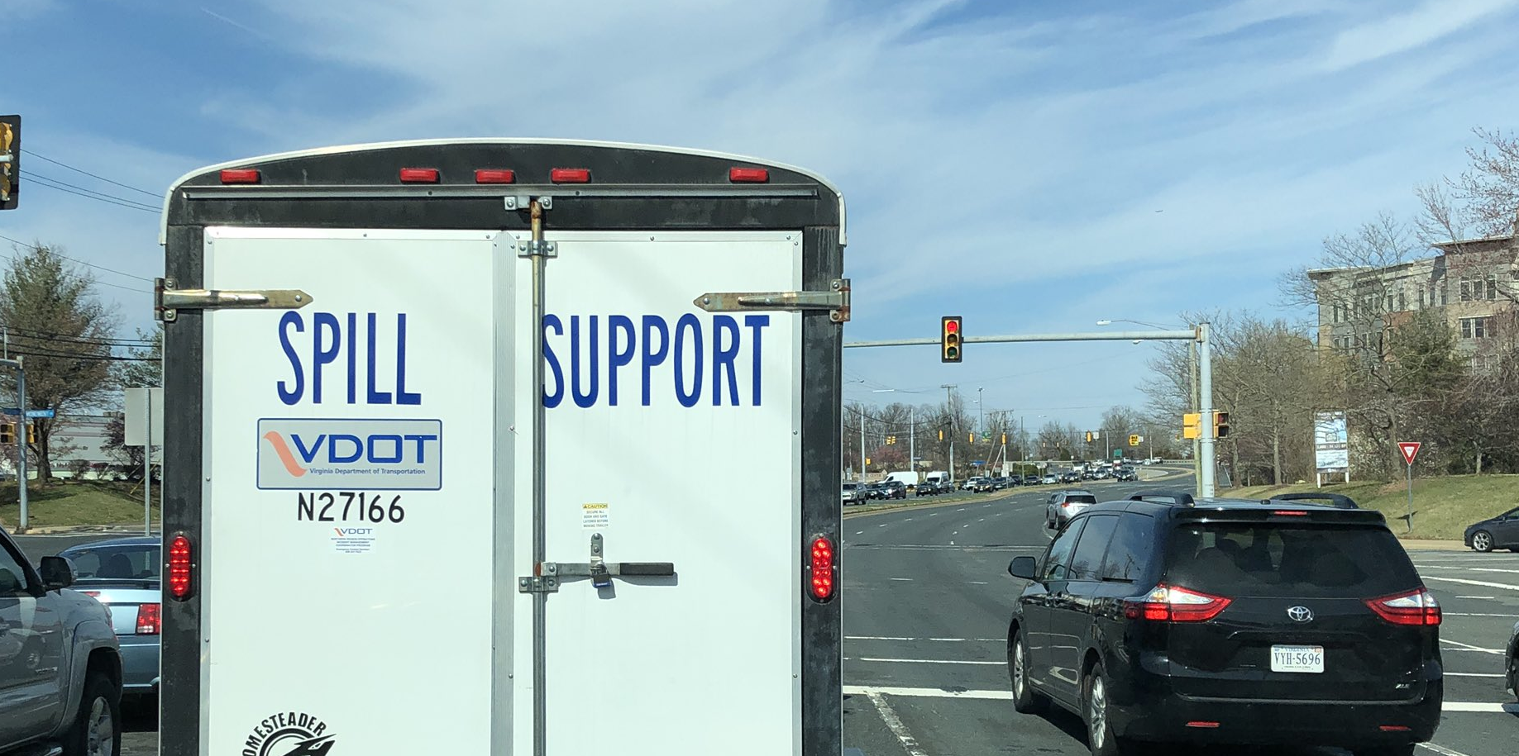
For more information, contact:

Tarin Hutchinson, MATOC Facilitator
Metropolitan Area Transportation Operations Coordination
5000 College Avenue, Suite 3121
College Park, MD 20742
301-405-7841 | taran.hutchinson@matoc.org
RITIS Performance Report

