Slide 1

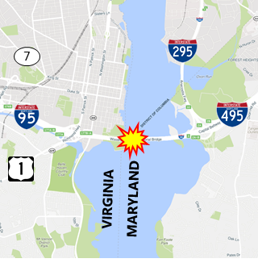





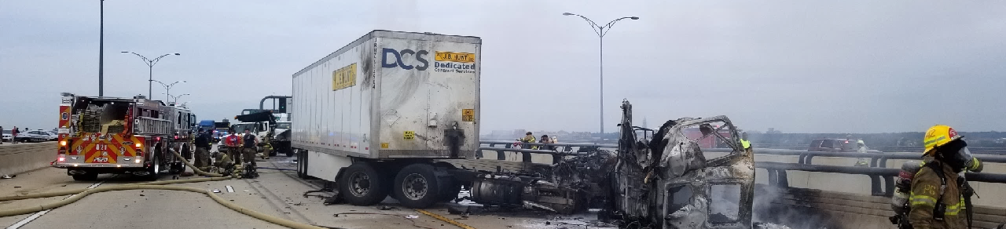
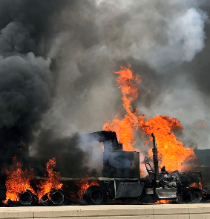
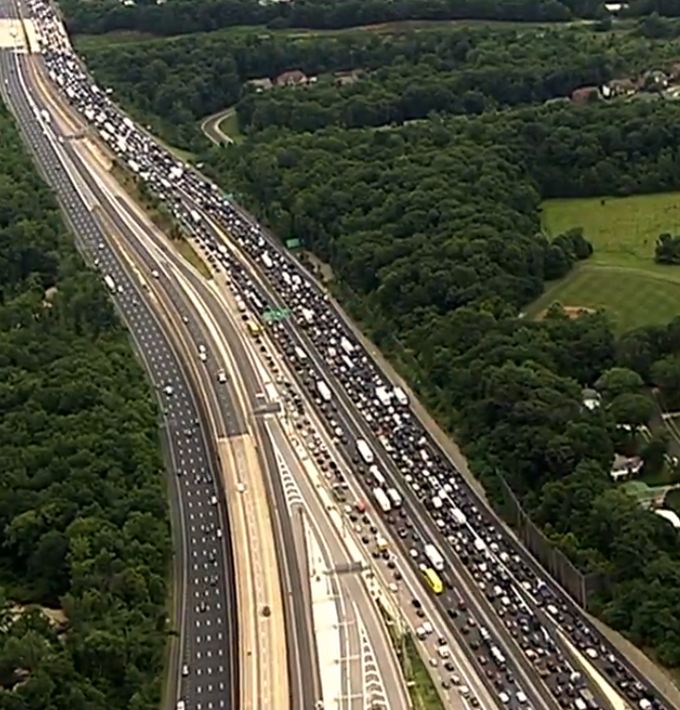
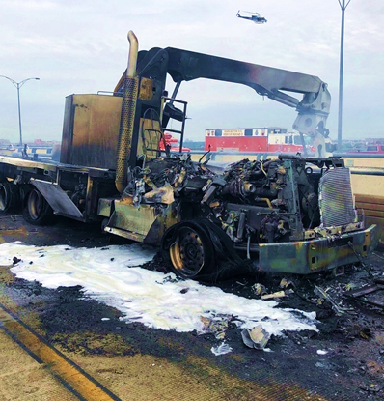






Incident Location
Incident Summary Vehicle Collision & Fire on the Woodrow Wilson Bridge
Occurred on the I-95/495 NB Outer Loop in Prince Georges County, MD • Wednesday, June 20, 2018
The incident occurred at about 10:45 AM, with traffic back to normal about 10:31 PM.
A tractor trailer hit two utility vehicles on the Woodrow Wilson Bridge.
The I-95/I-495 NB Outer Loop on the bridge was closed for 10 hr. 20 min.
17 agencies and over 100 responders actively participated in this operation.
3x to 8x
59K – 74K
(232% - 338%)
$1.79M - $2.22M
(232% - 338%)
One of the utility vehicles caught fire from a fuel leak.
A work crew trapped below the bridge had to be rescued.
There were 12mi backups NB into VA, and 4mi backups SB into MD.
Injuries included:
1 fatality
1 hospitalized
7 treated & released
Increase in travel time on alternate routes for the day of the accident vs typical free-flow conditions.
Increase in vehicle-hours of delay for the region on the day of the accident vs normal June Wednesdays.
Increase in delay cost for the region on the day of the accident vs normal June Wednesdays.

Slide 2

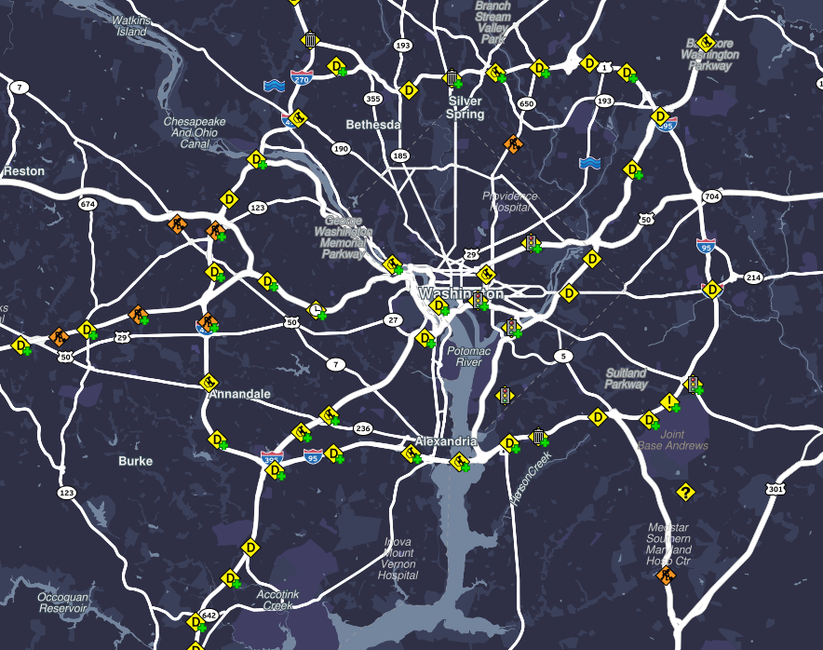
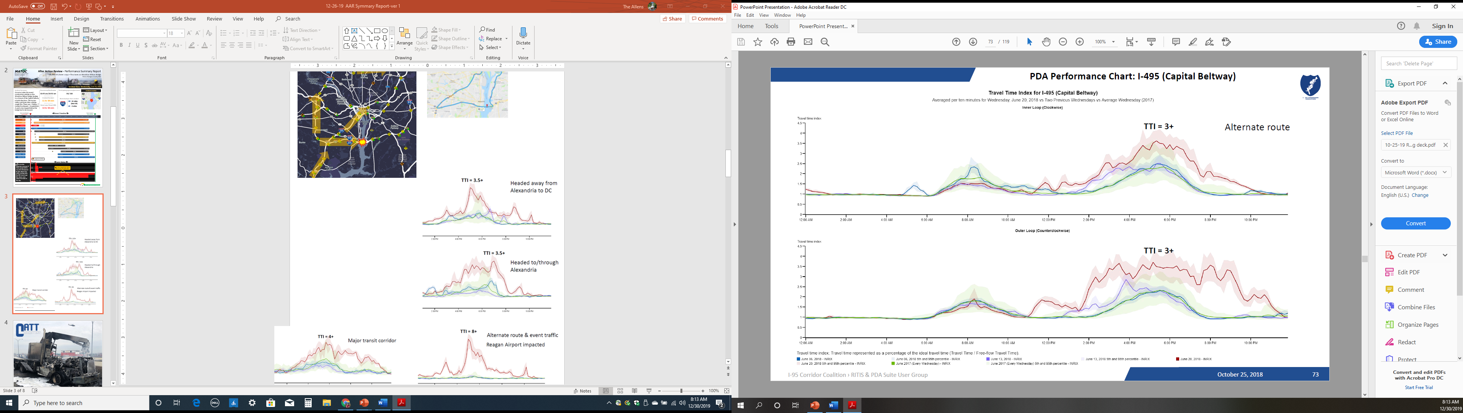
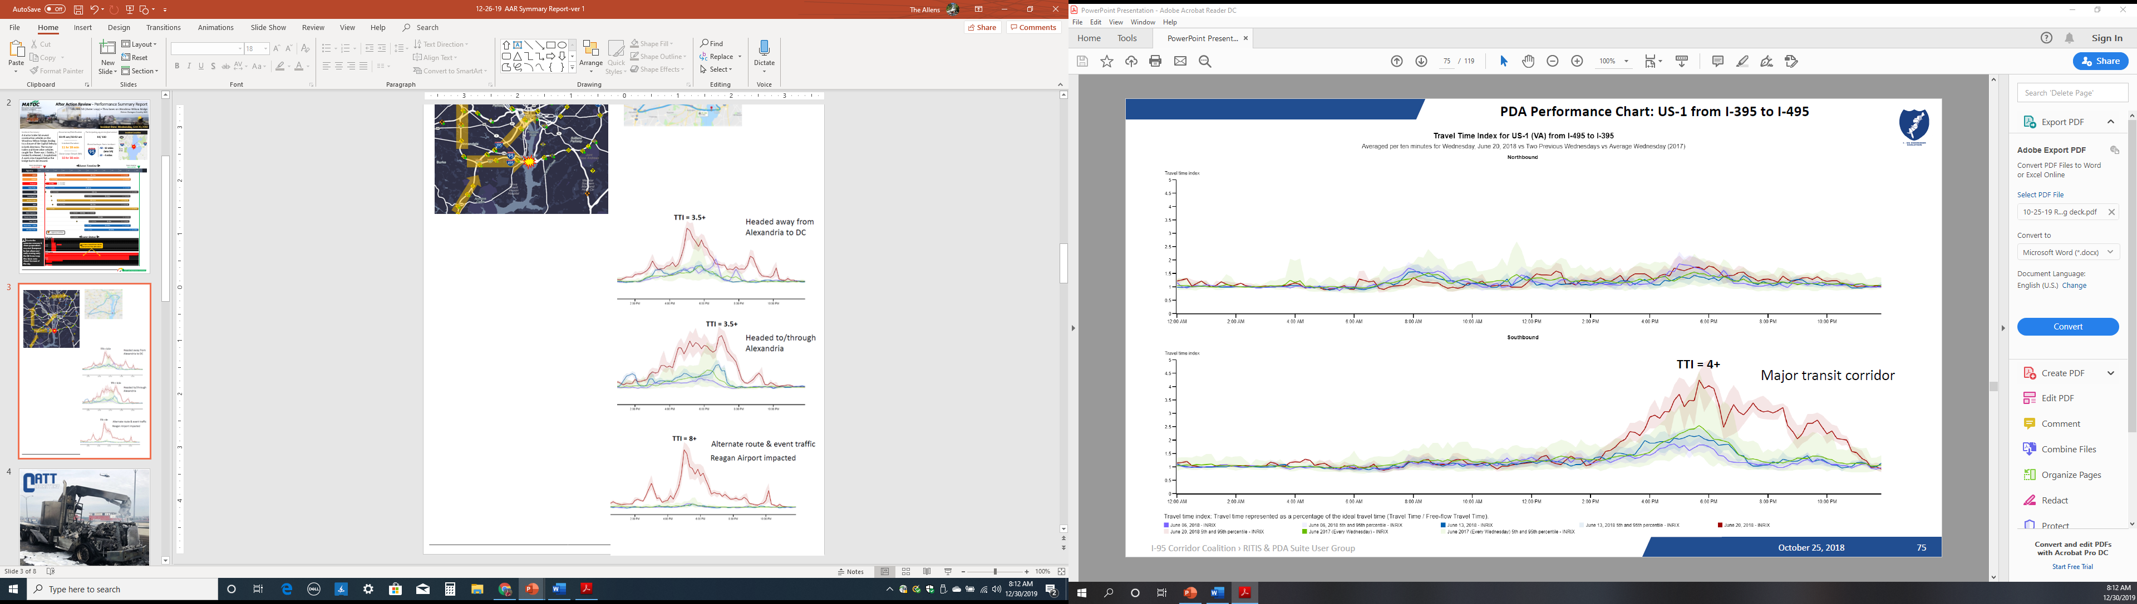




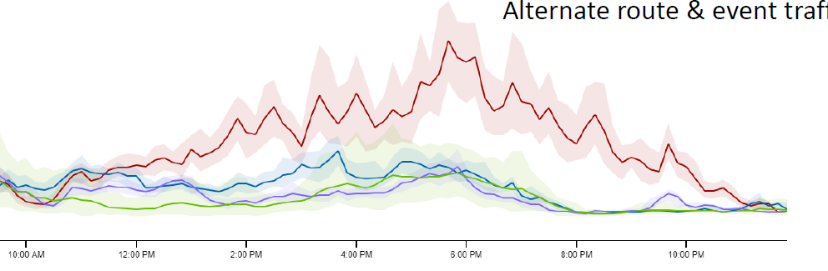
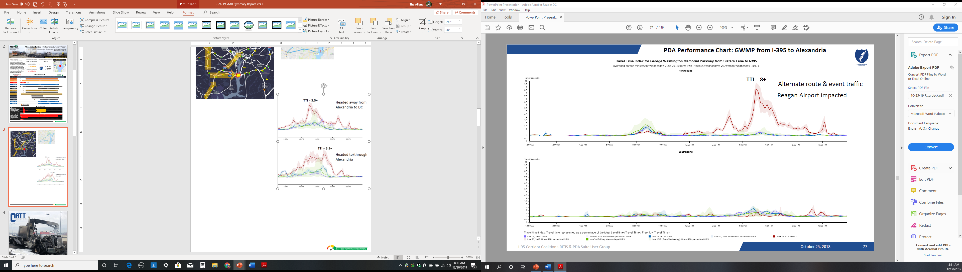
Regional Impact
Vehicle Collision & Fire on the Woodrow Wilson Bridge
I-95/495 NB Outer Loop in Prince Georges County, MD • Wednesday, June 20, 2018
Secondary Incidents
Travel Time Index (TTI) Comparisons
I-495 (Capital Beltway)
US-1 (VA, from I-495 to I-395)
A significant number of secondary incidents occurred in the area, primarily due the stop-and-go nature of the queued traffic at the incident site and heavy congestion on alternate routes used to bypass the WWB closure.
TTI = 3+
Outer Loop
TTI = 4+
Major Transit Corridor
Select example increases in travel time on alternate routes for the day of the accident compared to typical free-flow conditions.
I-395 (from 3rd St. Tunnel to I-495)
George Washington Memorial Pkwy. (from Slater Ln. to I-395)
TTI = 6+
Event Traffic
TTI = 8+
Event Traffic / Reagan Airport impacted
- June 6, 2018
- June 13, 2018
- June 20, 2018
- June 2017 (every Wednesday)
NOTE: Light colored bands - 5th / 95th Percentile
User Delay Cost Comparisons
National Capital Region | WWB Event Extended Impacts (8:00 PM EST)
Wed., June 13th
Wed., June 20th 2018
Wed., June 27th
June 6, 2018
June 13, 2018
June 20, 2018
Substantial increases in delay cost and hours of delay for the region on the day of the accident versus normal June Wednesdays.
Delay Cost
Two previous Wednesdays show minimal traffic in the NCR at 8:00 PM, but on 6/20, regional traffic impacts remained substantial, even almost 10 hr.
after the accident.
Delay Cost
Delay Cost
$1,359,734
$3,153,861
$933,589
Hours of Delay
Hours of Delay
Hours of Delay
55,159 person-hrs.
127,939 person-hrs.
37,872 person-hrs.
45,028 vehicle-hrs.
104,440 vehicle-hrs.
30,916 vehicle-hrs.
Delay per VMT
Delay per VMT
0.73 min/mi
Delay per VMT
0.50 min/mi
1.75 min/mi

Slide 3
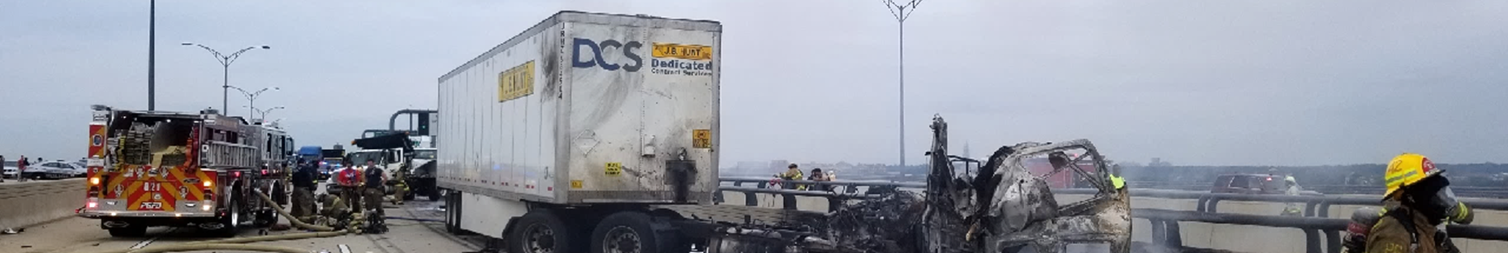






Incident Location
Incident Summary Vehicle Collision & Fire on the Woodrow Wilson Bridge
Occurred on the I-95/495 NB Outer Loop in Prince Georges County, MD
Incident Timeline
Wednesday, June 20, 2018
ALL TRAFFIC LANES OPEN
Begin
End
10:45 am
A tractor-trailer lost control and hit two vehicles on the bridge.
10:52 am
The Incident was reported.
10:53 am to 2:55 pm
Over 100 personnel from 17 agencies were dispatched to the scene.
10:56 am to 4:16 pm
Extensive recovery & cleanup closed the NB Outer Loop thru lanes for most of the day.
Efforts were hampered by late afternoon / early evening rain.
9:23 pm
The cleanup operations were completed.
10:31 pm
Incident closed & roadway reopened.
3x to 8x
59K – 74K
(232% - 338%)
$1.79M - $2.22M
(232% - 338%)
One of the utility vehicles caught fire from a fuel leak.
A work crew trapped below the bridge had to be rescued.
There were 12mi backups NB into VA, and 4mi backups SB into MD.
Injuries included:
1 fatality
1 hospitalized
7 treated & released
Increase in travel time on alternate routes for the day of the accident vs typical free-flow conditions.
Increase in vehicle-hours of delay for the region on the day of the accident vs normal June Wednesdays.
Increase in delay cost for the region on the day of the accident vs normal June Wednesdays.

Slide 4
Regional Impact
Vehicle Collision & Fire on the Woodrow Wilson Bridge
I-95/495 NB Outer Loop in Prince Georges County, MD • Wednesday, June 20, 2018
Secondary Incidents
Travel Time Index (TTI) Comparisons
I-495 (Capital Beltway)
US-1 (VA, from I-495 to I-395)
A significant number of secondary incidents occurred in the area, primarily due the stop-and-go nature of the queued traffic at the incident site and heavy congestion on alternate routes used to bypass the WWB closure.
TTI = 3+
Outer Loop
TTI = 4+
Major Transit Corridor
Select example increases in travel time on alternate routes for the day of the accident compared to typical free-flow conditions.
I-395 (from 3rd St. Tunnel to I-495)
George Washington Memorial Pkwy. (from Slater Ln. to I-395)
TTI = 6+
Event Traffic
TTI = 8+
Event Traffic / Reagan Airport impacted
- June 6, 2018
- June 13, 2018
- June 20, 2018
- June 2017 (every Wednesday)
NOTE: Light colored bands - 5th / 95th Percentile
User Delay Cost Comparisons
National Capital Region | WWB Event Extended Impacts (8:00 PM EST)
Wed., June 13th
Wed., June 20th 2018
Wed., June 27th
June 6, 2018
June 13, 2018
June 20, 2018
Substantial increases in delay cost and hours of delay for the region on the day of the accident versus normal June Wednesdays.
Delay Cost
Two previous Wednesdays show minimal traffic in the NCR at 8:00 PM, but on 6/20, regional traffic impacts remained substantial, even almost 10 hr.
after the accident.
Delay Cost
Delay Cost
$1,359,734
$3,153,861
$933,589
Hours of Delay
Hours of Delay
Hours of Delay
55,159 person-hrs.
127,939 person-hrs.
37,872 person-hrs.
45,028 vehicle-hrs.
104,440 vehicle-hrs.
30,916 vehicle-hrs.
Delay per VMT
Delay per VMT
0.73 min/mi
Delay per VMT
0.50 min/mi
1.75 min/mi

Slide 5
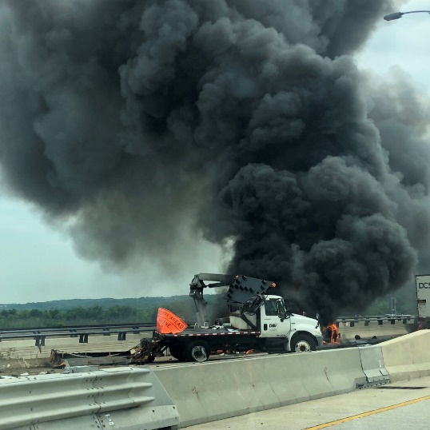
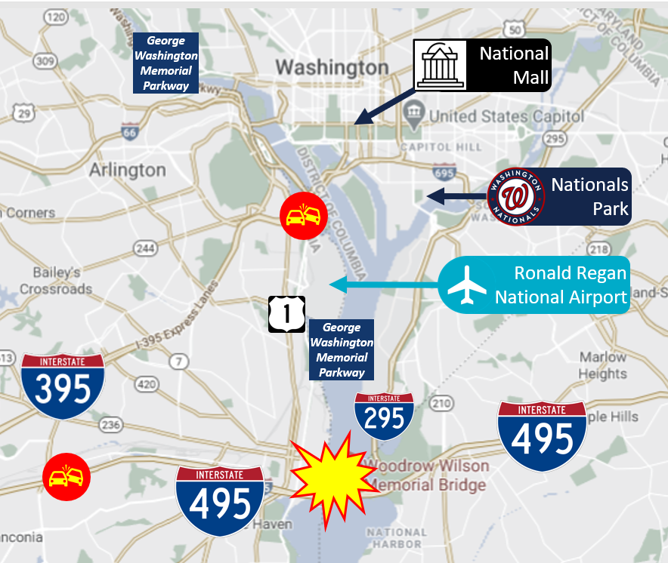







Incident Summary
Vehicle Collision & Fire on the Woodrow Wilson Bridge
I-95/495 NB Outer Loop in Prince Georges County, MD • Wednesday, June 20, 2018
What Happened
Event Timeline
Area of Impact
Response / Regional Impacts
A tractor trailer hit two construction vehicles on the Woodrow Wilson Bridge, leading to a closure of the Capital Beltway (primarily NB) for an extended period. A late afternoon / early evening rainfall hindered cleanup efforts. There were numerous secondary incidents in the queued traffic and on alternate routes.
Occurrence/Notification
10:45 am/10:52 am
Participating agencies/personnel
17/ 100+
Incident Duration
Major regional impacts from diverted traffic
11 h 39 m
Ronald Reagan Washington National Airport, Alexandria, the District of Columbia, transit corridors and two planned events in the area:
Midday Rally/March – near the National Mall & Pennsylvania Ave (5,000+ attendees)
Evening MLB Event –Orioles at Nationals in
Nationals Park (41,000+ expected attendees)
NB Outer Loop Closed
10 h 20 m
Secondary incidents
Alternate Route / Regional Roadway Network Performance Impacts
A Sequence of Events Pictorial
3x to 8x
59K – 74K
(232% - 338%)
$1.79M - $2.22M
(232% - 338%)
(greater Travel Time Index)
One of the utility vehicles caught fire from a fuel leak.
A work crew trapped below the bridge had to be rescued.
Increase in travel time on alternate routes for the day of the accident vs typical free-flow conditions.
Increase in vehicle-hours of delay for the region on the day of the accident vs normal June Wednesdays.
Increase in delay cost for the region on the day of the accident vs normal June Wednesdays.
There were 12mi backups NB into VA, and 4mi backups SB into MD.
Injuries included:
1 fatality
1 hospitalized
7 treated & released

Slide 6

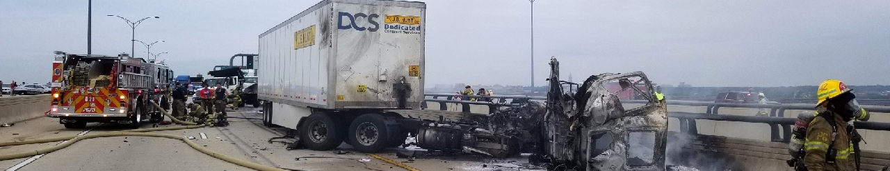
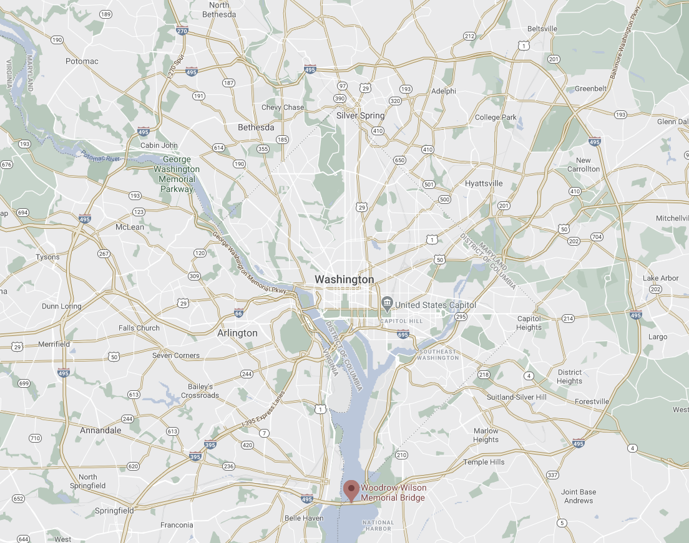
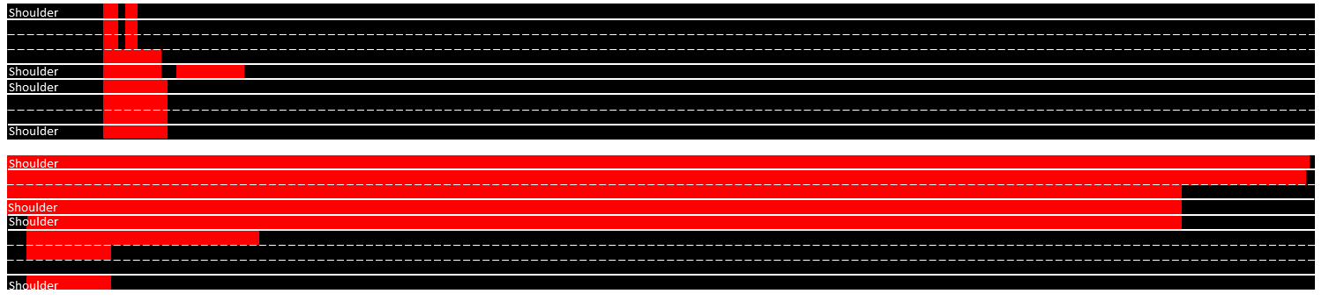







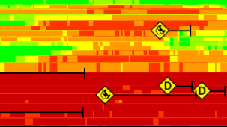




Event Summary
After Action Review - Performance Summary Report
Lane Status
A tractor trailer hit several construction vehicles on the Woodrow Wilson Bridge, leading to a closure of the Capital Beltway (primarily NB). The tractor-trailer and three other vehicles caught fire. There was 1 fatality, 7 treated & released, 1 hospitalized. A work crew trapped below the bridge had to be rescued.
I-95/495 NB (Outer Loop) • Thru lanes on Woodrow Wilson Bridge
Prince Georges County, MD
Due to the extensive recovery & cleanup operations required (hampered by late afternoon/ early evening rain), the NB Outer Loop thru lanes were closed for most of the day - from 11:03 AM to 9:23 PM (10h 20m).
Incident Date: Wednesday, June 20, 2018 | Occurrence/Notification: 10:45 am/10:52 am | Duration: 11h 39m
ALL LANES CLOSED
STAY ALERT
Some Key Aspects
User Delay Cost Comparisons
Delay Cost
% Increase
For the region on this day
compared to typical Wednesdays
Participating agencies/personnel
Region of Impact
$3,153,861
285% 
17/ 100+
Hours of Delay
% Increase
For the region on this day
compared to typical Wednesdays
127,939 per.-hrs.
285% 
Worst backups from incident
104,440 veh.-hrs.
295% 
NB 12 miles (into VA)
SB 4 miles (into MD)
George Washington Memorial Parkway
National
Mall
Other Regional Impacts
Backups of 8 miles were common, increasing at times to 12 miles. There were numerous minor secondary incidents in the queued traffic (worst hours shown below).
Significant Impacts were also felt around Ronald Reagan Washington National Airport, Alexandria, the District of Columbia, major transit corridors (particularly along Route 1) and two planned events in the area:
Midday Rally/March near the National Mall & Pennsylvania Ave
(5,000+ attendees)
The Baltimore Orioles at Washington Nationals in Nationals Park (41,000+ attendees, late afternoon /
early evening)
Nationals
Park
Ronald Regan National Airport
4:45 pm
5:45 pm
6:45 pm
George Washington Memorial Parkway
National
Mall
12mi
8mi
Nationals
Park
EVENT
Travel Time Index of Alternate Routes
< 10 mph
10-20 mph
20-30 mph
30-40 mph
Incident Location
3+
3.5+
4+
6+
8+
Areas of secondary incidents
40-50 mph
> 50 mph
(Travel Time / Free-flow Travel Time)

Slide 7

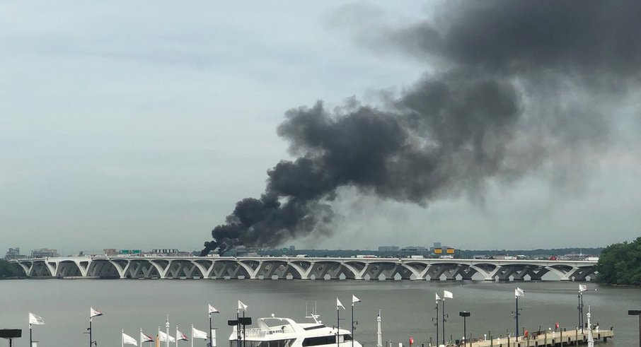
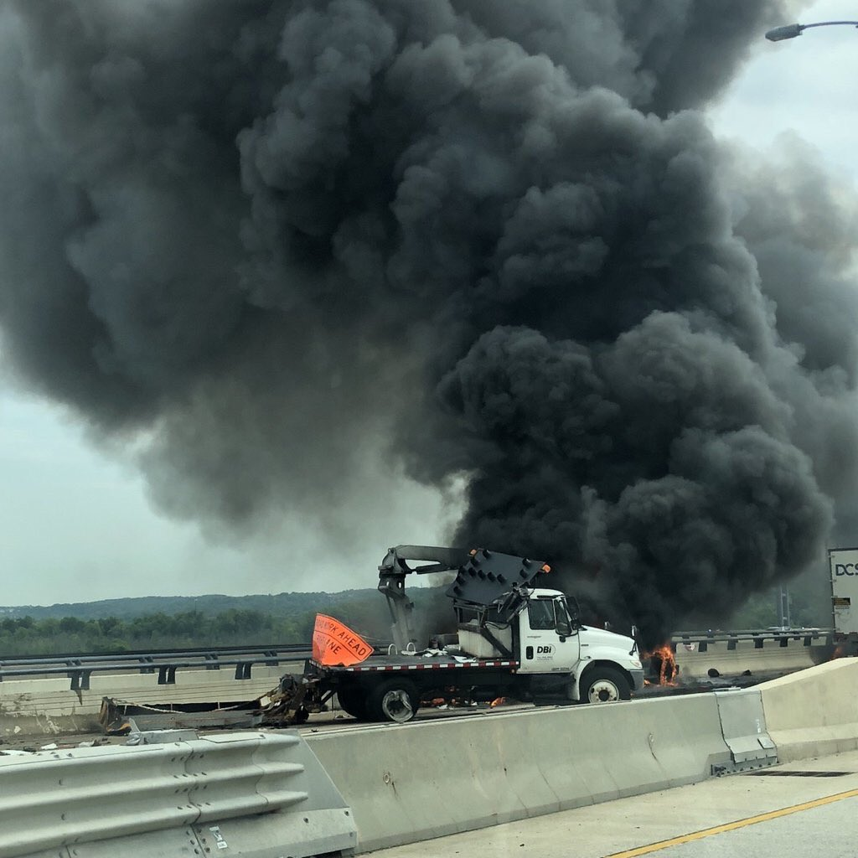



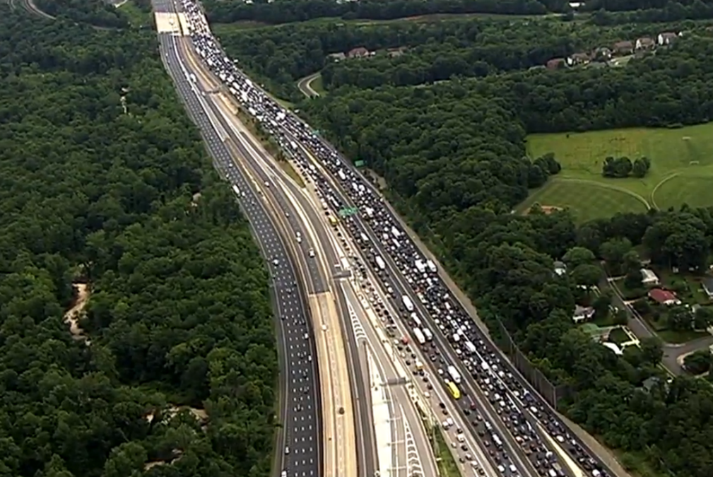


Event Photos
After Action Review Takeaways
What worked well?
Overall, the response was a success given the complicated nature of the incident; there were no single points of failure.
What needs improvement?
Some DOT response trucks could have been delayed in responding to the incident given they are not classified as emergency response vehicles.
Delays in opening retractable barriers to bleed off queued traffic led to additional delays in opening lanes.
Queued motorists upstream from the incident sometimes self-diverted, often reversing down on-ramps which created additional hazards; other factors to consider are knowledge of alternate routes and the influence of personal navigation devices.
There were numerous minor secondary incidents in queued traffic, including an increase in incidents on roadways that served as alternate routes.
Local transit bus operations in the area were severely impacted (but rail services served as a good alternate).
Recommendations
Examine Unified Command & Command Post locations as they related to the WWB
Regularly train responders on how to operate and open the retractable barriers to address staff turnover (and get the barrier(s) back into a state of good repair)
Explore opportunities to conduct bridge related training for DOTs and responders
Expand TMARS access to select field users like Incident Management Coordinators
Consider periodic reporting via conference calls for major incidents
Update and share Maryland and Virginia FITM plans; including updates in RITIS
Explore conducting a broader multi-jurisdiction/multi-discipline AAR for this incident
Next Steps
Develop an on-going and comprehensive training program for transportation agencies – DOTs, transit, etc. – law enforcement, fire, safety, contractors and others that focuses on high-profile facilities and catastrophic events. Investigate Virtual Incident Management Training to supplement and enhance traditional training methods.

