Slide 1
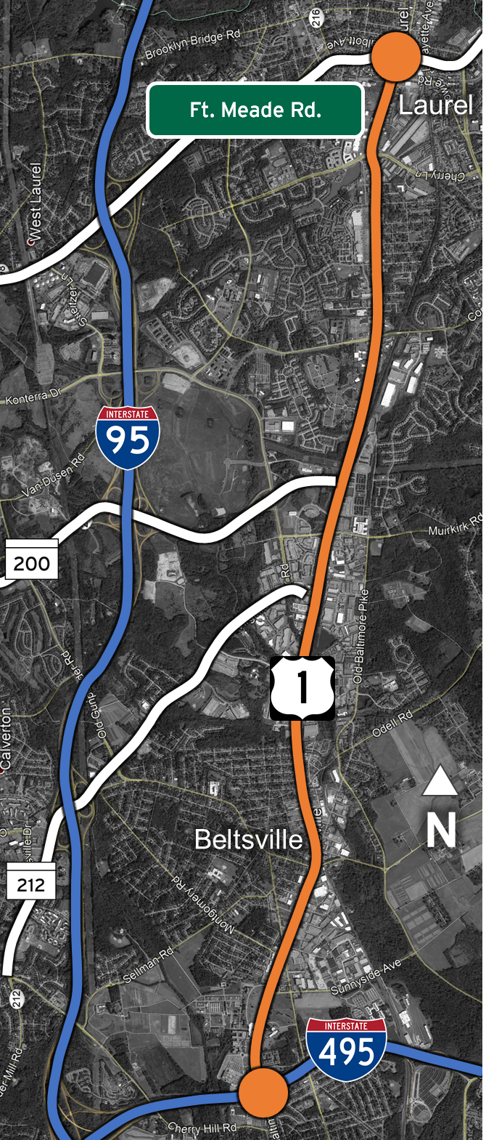
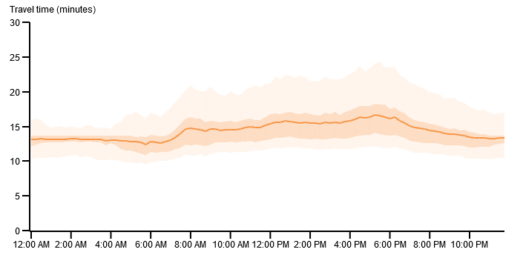
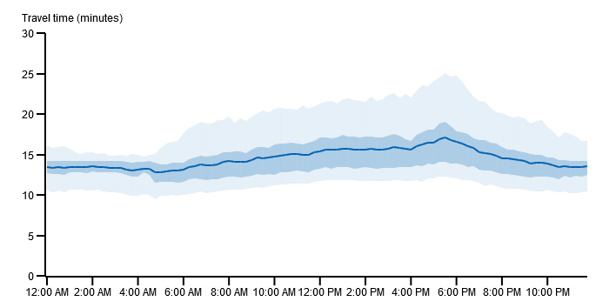
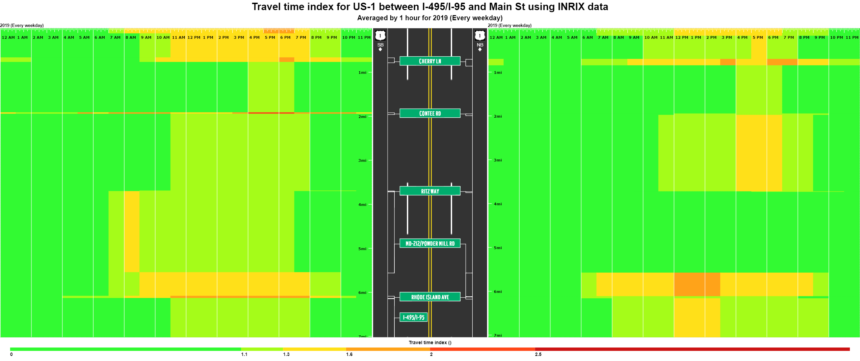
Corridor Performance Report
I-495 to Fort Meade Rd.
Year
2019
2019 Corridor Travel Times
Weekday travel times for the US-1 corridor were aggregated over the entire year and are presented below. This corridor does not exhibit a clear peak travel direction in either the AM or PM peak periods. Instead, the PM peak travel times are consistently higher than the AM peak travel times. In each direction, the average PM peak travel time is approximately 3 minutes longer than the AM peak period travel time, with the planning time being approximately 4 minutes longer. The heat map at the bottom of the page shows the geographic location of typical congestion through the day.
Region of Study:
US-1 between I-495 and Fort Meade Rd.
Southbound
Northbound
U.S. Highway 1 is the primary north-south corridor connecting Beltsville and Laurel, Maryland. This portion of US-1 is paralleled by Interstate 95 to the west and the Baltimore Washington Parkway to the east. All three of the routes connect Washington, DC and Baltimore, MD.
This seven-mile section of US-1 between I-495 and Fort Meade Rd. is mostly a four-lane undivided highway. Some sections are four-lane divided, four lane with bi-directional median turns, and six-lane divided.
Average bidirectional weekday daily traffic for this section of highway in 2018 ranged from 41,000 near I-495 to 35,500 in Laurel to 31,500 between MD-200 and MD-212.
AM Peak
Avg Travel Time = 13.7 mins
Planning Time = 19.1 mins
AM Peak
Avg Travel Time = 13.8 mins
Planning Time = 19.0 mins
PM Peak
Avg Travel Time = 16.2 mins
Planning Time = 23.1 mins
PM Peak
Avg Travel Time = 16.3 mins
Planning Time = 23.8 mins
6 AM – 9 AM
4 PM – 7 PM
6 AM – 9 AM
4 PM – 7 PM
Travel Time Index
B
E
F
A
C
D
Purpose of Study:
This annual study examines the yearly performance of this critical business corridor and compares it to performance in previous years.
Locations of Typical Slow Downs (SB)
Locations of Typical Slow Downs (NB)
A: 8AM – 9AM : Ritz Way to Powder Mill Rd.
B: 11AM – 8PM : Ft. Meade Rd. to Cherry Ln.
C: 9AM – 8PM : Powder Mill Rd. to Rhode Island Ave.
D: 7AM – 9PM : Rhode Island Ave. to Powder Mill Rd.
E: 8AM – 10PM : at Cherry Ln.
F: 4PM – 7PM : Ritz. Way to Contee Rd.

Slide 2
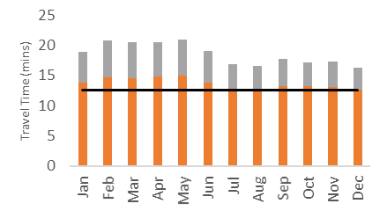
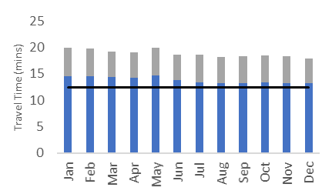
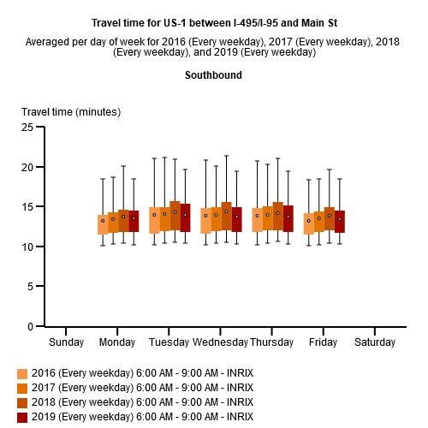
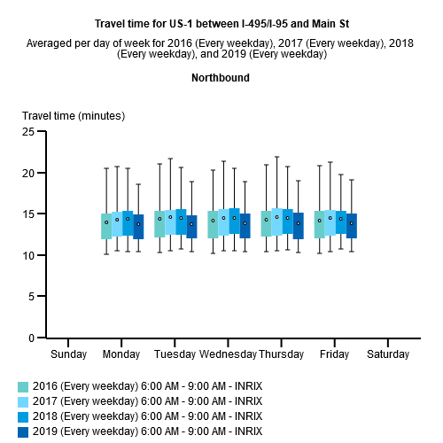
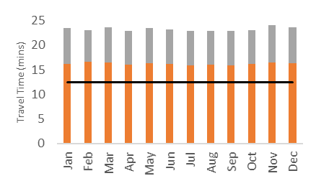
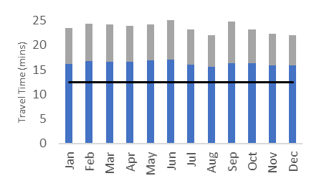
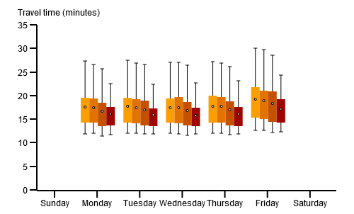
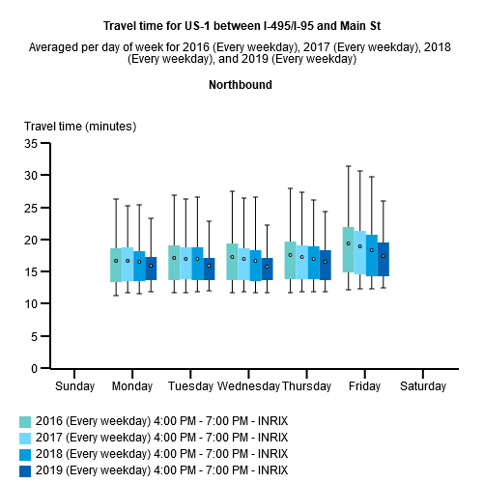
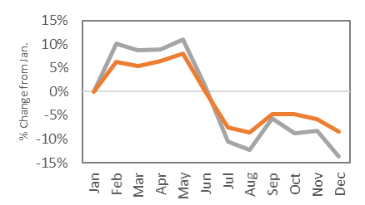
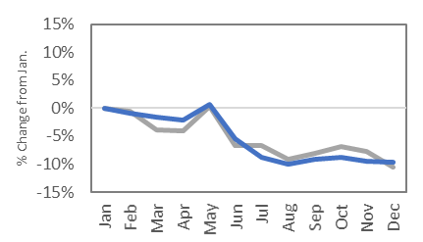
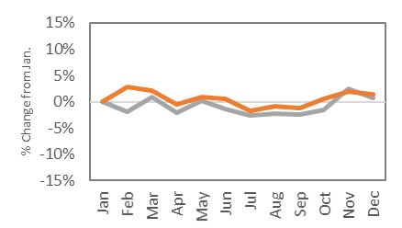
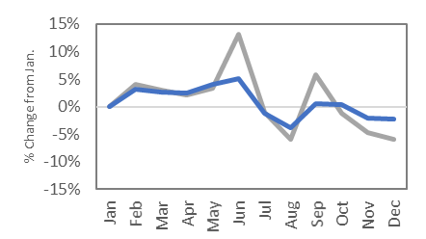
Travel times through the year
Comparison with previous years
How much did travel times change over the course of 2019? This depends on time of day and direction of travel. The bar charts show monthly travel times by peak period and direction. The line charts show the percentage change in travel times as compared with January 2019.
How much did travel times change compared with previous years? In the AM peak period, average travel times and travel time reliability were fairly constant from 2016 to 2019.
Southbound
Northbound
Southbound
Northbound
A
Stable
B
Stable
AM Peak
6AM – 9AM
AM Peak
6AM – 9AM
PM Peak
4PM – 7PM
C
Improving
D
Improving
Free flow Travel Time
Free flow Travel Time
Average Travel Time
Average Travel Time
Planning Travel Time
Planning Travel Time
PM Peak
4PM – 7PM
A
B
Consistent
June Transition
AM Peak
6AM – 9AM
A: Travel time and reliability remained stable and relatively constant over the past four years in the southbound direction during the AM peak period. B: In the AM peak period northbound direction, travel times and reliability were relatively constant from 2016 – 2018, with a slight improvement in 2019. /
In the PM peak period, a steady improvement in travel times and reliability has been seen over the years 2016 – 2019, with a stepwise improvement for some days in 2019.
%
A
B
C
D
C
D
Consistent
More Variable
PM Peak
4PM – 7PM
95th
Converging whiskers denote improving reliability
The box plot presents a simplified distribution of the range of travel times throughout the period of interest, based on percentiles.
75th
Observations
A: In the southbound AM peak period, travel times increased Feb. to May, then dropped below January levels from July to Dec. B: In the northbound direction during the AM peak period, travel times were mostly constant through May, then decreased June to Dec. C: Travel times in the southbound PM peak direction remained relatively constant throughout 2019. D: Travel times in the northbound PM peak direction were more variable, becoming more unpredictable between June and Dec.
AVG
Reduced average travel time denotes improving typical conditions
A
B
25th
C
D
5th

Slide 3
Another option

Slide 4
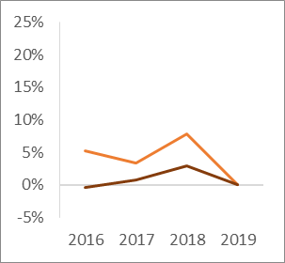
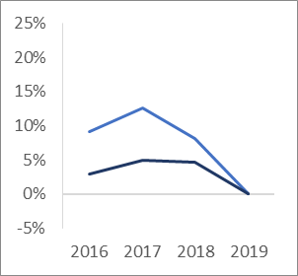
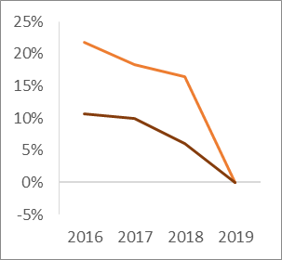
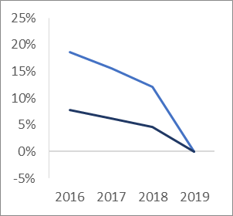
Corridor Performance Report
I-495 to Fort Meade Rd.
Year
2019
How much did travel times change during 2019?
Weekday travel times for the US-1 corridor were aggregated over the entire year and are presented below. This corridor does not exhibit a clear peak travel direction in either the AM or PM peak periods. Instead, the PM peak travel times are consistently higher than the AM peak travel times. In each direction, the average PM peak travel time is approximately 3 minutes longer than the AM peak period travel time, with the planning time being approximately 4 minutes longer. The heat map at the bottom of the page shows the geographic location of typical congestion through the day.
A
B
Consistent
June Transition
AM Peak
6AM – 9AM
Southbound
Northbound
%
AM Peak
Avg Travel Time = 13.7 mins
Planning Time = 19.1 mins
AM Peak
Avg Travel Time = 13.8 mins
Planning Time = 19.0 mins
C
D
Consistent
More Variable
PM Peak
4PM – 7PM
PM Peak
Avg Travel Time = 16.2 mins
Planning Time = 23.1 mins
PM Peak
Avg Travel Time = 16.3 mins
Planning Time = 23.8 mins
Average Travel Time
Planning Travel Time
Average Travel Time
Observations
A: In the southbound AM peak period, travel times increased Feb. to May, then dropped below January levels from July to Dec. B: In the northbound direction during the AM peak period, travel times were mostly constant through May, then decreased June to Dec. C: Travel times in the southbound PM peak direction remained relatively constant throughout 2019. D: Travel times in the northbound PM peak direction were more variable, becoming more unpredictable between June and Dec.
A
B
C
D
6 AM – 9 AM
4 PM – 7 PM
Travel Time Index
6 AM – 9 AM
4 PM – 7 PM
How much did travel times change compared with previous years?
B
E
Southbound
Northbound
AM Peak Travel Times Relatively Stable
/ Slight Improvement
F
AM Peak
6AM – 9AM
Travel time and reliability remained relatively stable over the past four years in during the AM peak period. A slight improvement was noted in the NB direction in 2019.
A
C
D
PM Peak Travel Times Improving
PM Peak
4PM – 7PM
In the PM peak period, a steady improvement in travel times and reliability has been seen over the years 2016 – 2019.
Locations of Typical Slow Downs (SB)
Locations of Typical Slow Downs (NB)
A: 8AM – 9AM : Ritz Way to Powder Mill Rd.
B: 11AM – 8PM : Ft. Meade Rd. to Cherry Ln.
C: 9AM – 8PM : Powder Mill Rd. to Rhode Island Ave.
D: 7AM – 9PM : Rhode Island Ave. to Powder Mill Rd.
E: 8AM – 10PM : at Cherry Ln.
F: 4PM – 7PM : Ritz. Way to Contee Rd.
How to read:
Travel times were 10% higher in 2016 than in 2019

