Slide 1
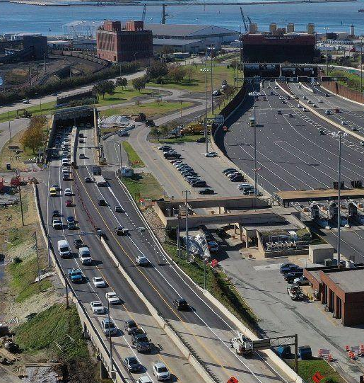



Maryland
Transportation
Authority
CATT Lab Performance Summary
Rehabilitating the Baltimore Harbor Tunnel
Week 3 Work Zone Performance Summary Report

Slide 2
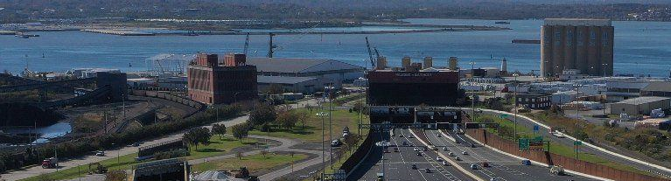



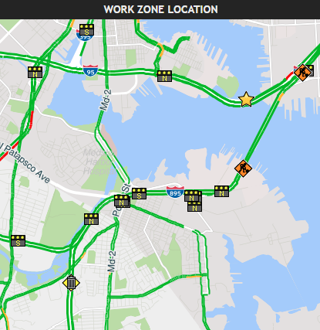



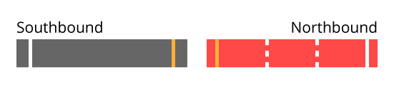










Maryland
Transportation
Authority
Weekly Work Zone Performance Summary Report
I-895 NORTH/SOUTH AT MP 9.4 (BALTIMORE HARBOR TUNNEL)
Started: Apr 16, 2019 Tuesday 9:43 AM
Week 3 05/05/19 – 05/11/19
Work Zone Details
Week 3 Weather
Sun
Mon
Tue
Wed
Thu
Fri
Sat
Improvement Type
Devices
(7.3mi upstream/5.6mi downstream)
Posted Speed
Work Zone Location
Rehabilitating the Harbor Tunnel including repairs to the tunnel portal, approach ramps & walls, deck and tiles
8 DMS (4 NB/4 SB)
4 CCTV (3 NB/1 SB)
45 MPH
Police Enforcement
Operation
Posted WZ Speed
Yes
NB bore closed; 2-way traffic through SB bore
25 MPH
Lane Status
Hours
Actual Speed
24/7
22 MPH
Work Zone Impact
(05/05/19 to 05/11/19)
Longest backup
Slowest speed
Longest travel time
Wednesday, 5/8/19
3.4 mi @ 5:15 PM
Thursday, 5/9/19
4.0 MPH @ 6:24 PM
Thursday, 5/9/19
6m 32s @ 6:20 PM
Traveler Impact
(Tuesday • 05/07/19 • 12 PM - 4 PM)
Delay cost
Hours of delay
Vehicle Miles traveled
$1,302.75 (total)
$0.14 (per VMT)
55h 46m (person-hrs.)
45h 43m (vehicle-hrs.)
7,028 mi (passenger)
878 mi (commercial)
Traffic Trends
(For the life of the project)
Nearby incidents*
Max queue length
User delay cost
To date
53
Last week
14
This week
13
To date
5mi
Last week
2.7mi
This week
3.4mi
Cumulative for the week
$22,330
* - within one mile upstream & downstream of the work zone
Notes: Vigorously continue outreach campaign to inform motorists to avoid I-895 and use I-695 and I-95 as alternative routes, and to pay attention to electronic and static signs for up-to-date travel information.

Slide 3
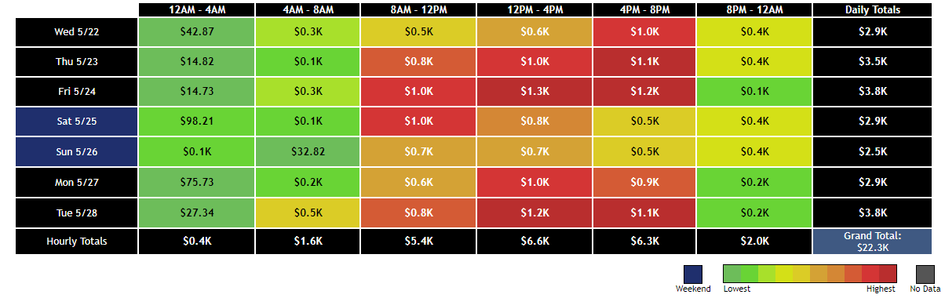
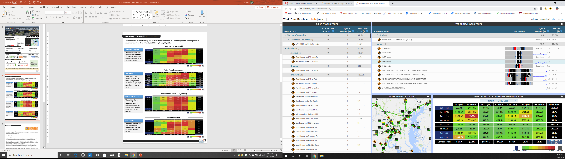
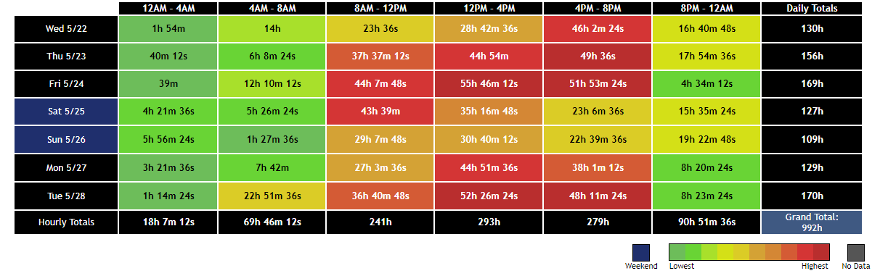
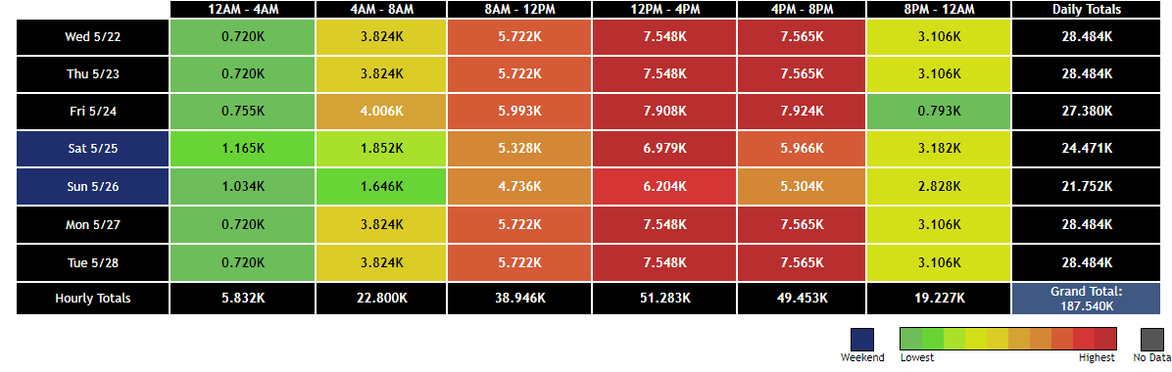
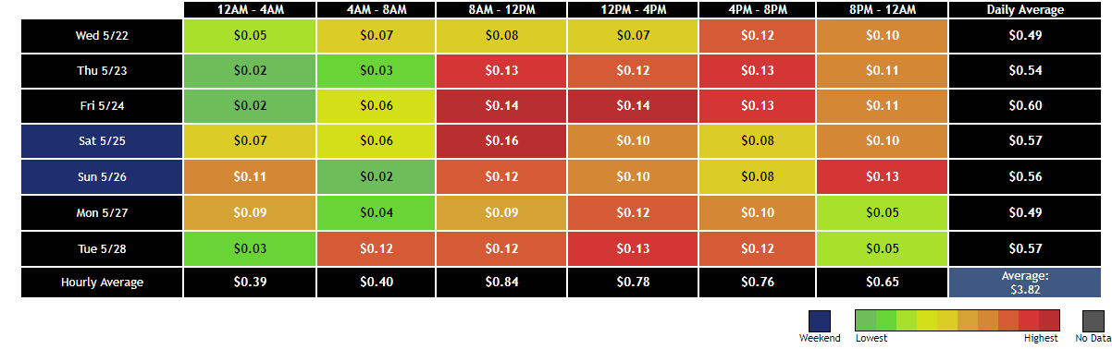
User Delay Cost Detail
(05/05/19 to 05/11/19)
These UDC tables summarize delay and cost-related information in 4-hr time periods, at the Baltimore Harbor Tunnel for the week of May 5, 2019 through May 11, 2019.
Results indicate the most significant overall impacts in user delay cost and delay during Week 3 primarily occurred during the 12PM – 4PM period.
i
Total User Delay Cost ($)
Total User Delay Cost
Sun 5/05
Mon 5/06
12PM – 4 PM Hourly Total
Tue 5/07
Last week
$6.7K
This week
$6.6K
Wed 5/08
Thu 5/09
Fri 5/10
Sat 5/11
Delay cost = delay for the hour times the value of a person's time times the vehicle occupancy
Total Delay (hr, min, sec)
Total Delay
Sun 5/05
Mon 5/06
12PM – 4 PM Hourly Total
Tue 5/07
Last week
286h
This week
293h
Wed 5/08
Thu 5/09
Fri 5/10
Sat 5/11
The extra time spent traveling due to congestion, represented by the total vehicle hours of delay
Vehicle Miles Traveled (1,000 mi)
Vehicle Miles Traveled
Sun 5/05
Mon 5/06
12PM – 4 PM Hourly Total
Tue 5/07
Last week
53,377
This week
51,283
Wed 5/08
Thu 5/09
Fri 5/10
Sat 5/11
VMT = the hourly volume of the segment times the length of the segment
Cost per VMT ($)
Cost per VMT
Sun 5/05
12PM – 4 PM Hourly Avg.
Mon 5/06
Tue 5/07
Last week
$0.80
This week
$0.78
Wed 5/08
Thu 5/09
Fri 5/10
Sat 5/11
The costs per VMT represent an average value over the region and analysis period.

Slide 4
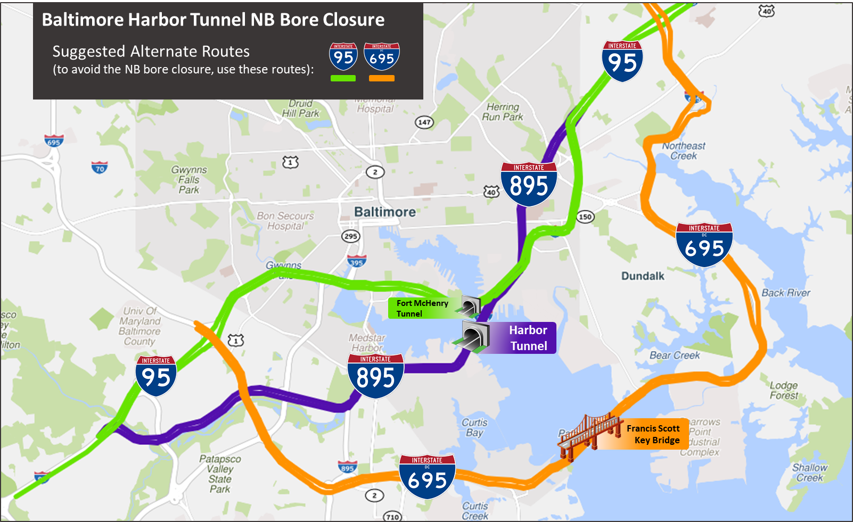


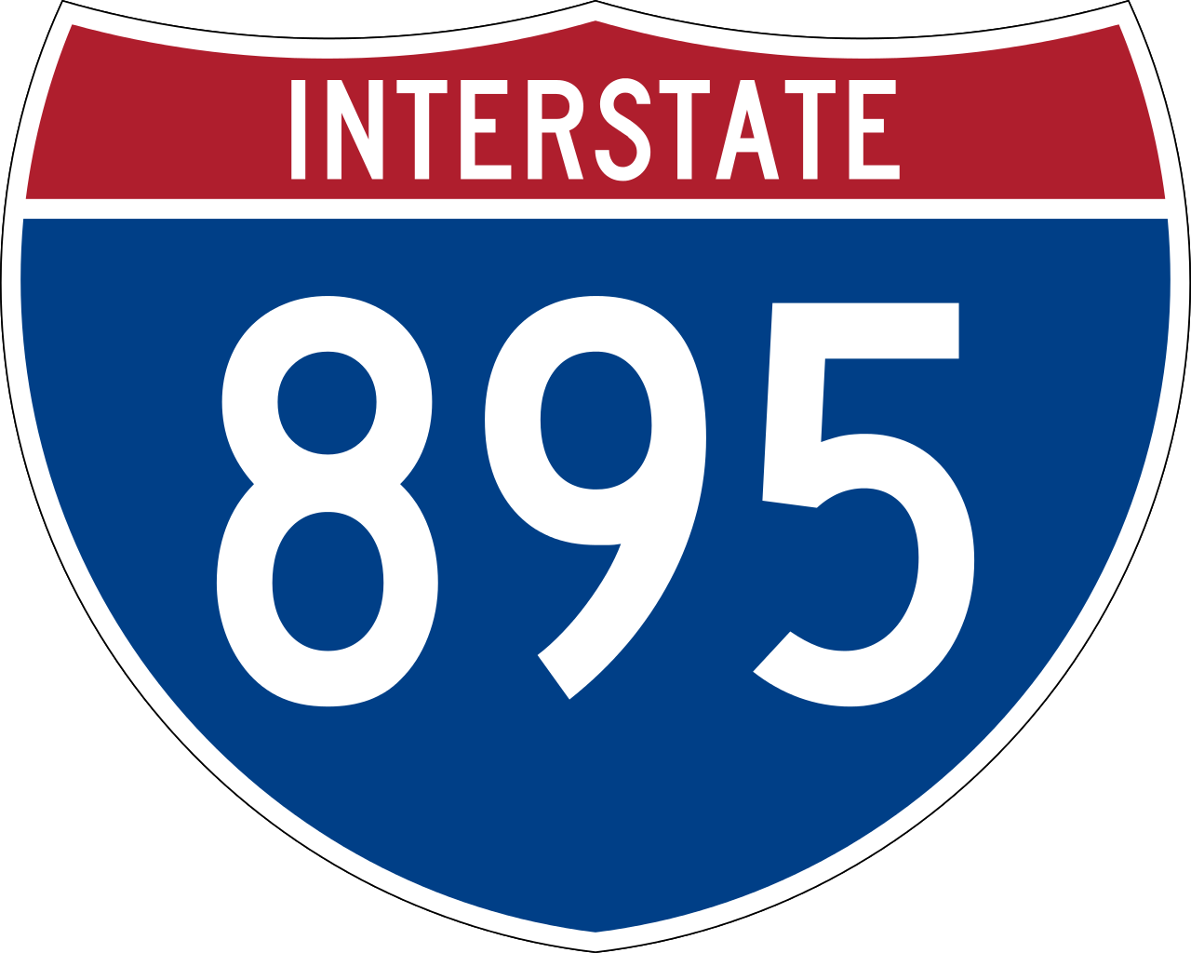
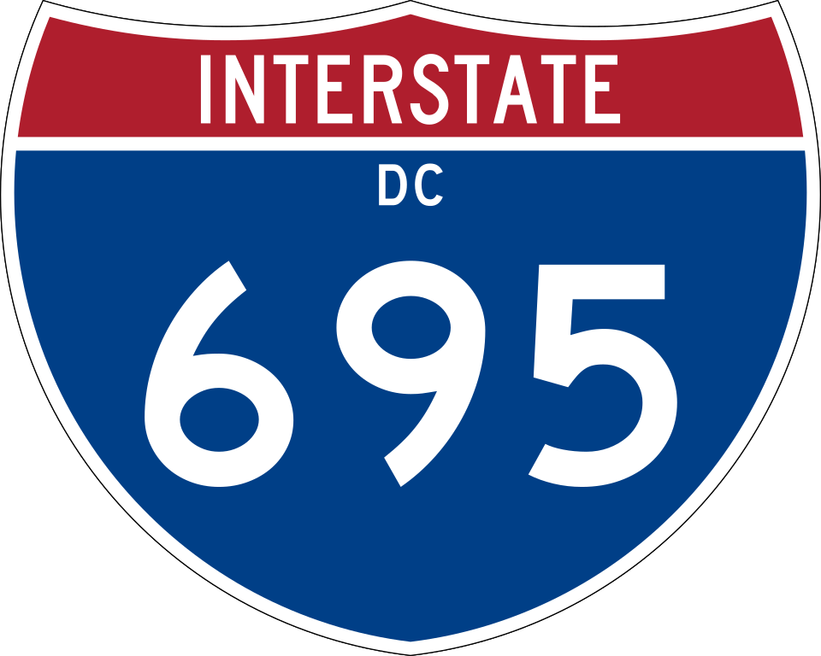
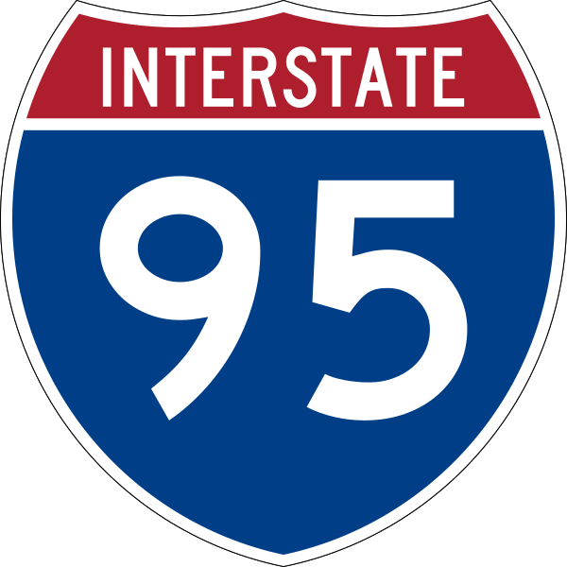
Alternate Route Speed Comparison
The table below summarize speed comparisons between I-895 and two alternate routes – I-95 and I-695 – for one year before the bore closure, one week before and Week 3 after the closure.
i
Results show some apparent shifts in traffic to I-695 (21% speed drop) and I-95 (17% drop) a
week before, and after the NB bore closure, indicating some success in alternate route use PR.
Mainline/Alternate Route Screen line - Average Speed Comparisons (Northbound Direction)
Route
Year Before Closing
(April 5, to April 11, 2018)
Week Before Closing
(April 5 to April 11, 2019)
Week 3 After Closing
(May 5 to May 11, 2019)
Insight
8:00am
5:00pm
8:00am
5:00pm
8:00am
5:00pm
Speed drop of 19% in AM PK HR; PM PK HR speeds relatively stable, even though closure reduced NB lanes from 2 to 1 (i.e.; 2-way traffic in SB bore).
36 mph
18 mph
31 mph
20 mph
29 mph
18 mph
@ Baltimore Harbor
Tunnel
8:00am
5:00pm
8:00am
5:00pm
8:00am
5:00pm
Speed drop of 21% in the PM PK HR, indicating possible traffic shifting form I-895; AM PK HR speeds relatively stable.
51 mph
54 mph
52 mph
43 mph
53 mph
43 mph
@ Francis Scott Key Bridge
8:00am
5:00pm
8:00am
5:00pm
8:00am
5:00pm
Speed drop of 17% in the AM PK HR, indicating possible traffic shifting form I-895; PM PK HR speeds relatively stable.
59 mph
32 mph
49 mph
35 mph
48 mph
32 mph
@ Fort McHenry
Tunnel

Slide 5



Reliability Comparison
The graphics below summarize reliability comparisons between I-895 and two alternate routes – I-95 and I-695 –Week 3 after the closure to the week before.
i
Results show little change in overall Travel Time, moderate change in Buffer Time and slight change in Planning Time between Week 3 (May 5th-11th) when compared to the previous week.
Week 3 vs the Week Before
Travel Time
Buffer Time
Planning Time
NB
0%
+11%
+4%
Increase in
weekday travel time
Increase in
weekday buffer time
Increase in
weekday planning time
Week 3 vs the Week Before
Travel Time
Buffer Time
Planning Time
NB
+2%
+13%
+4%
Increase in
weekday travel time
Increase in
weekday buffer time
Increase in
weekday planning time
Week 3 vs the Week Before
Travel Time
Buffer Time
Planning Time
NB
+1%
+9%
+4%
Increase in
weekday travel time
Increase in
weekday buffer time
Increase in
weekday planning time
Travel Time - the time it takes to drive along a stretch of road
Buffer Time - the extra time you must add to a trip to ensure an on-time arrival
Planning Time - the total time you should allow to ensure on-time arrival

Slide 6
Press Release
MAJOR ROAD WORK COMING TO I-895 IN BALTIMORE
The MDTA’s $189 million I-895 Bridge Project will replace the I-895 bridge located north of the Harbor Tunnel. Work includes replacing the Holabird Avenue exit ramp and rehabilitating the Harbor Tunnel, including repairs to the tunnel portal, approach ramps and walls, deck and tiles. Tutor Perini Corporation is performing the work. The project began in April 2018 and is expected to be completed in summer 2021.
As part of the event, the MDTA announced that major impacts from two other projects in Baltimore will end before major impacts begin on I-895.
A $49.4 million project to provide four continuous northbound and southbound lanes on I-95 between the Fort McHenry Tunnel and Moravia Road began in March 2017 and was completed in October 2018.
A $20 million project to rehabilitate the structural, mechanical, and electrical components of the Curtis Creek Drawbridge on I-695 began in December 2017 and is expected to be completed in time for the bridge to reopen to traffic on Nov. 20.
The I-95 project converted entrance and exit lanes into a continuous fourth lane northbound and southbound. Eliminating these bottlenecks will help manage congestion during the I-895 project and beyond. Work on the Curtis Creek Drawbridge will ensure reliable travel for commuters taking the I-695/Key Bridge alternate route. The completion of these two projects was key to preparing for the major impacts from the I-895 Bridge Project.
Due to the major traffic impacts and different stages of the I-895 Bridge Project, extensive public outreach will occur, including a project website at 895bmore.com. The MDTA will update motorists on changing traffic patterns via traffic advisories and social media. The MDTA will deploy an Active Traffic Management System for this project to alert drivers of ongoing traffic conditions.
Motorists should avoid I-895 and use I-695 and I-95 as alternative routes. Motorists also should pay attention to electronic and static signs for up-to-date travel information. To sign up for email/text alerts or view real-time traffic camera images on MDTA roadways, visit mdta.maryland.gov. For real-time updates on major incidents follow us on Twitter at twitter.com/The MDTA. Find us on Facebook atfacebook.com/The MDTA.
The MDTA thanks its customers for their patience and reminds them to Stay Alert So No One Gets Hurt!!
Project Timeline
November 27, 2018
Spring 2020
NB I-895 closes completely for one year
Two-way traffic (1 lane/direction) will operate on SB I-895
The I-895/Holabird Ave. exit ramp (Exit 10) will close during this time
NB I-895 and the Holabird Ave. exit ramp reopens to traffic
SB I-895 closes completely with two-way traffic operating on NB I-895
The SB bore of the Harbor Tunnel closes 24/7 for 60 days with two-way traffic operating in the NB bore
Spring 2019
Spring 2021
The NB bore of the Harbor Tunnel closes 24/7 for 60 days with two-way traffic operating in the SB bore
SB I-895 reopens to traffic

Slide 7
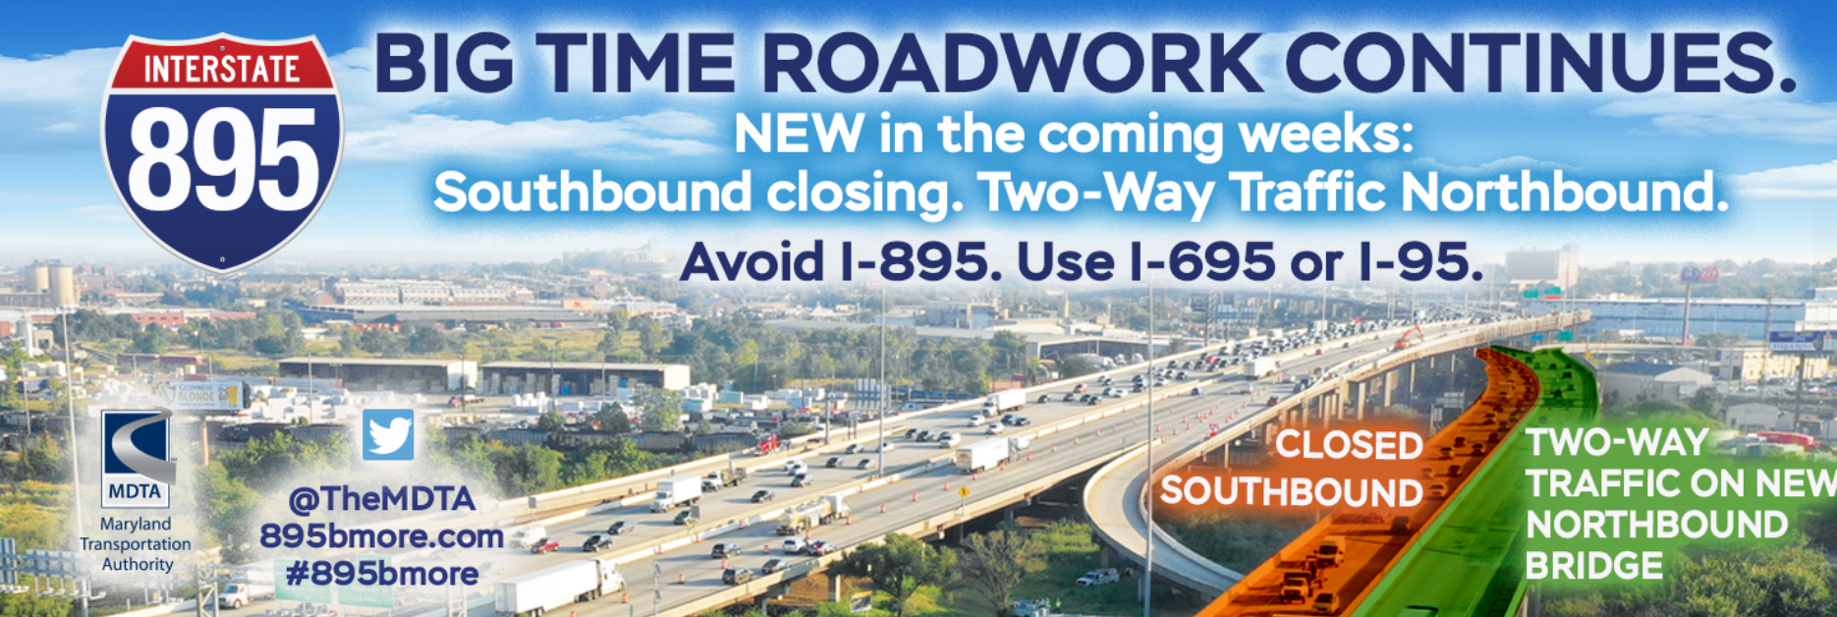
Press Release Update
Significant Backups Expected St. Patrick’s, Easter Weekends; Motorists Urged to Travel Off-Peak
BALTIMORE, MD – After a winter with crews expediting #BayBridgeWork with the help of lower traffic volumes and occasional mild temperatures, the Maryland Transportation Authority (MDTA) is preparing for an aggressive construction schedule in the coming weeks that will advance the project to rehabilitate the westbound right lane. Motorists should expect significant backups and delays as the work will coincide with increases in traffic volume that come with warmer weather.
Governor Larry Hogan’s aggressive timeline for the project, aimed at reopening all lanes of the Bay Bridge by summer, has gotten a boost over the winter. Relatively mild temperatures allowed crews to fill 13 bridge joints and all eight full-depth puncture holes with rapid set concrete. The success of those pours sets the stage to help streamline the upcoming pours of latex modified concrete (LMC) – decking material that needs temperatures of at least 45 degrees and a five-day curing process.
About 58% of the westbound span’s right lane has already received the latex modified concrete layer. After the remaining 42% of the right lane deck has been laid with latex material, the lane will be able to support traffic. As a reminder, this deck project is necessary because the westbound right lane surface has reached the end of its service life and is severely deteriorated.
Crews will continue to take advantage of good weather. Motorists should be aware that in coming weeks, mid-day westbound center lane closures may take place weekdays between the morning and afternoon rush hours. The center lane closures are necessary to give crews a safe work zone as they pour concrete onto the right lane. The center lane closures may occur Monday through Friday, any time between 10 a.m. and 2:45 p.m. daily, though the exact schedule will depend on weather, traffic volumes and work progress.
Project Timeline
November 27, 2018
Spring 2020
NB I-895 closes completely for one year
Two-way traffic (1 lane/direction) will operate on SB I-895
The I-895/Holabird Ave. exit ramp (Exit 10) will close during this time
NB I-895 and the Holabird Ave. exit ramp reopens to traffic
SB I-895 closes completely with two-way traffic operating on NB I-895
The SB bore of the Harbor Tunnel closes 24/7 for 60 days with two-way traffic operating in the NB bore
COMPLETED
Spring 2019
Spring 2021
The NB bore of the Harbor Tunnel closes 24/7 for 60 days with two-way traffic operating in the SB bore
We are here
SB I-895 reopens to traffic

Slide 8
Public Relations Handout

Slide 9
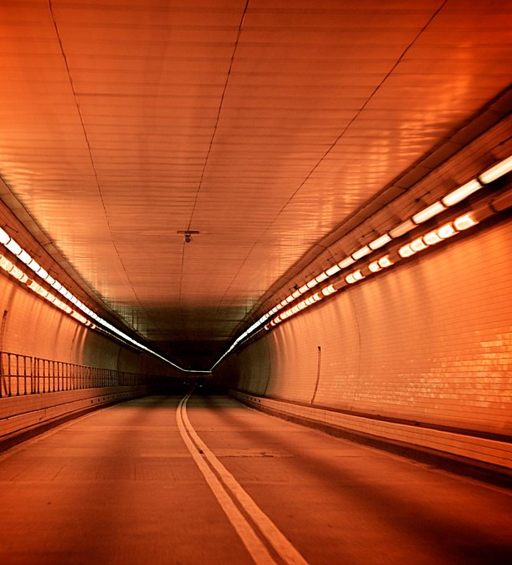
Maryland
Transportation
Authority
Management Offices
2310 Broening Highway
Baltimore, MD 21224
Local: (410) 537-1000 - Out of Area: 1 (866) 713-1596

