Slide 1
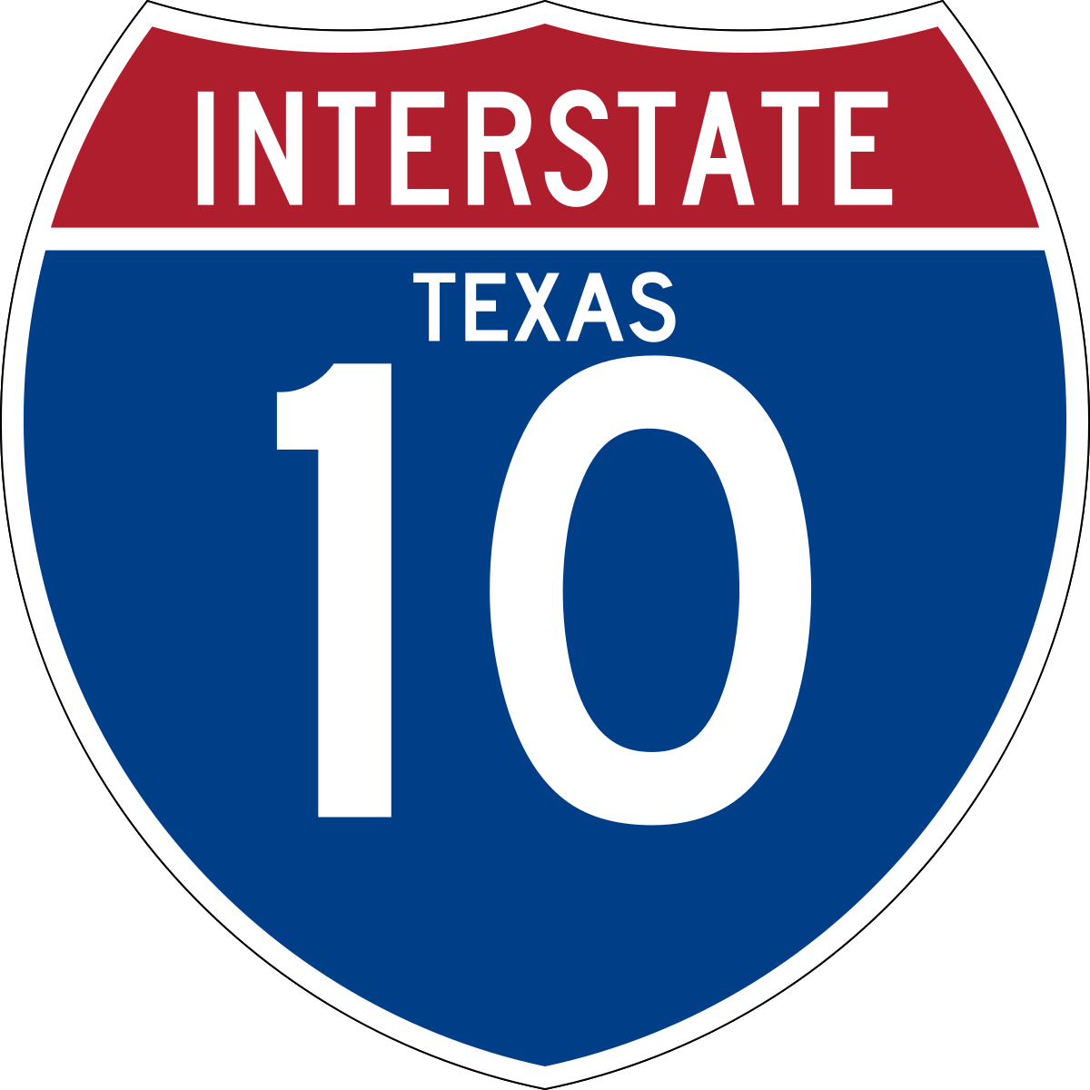
Labor Day Holiday Travel Forecast
I-10 (New Mexico to Louisiana) • August 31st to September 5th, 2023
THU 8/31
FRI 9/01
SAT 9/02
SUN 9/03
MON 9/04
TUE 9/05
Expect Some Delays
2 PM – 8 PM
in these areas:
El Paso
San Antonio
Houston
Beaumont
Boerne
(9 AM-4 PM)
Delays Possible
1 PM – 8 PM
in these areas:
El Paso
Converse
Seguin
San Felipe
Katy
Houston
Beaumont
Normal Travel Conditions
(for a typical Saturday, throughout
the day)
Normal Travel Conditions
(for a typical Sunday, throughout
the day)
Lighter than Normal
Travel Conditions
(possible delays in Schertz to Seguin and Columbus to San Felipe
12 PM – 7 PM)
Expect
Some Delays
2 PM – 6 PM
in these areas:
San Antonio
Houston
Beaumont
*: Based on previous years’ data and travel trends

Slide 2
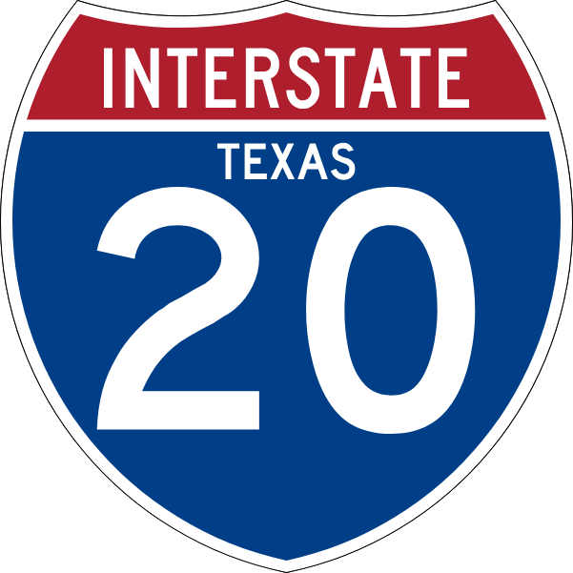
Labor Day Holiday Travel Forecast
I-20 (from the I-20/I-10 split to Louisiana) • August 31st to September 5th, 2023
THU 8/31
FRI 9/01
SAT 9/02
SUN 9/03
MON 9/04
TUE 9/05
Delays Possible
12 PM – 8 PM
in these areas:
Abilene
Cisco
Dallas/Fort Worth
Merkel
Weatherford
Expect
Some Delays
12 PM – 8 PM
in these areas:
Abilene Weatherford Dallas/Fort Worth
Normal Travel Conditions
(throughout the day, but delays possible in Weatherford (11 AM-1 PM)
Expect Some Delays
in these areas:
Abilene
Dallas/Fort Worth
Terrell
(1 PM – 7 PM)
Cisco to Eastland
(6 PM – 10 PM)
Lighter than Normal
Travel Conditions
(delays possible in the Abilene area
(12 PM - 9 PM)
Kilgore
(1 PM – 4 PM)
Expect
Some Delays
in these areas:
Abilene Dallas/Fort Worth (1 PM – 7 PM)
Stanton to Big Springs
(10 AM – 9 PM)
*: Based on previous years’ data and travel trends

Slide 3
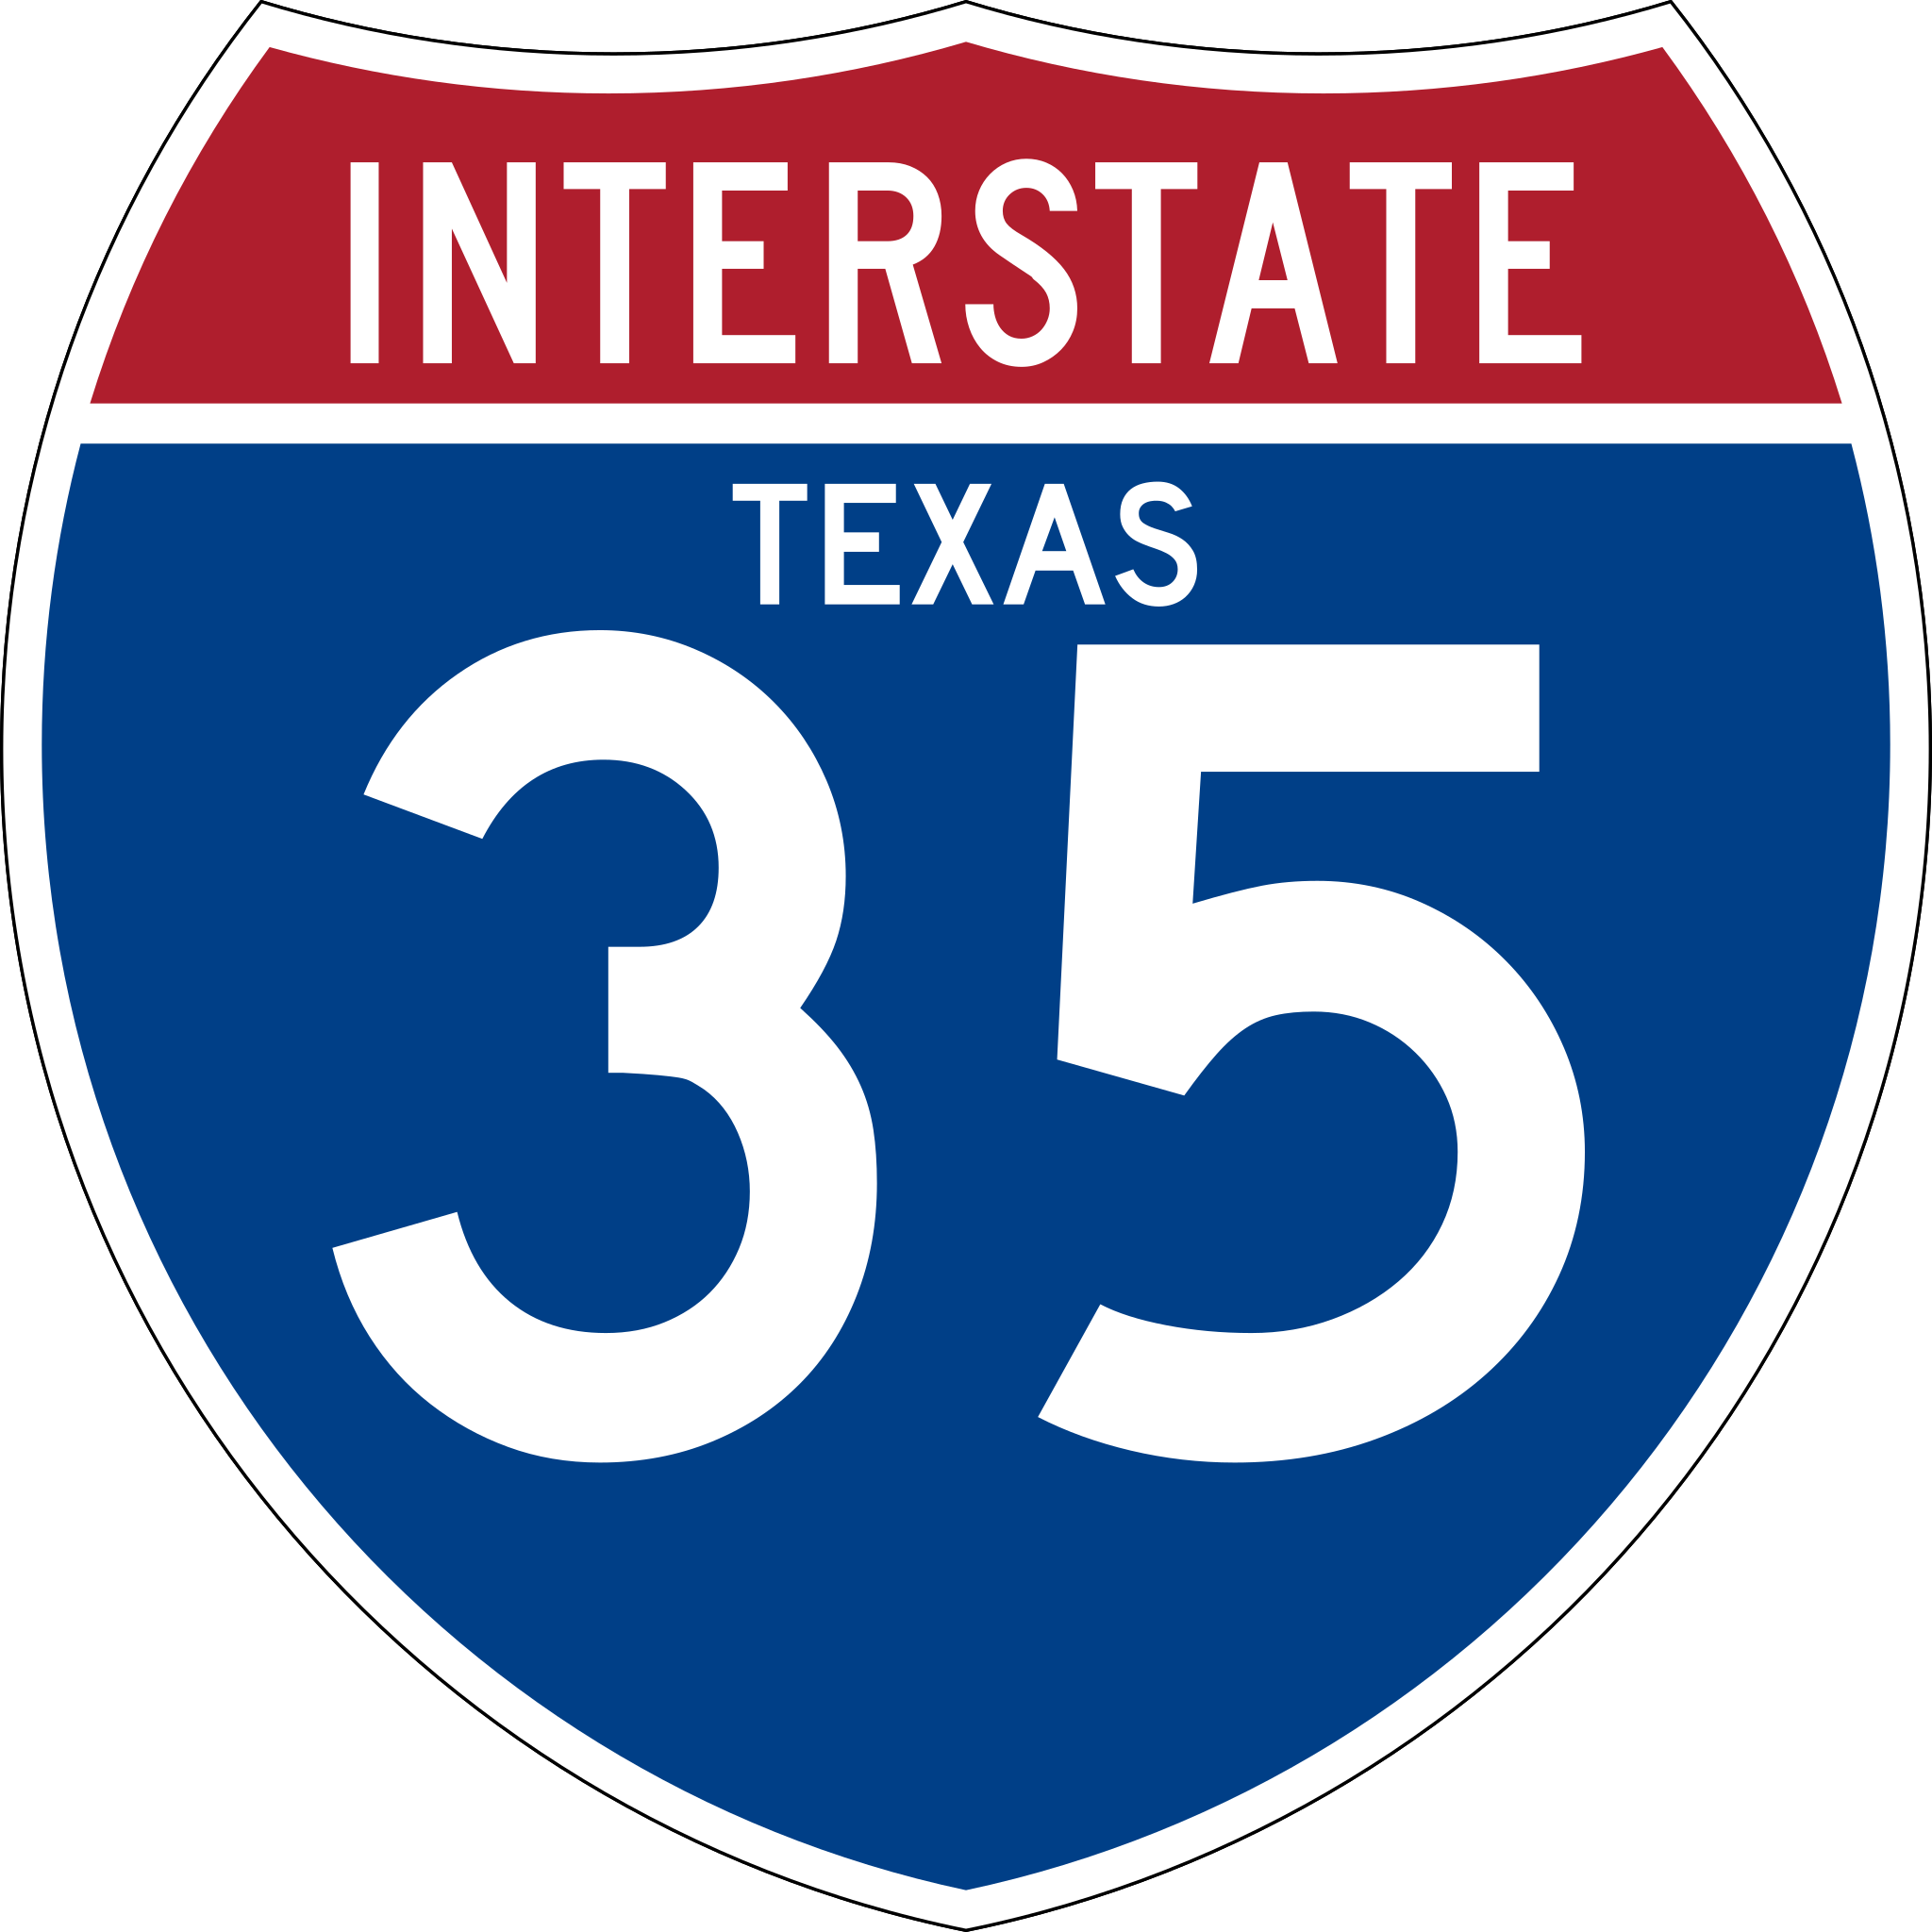
Labor Day Holiday Travel Forecast
I-35 (from Mexico to Oklahoma) • August 31st to September 5th, 2023
THU 8/31
FRI 9/01
SAT 9/02
SUN 9/03
MON 9/04
TUE 9/05
Expect Some Delays
12 PM – 7 PM
in these areas:
Dallas/Fort Worth
Denton
Sanger
Valley View
Gainesville
Delays Possible
1 PM – 9 PM
in these areas:
San Antonio
New Braunfels
San Marcos
Austin
Waco/Temple
Dallas/Fort Worth
Normal Travel Conditions
(for a typical Saturday, but expect some delays in Georgetown
Round Rock
(1 PM – 7 PM)
Waco
(10 AM – 3 PM)
Normal Travel Conditions
(for a typical Sunday, but expect some delays in Dallas/Fort Worth
(2 PM – 5 PM)
Gainesville
(1 PM – 3 PM)
Expect Some Delays
11 AM – 7 PM
in these areas:
San Antonio
New Braunfels
San Marcos
Round Rock/Austin
Waco/Temple
Denton
Normal Travel Conditions
(for a typical Tuesday, but expect some delays in San Marcos &
Dallas/Fort Worth
(3 PM – 7 PM)
*: Based on previous years’ data and travel trends

Slide 4
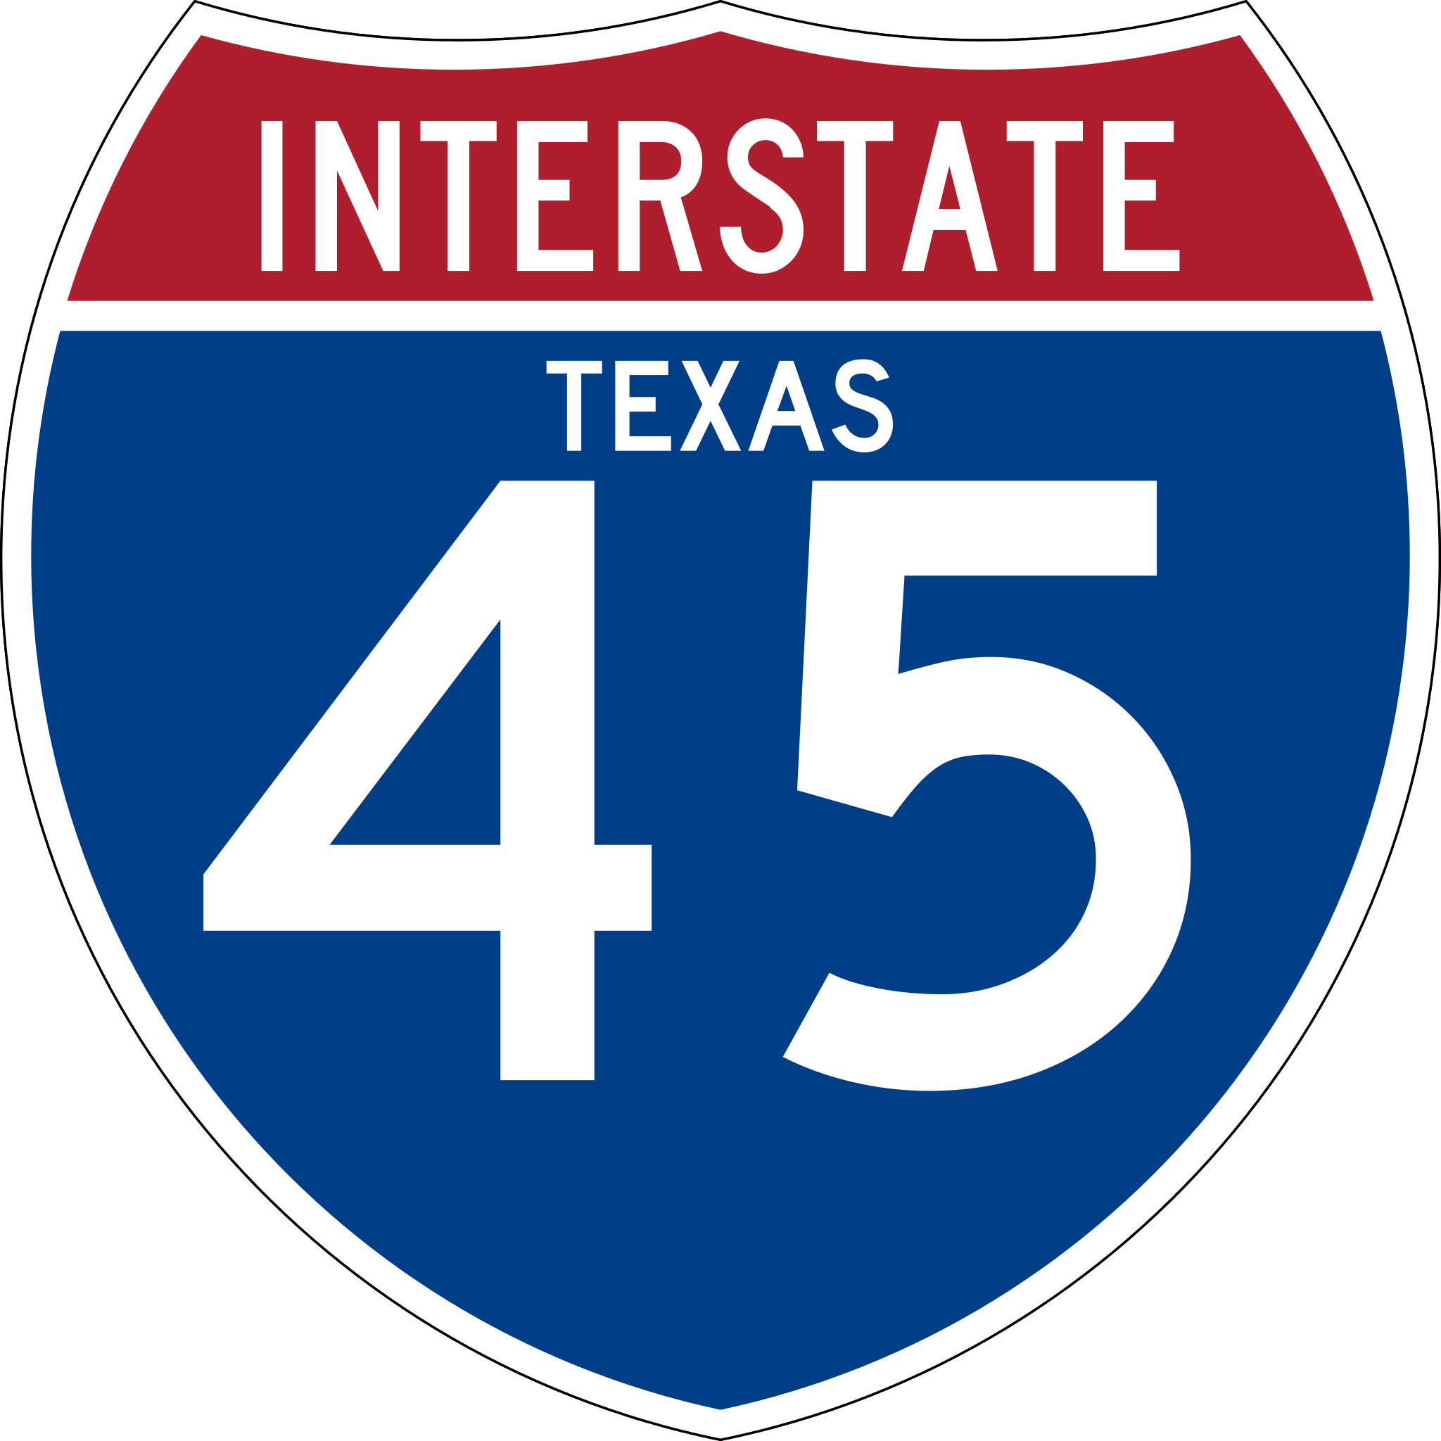
Labor Day Holiday Travel Forecast
I-45 (from Dallas to Galveston) • August 31st to September 5th, 2023
THU 8/31
FRI 9/01
SAT 9/02
SUN 9/03
MON 9/04
TUE 9/05
Some Delays Possible
1 PM – 7 PM
in these areas:
Houston
Conroe
Dallas
Some Delays Possible
1 PM – 9 PM
in these areas:
Houston to
New Waverly
Centerville
Streetman
Dallas
Normal Travel Conditions
(for a typical Sunday, but expect some delays in Houston
(12 PM – 7 PM)
Lighter than Normal Travel Conditions
(throughout
the day, but expect some delays in Pasadena
(9 AM – 11 AM)
Normal Travel Conditions
(throughout the day, but expect some delays in Texas City
(11 AM – 1 PM)
Huntsville to
Fairfield
(12 PM – 6 PM)
Normal Travel Conditions
(throughout the day, but expect some delays in
Houston
(6 AM – 1 PM)
Buffalo
(9 AM – 6 PM)
*: Based on previous years’ data and travel trends

