Slide 1
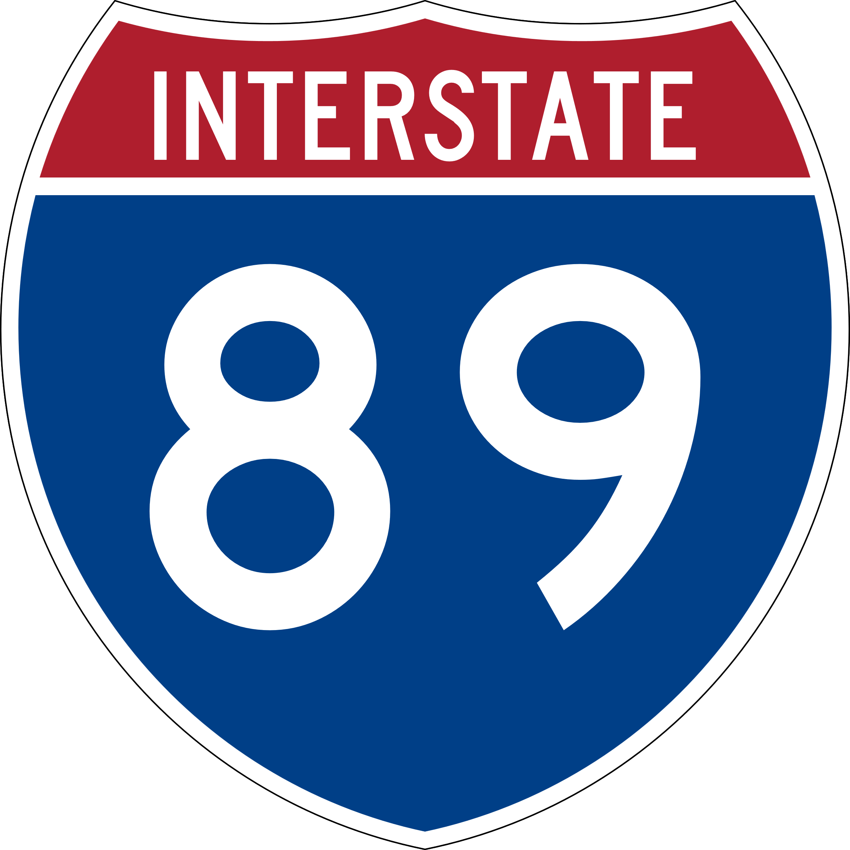
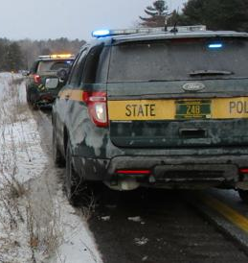
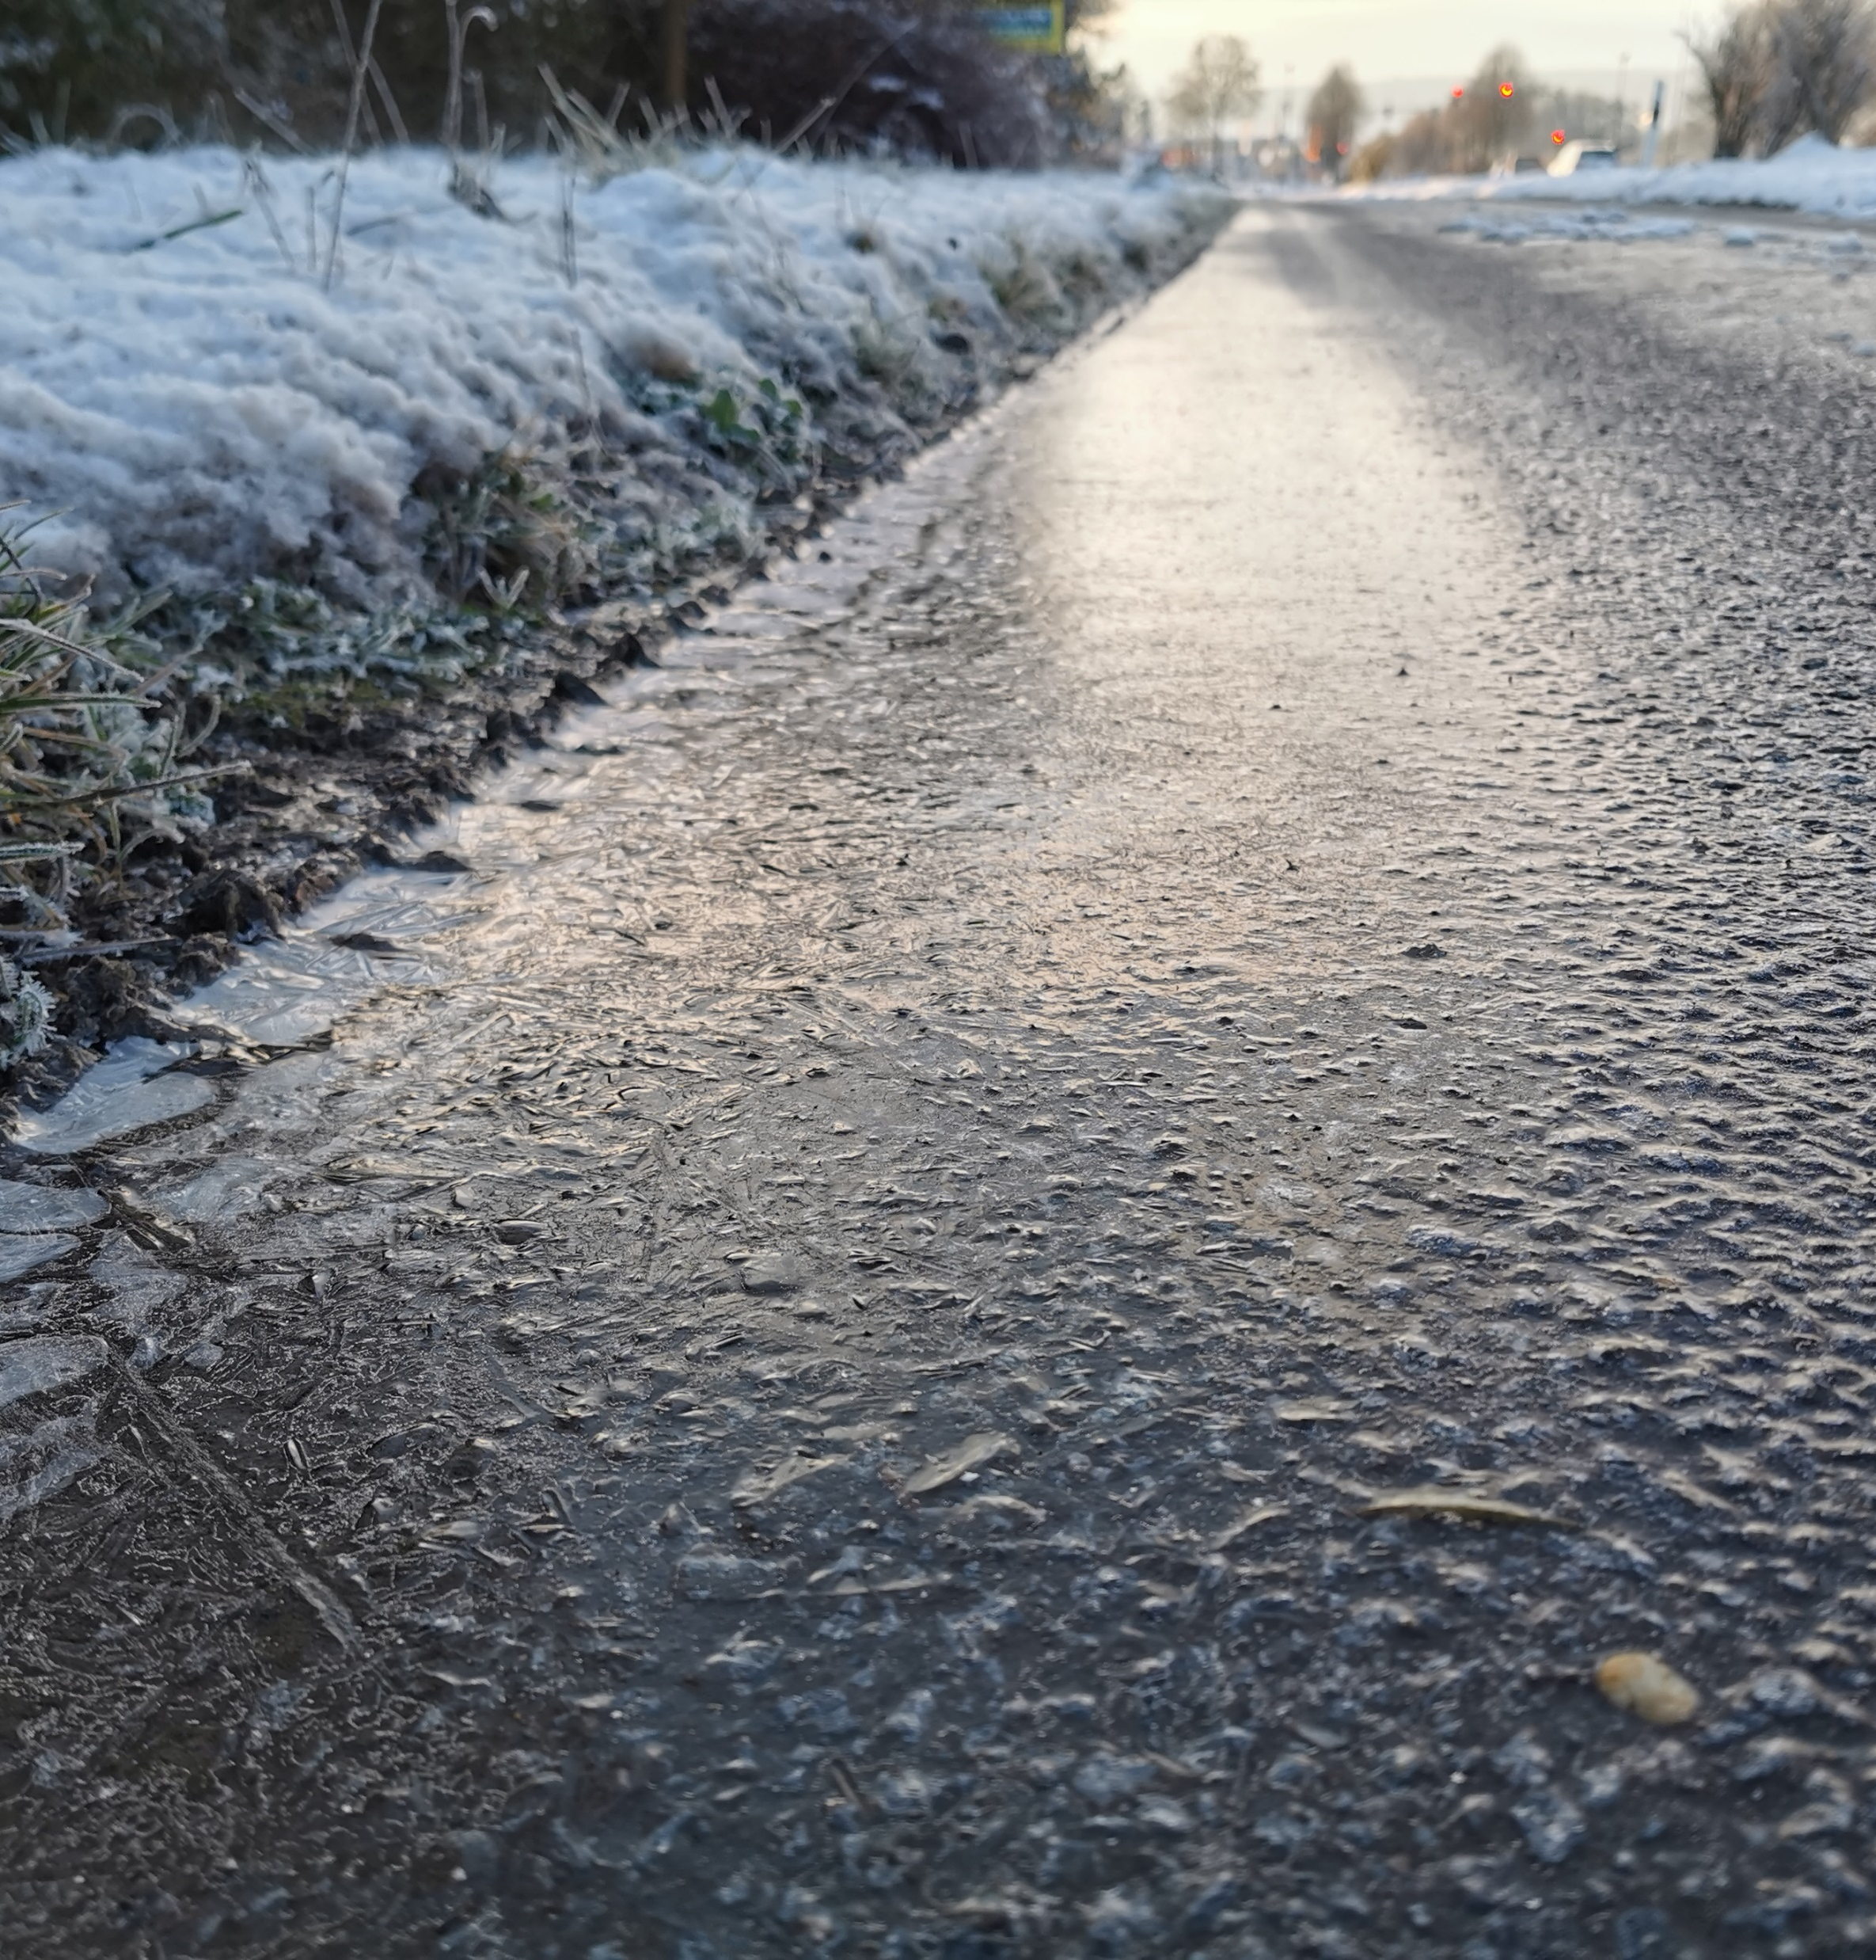
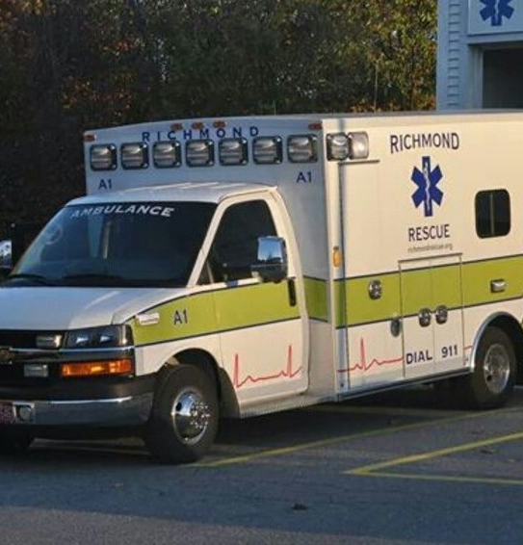
Event Summary 2 Car Motor Vehicle Crash
SB at MM 71 in Bolton, VT • Tuesday, October 31, 2023
Event Location
The incident occurred at about 6:30 AM, with traffic back to normal about 9:07 AM.
1 vehicle struck a guardrail and was subsequently struck by another vehicle.
The I-89 SB lanes were delayed for 2.5+ hours.
VSP, Bolton Fire, & Richmond Rescue actively participated in this incident.
Incident Timeline | Total Elapsed Time: 2 hours 38 minutes
Earliest record/ VSP enroute
(6:29 AM)
TMC issued notifications
to the public
(8:00 AM)
VSP reported roadway clearance
(8:30 AM)
Traffic returning to normal
(9:07 AM)
Excessive time lapse in notifying the public
SB
Begin
End
TMC notified about incident
(7:50 AM)
Report of stalled vehicle north of the crash site in the middle of travel lanes
(8:29 AM)
VSP reported incident clearance
(8:33 AM)
Incident closed/public notification made
(9:14 AM)
99.7min
(vs avg Tues of 12.8m)
1,095h
(vs avg Tues of 437)
$46K
(vs avg Tues of $13K)
VSP was the first on the scene to investigate this incident.
Travel time increase to 99.7m (or 780%) on the day of the accident vs Tues. in October 2023 @ 7:30 AM.
Black ice and slippery conditions reported the morning of the incident.
Veh-hr. of Delay increase to 1,095 (or 350%) on the day of the accident vs an average Tues. in October 2023.
Backups persisted for 2.5+ hours
Delay cost increase to $46K (or 350%) on the day of the accident vs an average Tues. in October 2023.
Injuries reported:
1 minor injury

Slide 2
Incident Impacts
2 Car Motor Vehicle Crash on I-89 SB
SB at MM 71 in Bolton, VT • Tuesday, October 31, 2023
Area Impacts (Click here to view Trend Map regional network animations)
I-89 SB Bolton Impacts (Click here to open Congestion Scan)
7:30 AM Oct 24, 2023 (Tues)
7:30 AM Oct 31, 2023 (Tues)
TUES 10/24/23
TUES 10/31/23
73-76 mph
2-9 mph
~ 2.5 hr Duration
SB
~ 5mi Backup
Speed (mph)
0
10
20
30
40
50
60
Major congestion became apparent at around 7:30 AM as traffic back-ups and slow-downs increased significantly. Further along in the animations, note significant congestion along I-89 SB lasting for a few hours. The incident was cleared, and traffic was back to free-flow conditions at approximately 9:07 AM.
Comparisons of the I-89 on the day of the incident vs the week prior to the incident shows substantial crash impact. Backups of 3-5 miles lasted over 2.5+ hours were experienced during the response & clean-up of the incident & subsequent reopening of the lane.
I-89 SB Bolton User Delay Cost (Click here to open full UDC results)
Takeaways
$41.2k
in delay costs
Messaging – Due to the delays in notification to the TMC, effective messaging was not put out in a timely fashion, likely leading to further congestion and delays.
Management – Improving incident clearance times and limiting unnecessary responders on scene would assist in limiting congestion.
Detours and Diversions – With earlier notification, motorists could seek alternate routes (US-2) and avoid adding to congestion.
This section of I-89 SB from Exit 11 to Exit 10 - showed significant impact from the incident, in terms of user delay cost and vehicle hours of delay.
1,365
veh-hr. of delay
Effective inter-agency information sharing and coordination due to Unified Command structure
“Knowing your local and regional partners before you get to the scene is critical”
Notes:
NOTE: HYPERLINKS HAVE BEEN DISABLED – SEE THE DESIGN RESOURCES DOCUMENT TO LEARN HOW TO CREATE YOUR OWN LINKS

